Slide 1

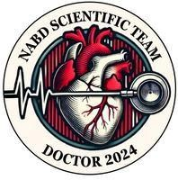


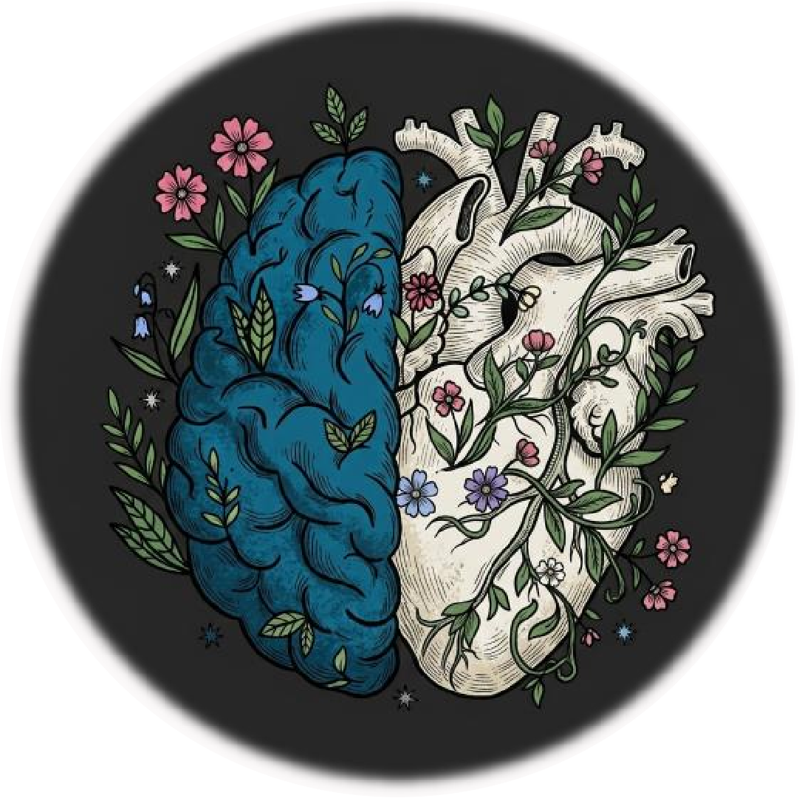
مـيحرلا نــٰمحرلا هللا مـسب
Psychology For Medical Students | MID
Midterm Exam 024
Written By :
NST

Slide 2
Q1
Why is psychology important?
A) It helps understand patient behavior, emotions, and fears to improve healthcare services
B) It replaces biomedical interventions with herbal remedies
C) It focuses exclusively on diagnosing genetic chromosomal disorders
D) It is used only to manage hospital administrative budgets
Ans: A

Slide 3
2. How can psychology improve communication between physicians and patients?
A) By teaching physicians to avoid direct conversation with patients
B) By training physicians on active listening and rephrasing questions to improve understanding
C) By instructing doctors to rely only on written forms
D) By restricting discussions strictly to laboratory numerical values
Q2
Ans: b

Slide 4
Q3
3. Why is it important to treat patients "as people, not just cases"?
A) To build trust and provide holistic care that considers the patient's emotional and psychological needs
B) To shorten clinical examination times to under two minutes
C) To eliminate the need for objective diagnostic laboratory tests
D) To satisfy legal paperwork without communicating directly
Ans: A

Slide 5
Q4
4. Why is the bio-psycho-social model important for medical students?
A) It proves that physical health is influenced strictly by biological genetics alone
B) It disregards psychological thoughts and emotions during patient care
C) It helps medical students understand the interplay of biological, psychological, and social factors in patient care
D) It focuses exclusively on environmental and social sanitation policies
Ans: c

Slide 6
Q5
5. Which psychological theory emphasizes the role of subconscious and early childhood experiences?
A) Cognitive Theory
B) Behavioral Theory
C) Humanistic Theory
D) Psychoanalytic Theory
Ans: d

Slide 7
Q6
6. What is the main focus of Behavioral Theory?
A) Parental nurturing styles and reinforcements
B) Unconscious internal drives and sexual complexes
C) Individual free will and self-actualization
D) Abstract information-processing architectures
Ans: a

Slide 8
Q7
7. Which psychologist is associated with the Humanistic Theory?
A) B.F. Skinner
B) Carl Rogers
C) Sigmund Freud
D) Lev Vygotsky
Ans: B

Slide 9
8. What is Cognitive Behavioral Therapy (CBT)?
A) A purely surgical procedure for brain lesions
B) A therapy combining cognitive and behavioral ideas
C) An approach focusing exclusively on unconscious dreams
D) A medicinal therapy that avoids talking or active behavioral change
Q8
Ans: B

Slide 10
Q9
9. Which parenting style is characterized by high love and acceptance but low behavioral discipline?
A) Permissive style
B) Dictatorship style
C) Democratic style
D) Neglectful style
Ans: A

Slide 11
10. What is the primary role of psychology in pain management?
A) Eliminating physical sensation using permanent nerve ablation
B) Relying solely on increasing opioid analgesic doses
C) Using cognitive distraction and guided imagery
D) Telling patients to suppress all emotional expression
Q10
Ans: c

Slide 12
Q11
11. How can psychology help medical students improve interpersonal skills?
A) By teaching them to work in total isolation from colleagues
B) By eliminating conversations during routine clinical rounds
C) By training them in empathy, active listening, and effective communication
D) By instructing them to use complex terminology with patients
Ans: c

Slide 13
12. What is one way psychology can help medical students manage stress and burnout?
A) By promoting resilience training and self-care programs
B) By encouraging continuous 120-hour work shifts without breaks
C) By suppressing feelings of fatigue and emotional distress
D) By advising against taking scheduled vacations
Q12
Ans: A

Slide 14
13. Why should medical students learn how to handle ethical dilemmas?
A) To avoid making clinical decisions entirely
B) To ensure institutional financial profit is prioritized
C) To respond appropriately to moral harm and ethical distress
D) To transfer all moral responsibilities to hospital legal teams
Q13
Ans: c

Slide 15
14. Broca's aphasia: most effective communication strategy?
A) Ask open-ended essay-style questions
B) Speak rapidly using advanced medical terminology
C) Ask yes/no questions and use pictures
D) Avoid all visual aids and rely only on phone calls
Q14
Ans: c

Slide 16
Q15
15. Repeatedly forgets wound hygiene routine despite education. Impairment in?
A) Procedural memory
B) Sensory memory
C) Flashbulb memory
D) Semantic memory
Ans: A

Slide 17
Q16
16. Loud crash distracts a physician during procedure. What attention was compromised?
A) Covert attention
B) Divided attention
C) Sustained attention
D) Top-down attention
Ans: c

Slide 18
Q17
17. Sterilizer flashes red and assistant notices an error. Example of?
A) Endogenous attention
B) Exogenous attention
C) Covert attention
D) Divided attention
Ans: b

Slide 19
Q18
18. Filters out operatory noise to focus on patient instructions?
A) Selective attention
B) Sensory neglect
C) Divided attention
D) Exogenous capture
Ans: A

Slide 20
Q19
19. Patient with primary progressive aphasia struggles to explain pain. Best approach?
A) Use simple words and visual cues
B) Present lengthy written brochures
C) Speak in complex sentences without pausing
D) Insist that the patient speak in full paragraphs
Ans: a

Slide 21
Q20
20. Cannot recognize familiar faces after stroke; vision intact. Brain region?
A) Prefrontal cortex
B) Fusiform gyrus
C) Primary auditory cortex
D) Cerebellum
Ans: b (deleted)

Slide 22
Q21
21. Best example of top-down processing?
A) A sudden unexpected loud alarm startling a doctor
B) A bright flashing indicator capturing a nurse's gaze
C) Actively searching for jugular venous distension during exam
D) An automated reflex withdrawal from a sharp surface
Ans: c

Slide 23
22. Which statement accurately describes divided attention?
A) Maintaining continuous focus on a single task for hours
B) Engaging in multiple tasks simultaneously with cognitive compromise
C) Automatically shifting eyes toward a sudden visual flash
D) Processing subconscious information during dream sleep
Q22
Ans: b

Slide 24
Q23
23. Damage to arcuate fasciculus leads to?
A) Conduction aphasia
B) Global amnesia
C) Complete visual blindness
D) Prosopagnosia
Ans: a

Slide 25
Q24
24. Clinical implication of Müller-Lyer illusion?
A) Total inability to perceive auditory speech
B) Loss of tactile sensation during surgical palpation
C) Misjudging lesion size in imaging
D) Inability to form new declarative memories
Ans: c

Slide 26
25. 10-year-old ADHD with poor working memory: likely behavior?
A) Forgets medication schedule
B) Speaks fluent words in reverse order
C) Demonstrates perfect long-term compliance without reminders
D) Exhibits immediate loss of all childhood memories
Q25
Ans: a

Slide 27
Q26
26. Which best describes semantic memory?
A) Personal recollection of what one ate for dinner yesterday
B) General knowledge such as anatomy
C) The physical motor skill of riding a bicycle
D) Sensory retention of a visual flash for 200 milliseconds
Ans: B

Slide 28
Q27
27. Brain area processes pitch and sound frequency?
A) Primary visual cortex
B) Primary auditory cortex
C) Somatosensory cortex
D) Motor cortex
Ans: B

Slide 29
Q28
28. Language pragmatics with diverse backgrounds?
A) Speak exclusively in medical jargon
B) Avoid checking for patient understanding
C) Adapt tone and context sensitivity
D) Treat all cultural groups identically without adjustments
Ans: C

Slide 30
Q29
29. Attention most compromised by fatigue in emergency settings?
A) Sustained attention
B) Exogenous reflex
C) Bottom-up detection
D) Overt eye orientation
Ans: A

Slide 31
30. Piaget sensorimotor milestone?
A) Abstract algebraic logic
B) Object permanence
C) Conservation of volume
D) Intimacy formation
Q30
Ans: B

Slide 32
Q31
31. 6-month-old cries when mother leaves but calms quickly when she returns. Indicates?
A) Avoidant attachment
B) Disorganized attachment
C) Secure attachment
D) Severe separation phobia
Ans: c

Slide 33
Q32
32. 50-year-old mentor interns and volunteers. Eriksonian virtue?
A) Autonomy
B) Identity
C) Generativity
D) Despair
Ans: C

Slide 34
Q33
33. Piagetian stage enabling conservation?
A) Sensorimotor
B) Preoperational
C) Concrete operational
D) Oral stage
Ans: C

Slide 35
Q34
34. Erikson: psychosocial challenge in early adulthood?
A) Trust vs. mistrust
B) Intimacy vs. isolation
C) Industry vs. inferiority
D) Integrity vs. despair
Ans: B

Slide 36
Q35
35. Child learns oral hygiene by observing and practicing with caregiver?
A) Social learning
B) Psychoanalytic fixation
C) Unconscious repression
D) Classical aversion conditioning
Ans: A

Slide 37
Q36
36. 3-year-old insists on dressing themselves and becomes upset if helped. Erikson?
A) Generativity vs. stagnation
B) Autonomy vs. shame and doubt
C) Identity vs. role confusion
D) Integrity vs. despair
Ans: B

Slide 38
37. Mother avoids physical affection but uses storytelling/proverbs. Reflects?
A) Pathological emotional detachment
B) Complete neglect of maternal duties
C) Culturally specific parenting
D) Sensorimotor developmental delay
Ans: C

Slide 39
38. What does ZPD describe?
A) The range between independent ability and potential with help
B) The biological timeline of embryonic organ formation
C) The time required for short-term memory to decay
D) The stage where adolescents experience hormonal surges
Ans: A

Slide 40
39. 13-year-old questions family values and experiments with new roles. Erikson?
A) Trust vs. mistrust
B) Autonomy vs. shame
C) Identity vs. role confusion
D) Generativity vs. stagnation
Ans: C

Slide 41
40. Biological influence on adolescent development?
A) Cultural storytelling practices
B) Hormonal changes during puberty
C) Peer pressure and social media use
D) Primary school classroom structure
Ans: B

Slide 42
:يملعلا قيرفلا نم ةلاسر

Slide 43
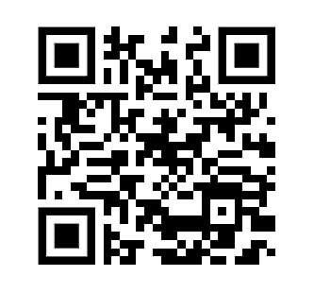
For any feedback, scan the code or click on it.
Corrections from previous versions:
Versions | Slide # and Place of Error | Before Correction | After Correction
V0 → V1
V1 → V2

