Slide 1
The practical of the 4th week
Liver
Gallbladder
Pancreas
Spleen

Slide 2

Liver
The students should know and identify the :
  Site
  Surfaces
  Relation and impression of liver surfaces
  Ligaments
  Porta hepatis
  Blood supply

Slide 3
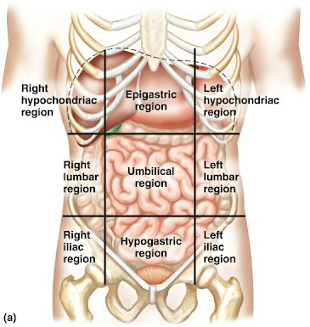
Site of the liver

Slide 4
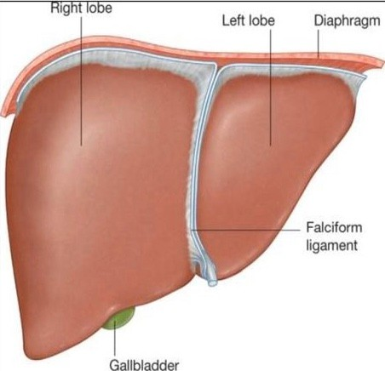
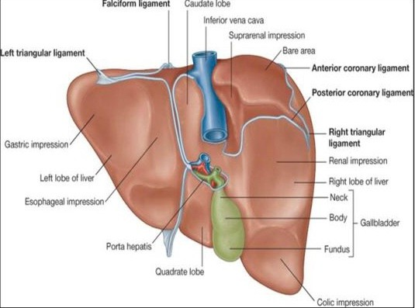
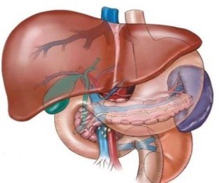
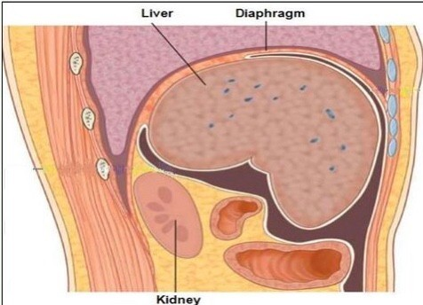
Surfaces of the liver
  Diaphragmatic surface:
( superior, anterior and right lateral surface)
Visceral surface:
( posteroinferior surface)

Slide 5
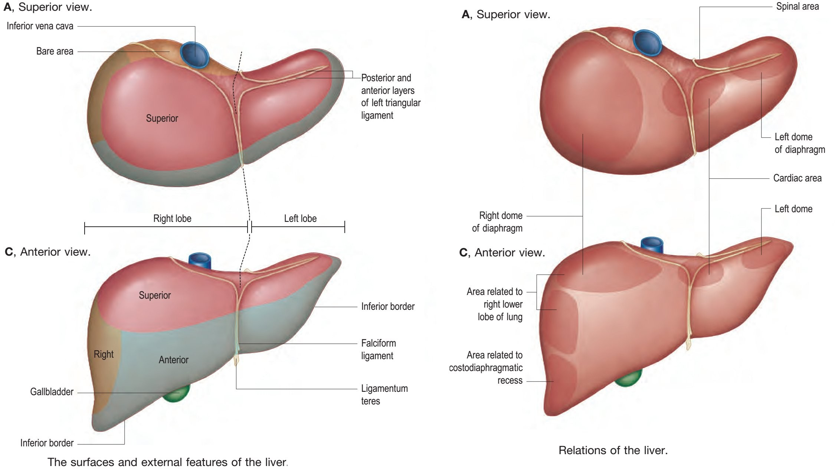
Relation and impression of liver surfaces
  superior and anterior surface:

Slide 6
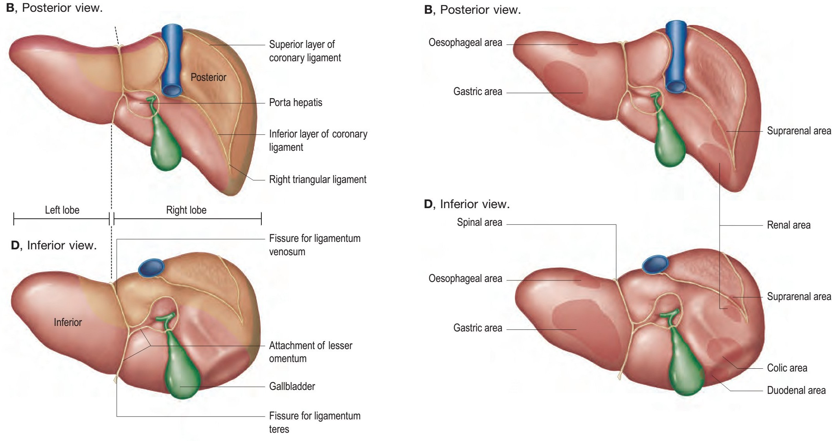
Relation and impression of liver surfaces
  Posterior and inferior surface:

Slide 7
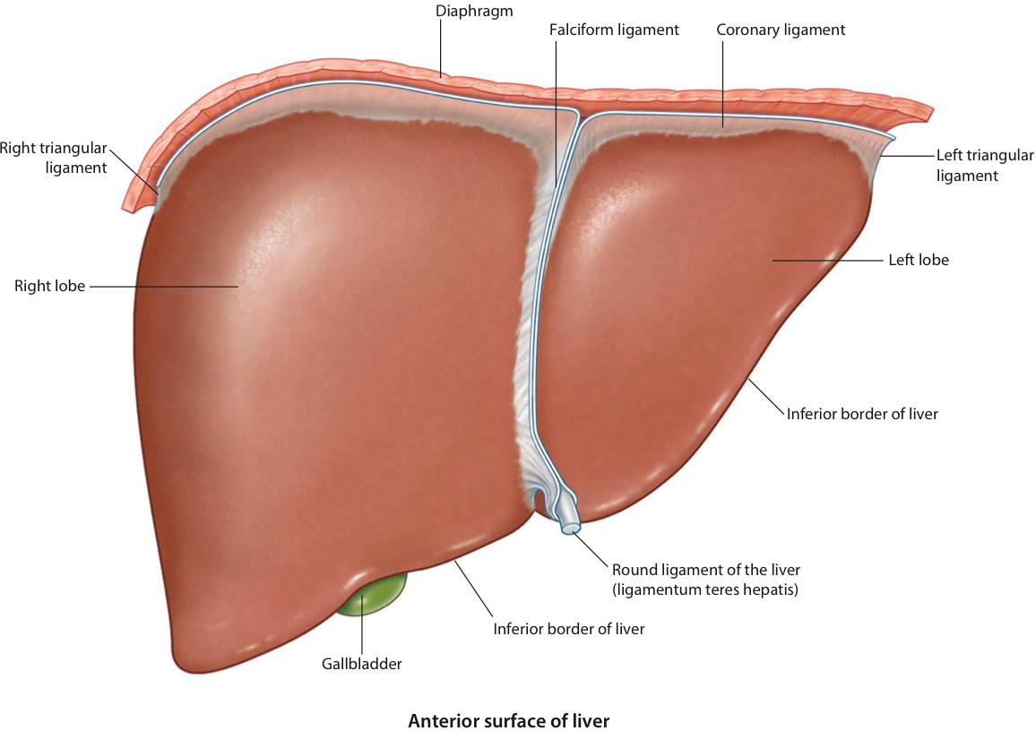
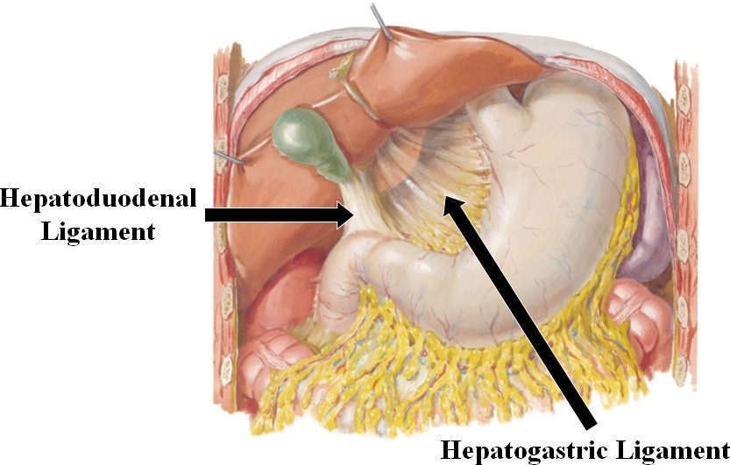
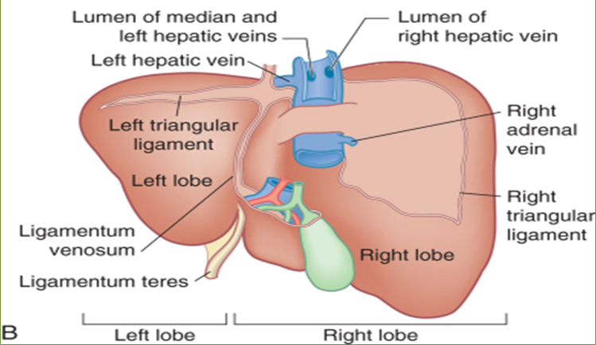
Ligaments of the liver
The students should observe the following :
  The falciform ligament of liver
  The ligamentum teres hepatis
  The coronary ligament
  The right triangular ligament
  The left triangular ligament
  The hepatogastric ligament
  The hepatoduonedenal ligament
  The Ligamentum Venoosum

Slide 8
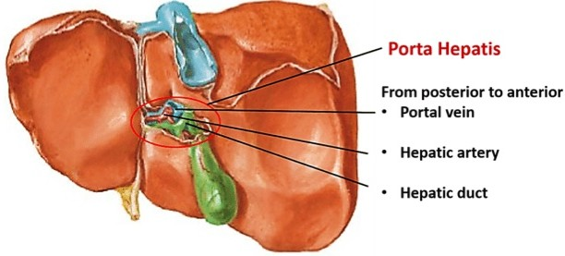
Porta hepatis of the liver

Slide 9
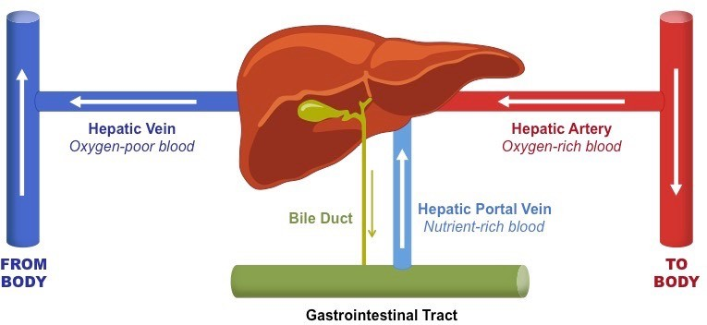
Blood supply of the liver

Slide 10
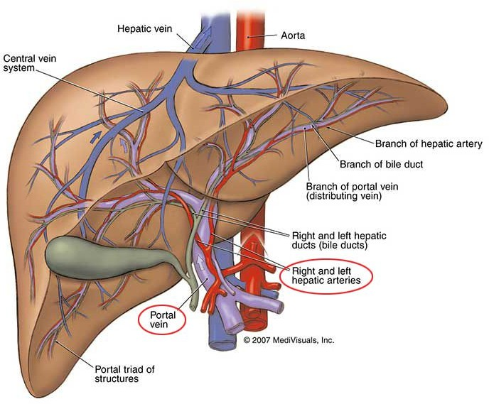
Blood supply of the liver
Arterial supply

Slide 11
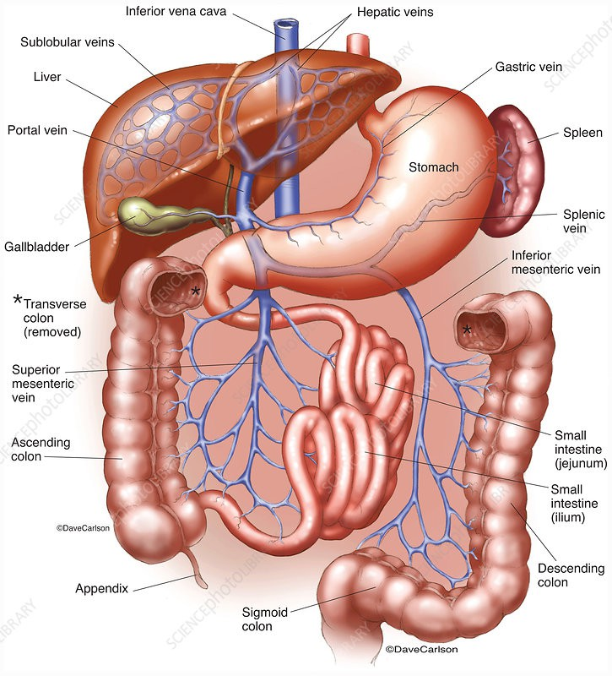
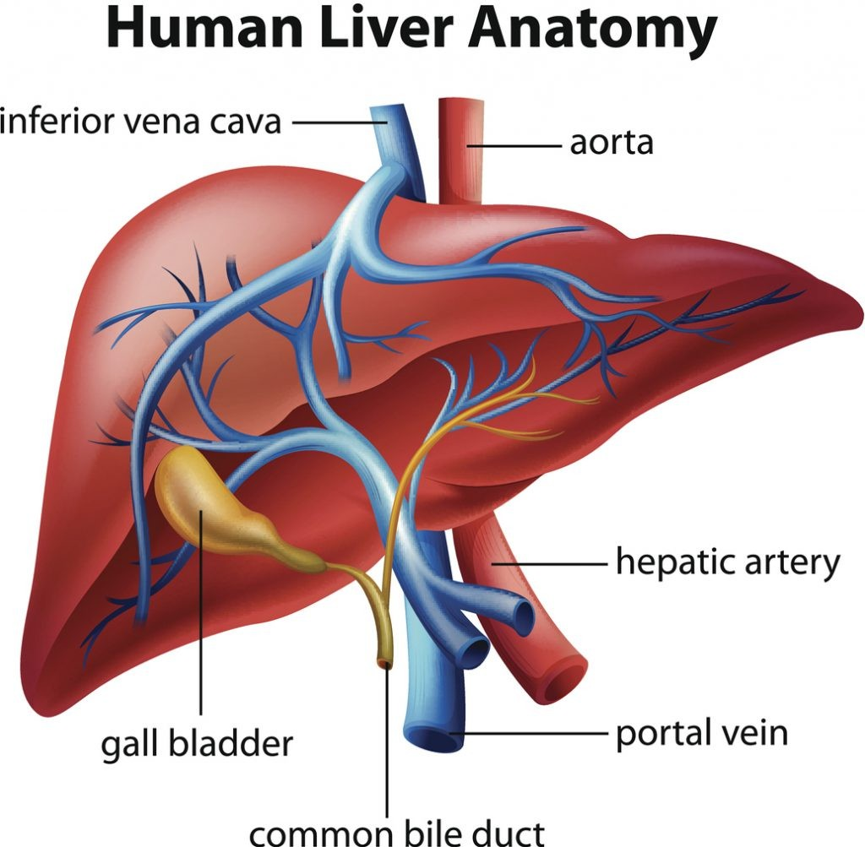
Blood supply of the liver
Venous and portal drainage

Slide 12

Gallbladder
The students should know and identify the :
  Site
  Structure Of Gallbladder
  Blood supply
  Common bile duct

Slide 13
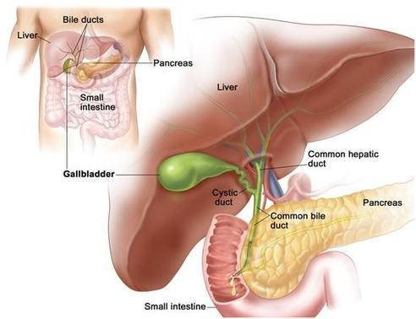
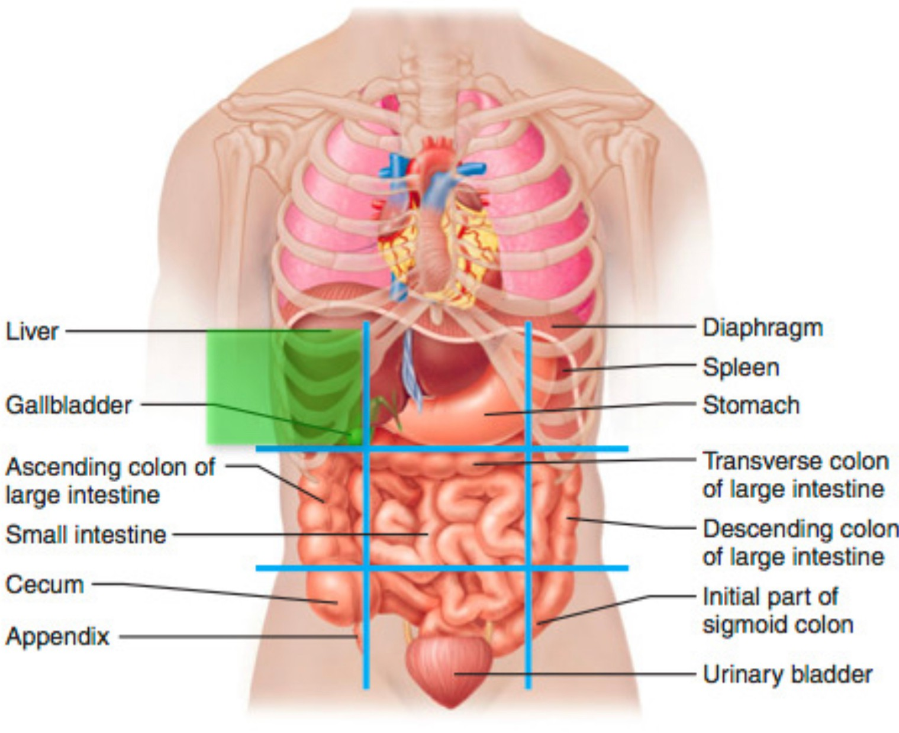
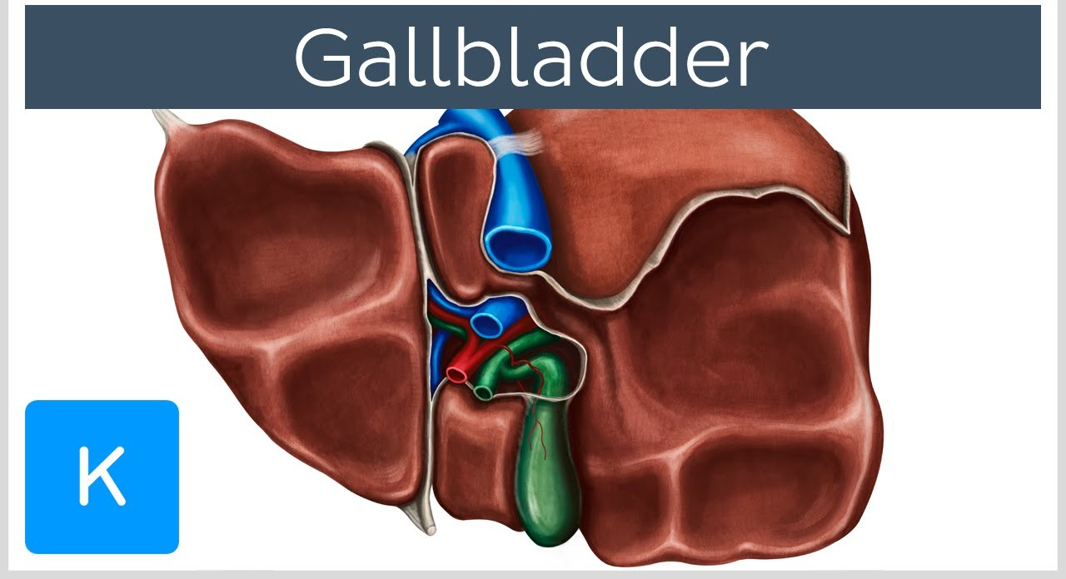
Site of the Gallbladder
Between quadrate and right lobes

Slide 14
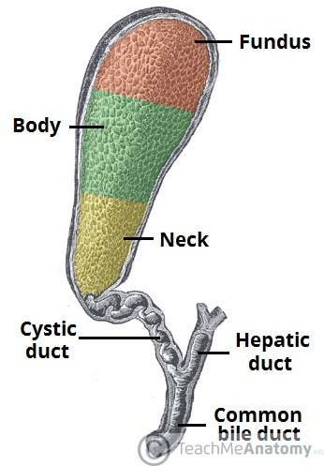
Structure Of Gallbladder

Slide 15

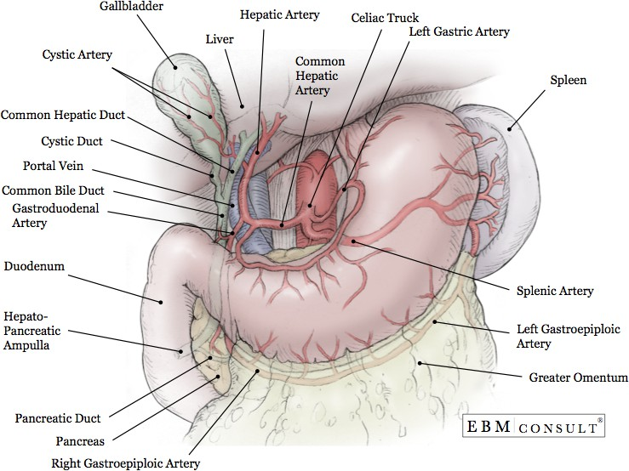
Blood supply of the Gallbladder
Arterial supply

Slide 16
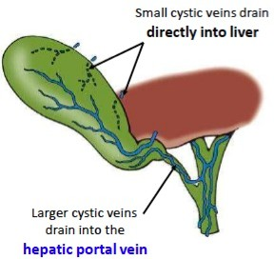
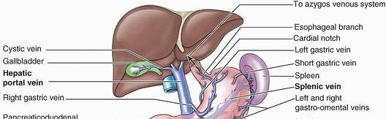
Blood supply of the Gallbladder
Venous drainage

Slide 17
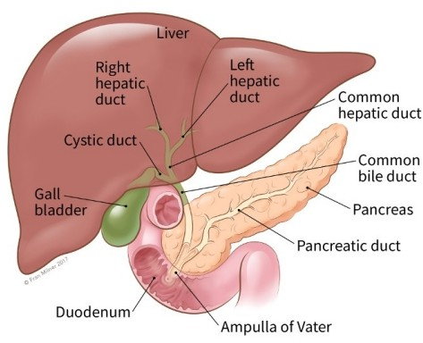
Common bile duct
Relation of common bile duct
End in the half second part of duodenum at ampulla of Vater

Slide 18
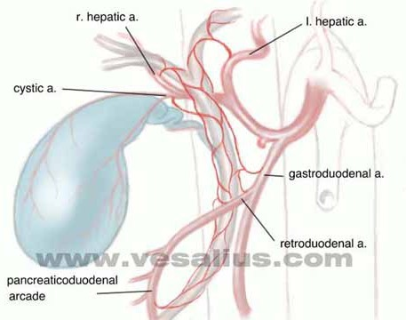
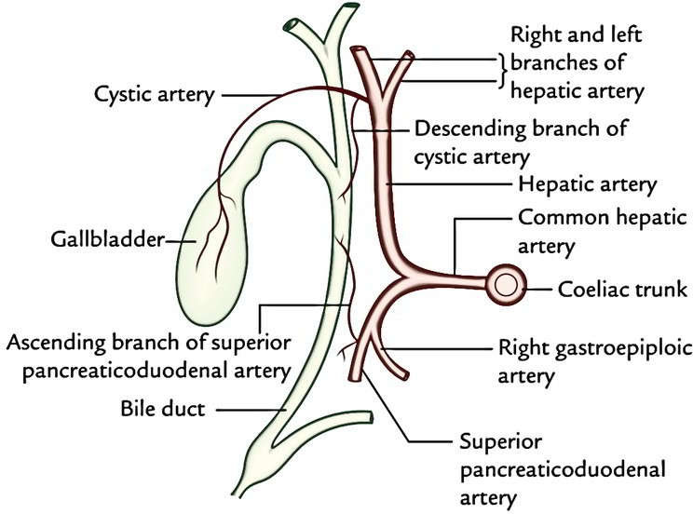
Common bile duct
Arterial supply

Slide 19
Pancreas
The students should know and identify the :
  Site
  Relations
  parts of the Pancreas
  Pancreatic ducts
  Blood supply

Slide 20
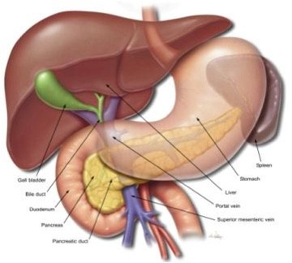
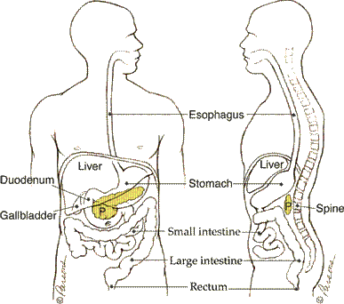
Site of the Pancreas

Slide 21
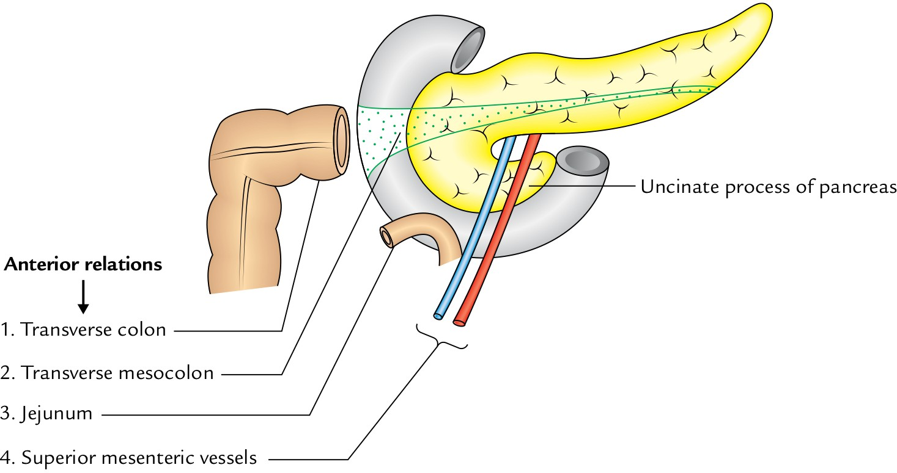
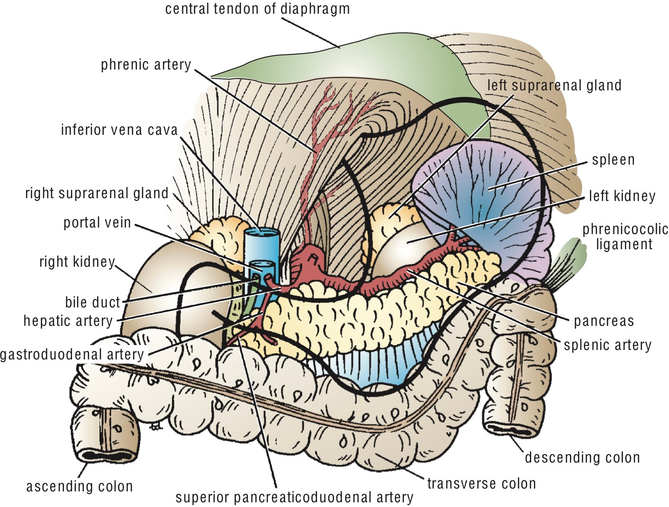
Relations of the Pancreas
  Anterior relation:
Transverse colon
Transvers mesocolon
Lesser sac
Stomach

Slide 22
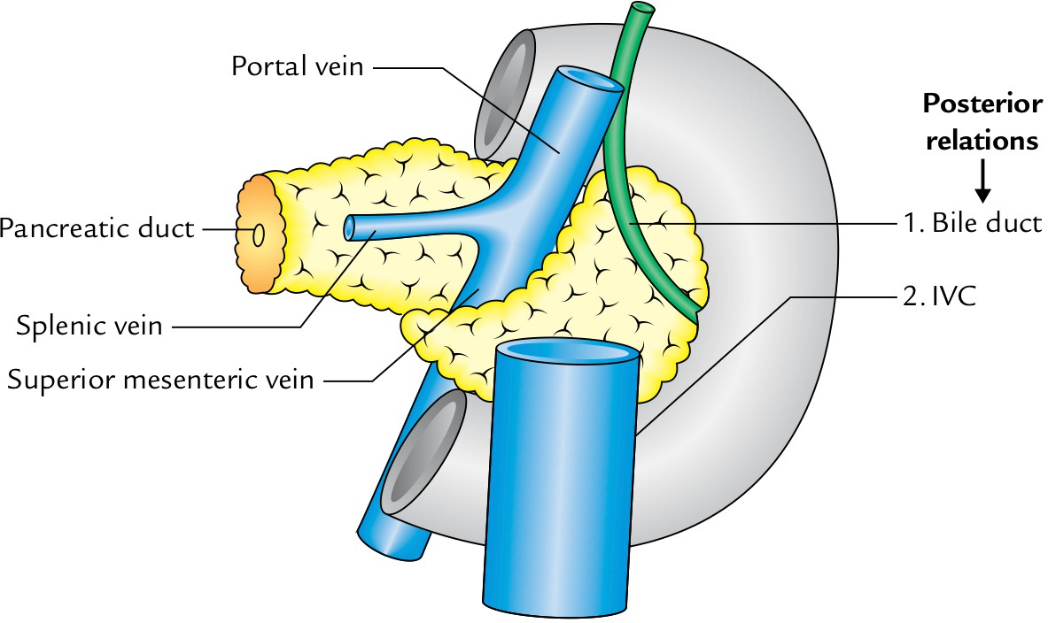
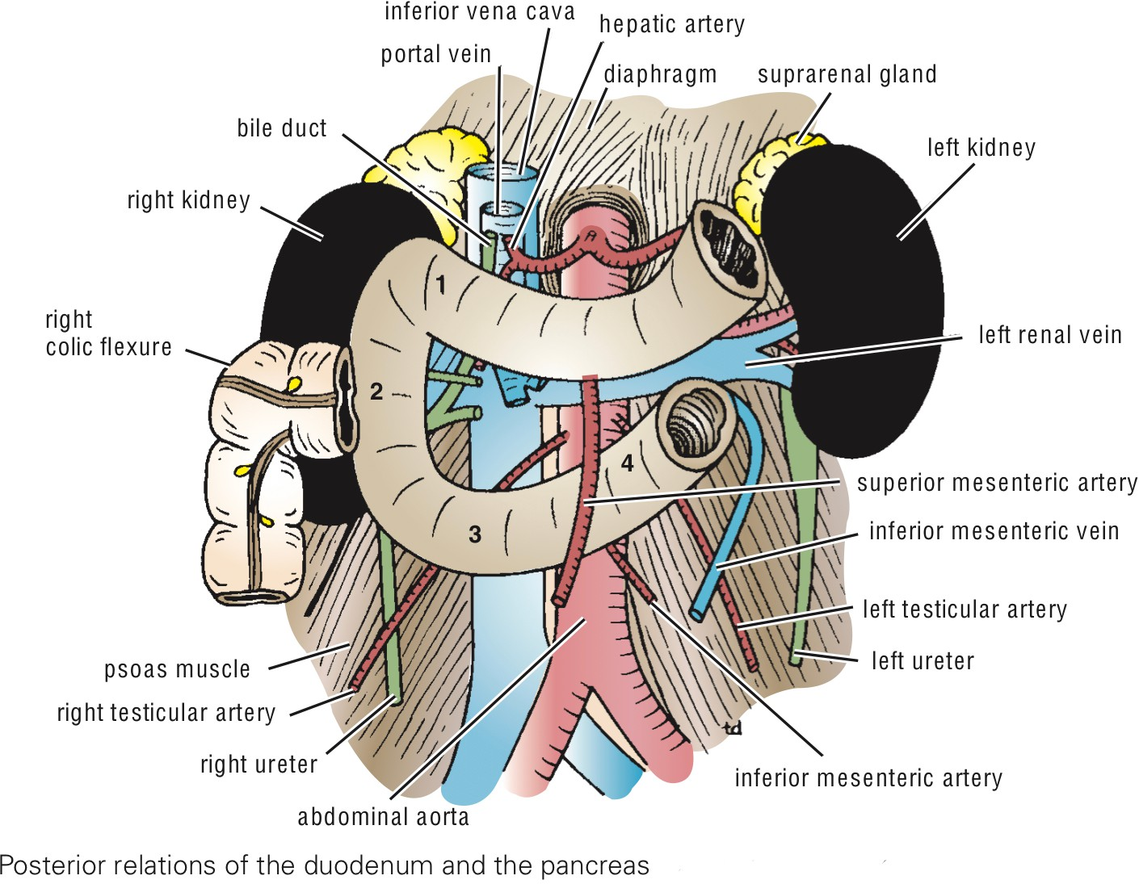
Relations of the Pancreas
Posterior relation
Bile duct
Portal vein
Splenic vein
IVC
Aorta
origin of Sup.mesentric.a
Lt.Psoas muscle
Lt.Suuprarenal gland
Left kidney
Hilum of the spleen

Slide 23
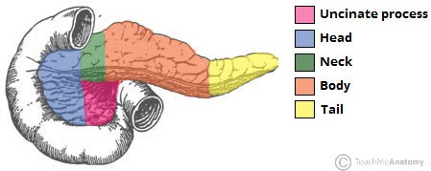
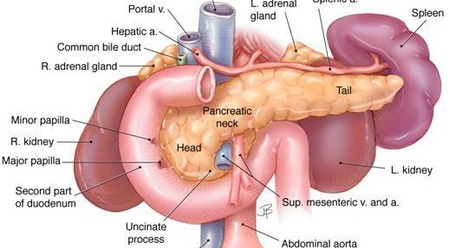
Parts of the Pancreas

Slide 24
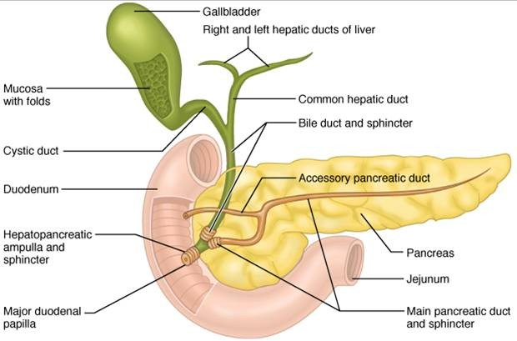
Pancreatic ducts

Slide 25
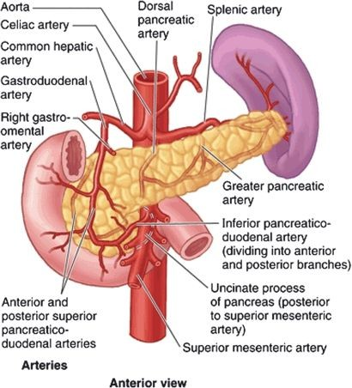
Blood supply of the Pancreas
Arterial supply

Slide 26
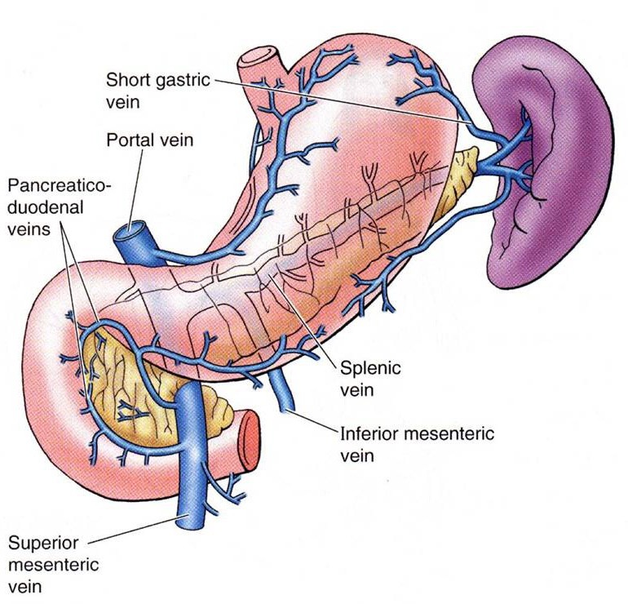
Blood supply of the Pancreas
Venous drainage

Slide 27
Spleen
The students should know and identify the :
  Site
  Peritoneal Relations
  Surfaces of the Spleen
  Borders of spleen
  Blood supply

Slide 28
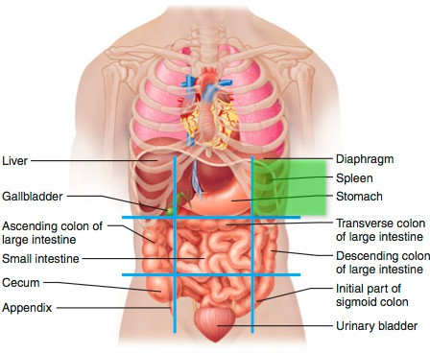
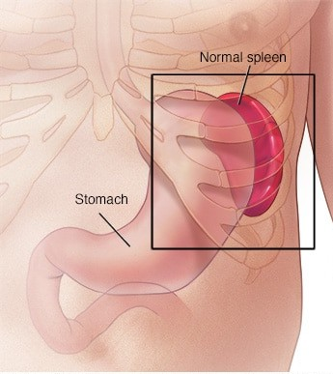
Site of the Spleen

Slide 29
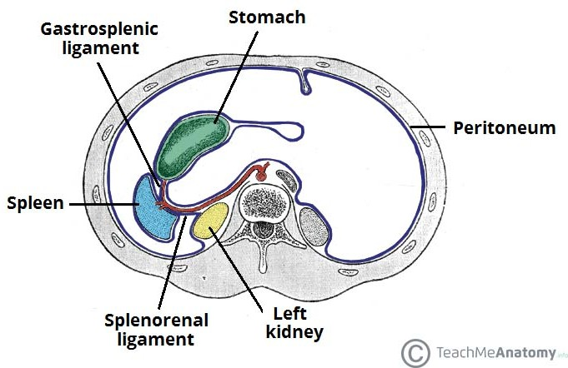
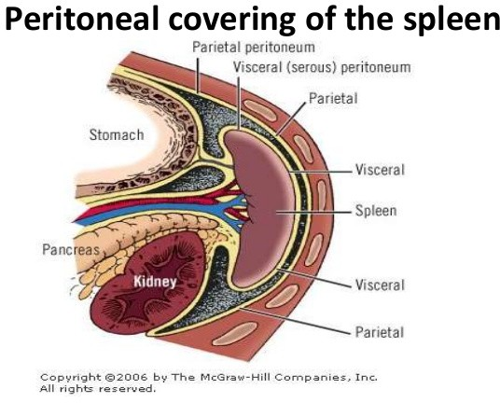
Peritoneal Relations of the Spleen
intraperitoneal

Slide 30
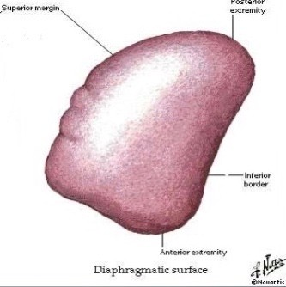
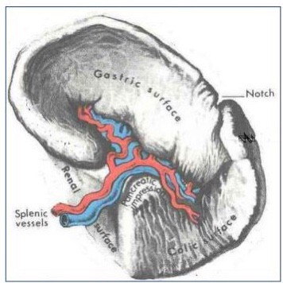
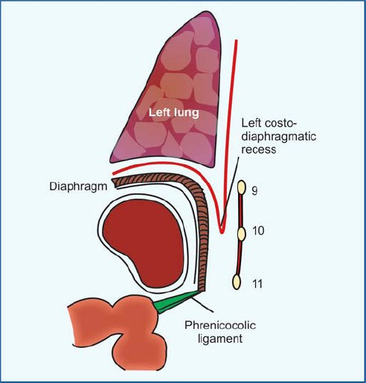
Surfaces of the Spleen
Diaphragmatic surface:
Visceral surface:
- has (Colic surface/Pancreatic surface)
has convex, smooth surface
Diaphragm separates it from (Pleura & lung - Ribs 9,10 ,11 )

Slide 31
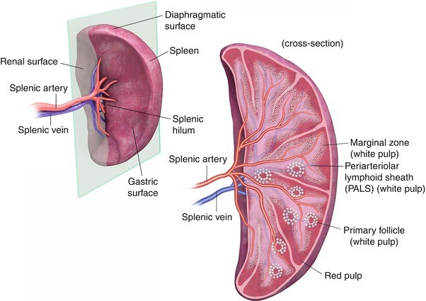
Hilum of spleen

Slide 32
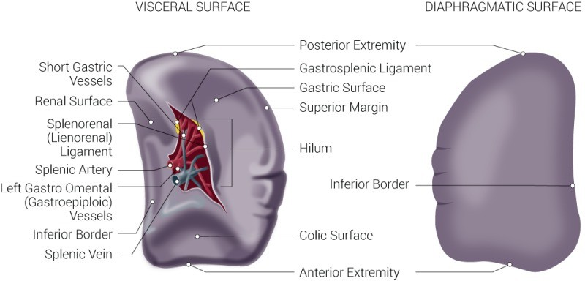
Borders of the spleen

Slide 33
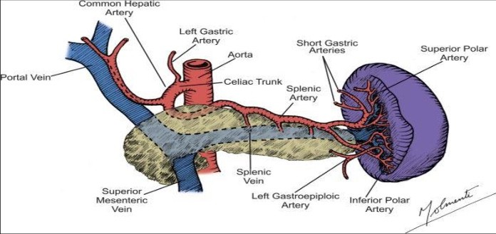
Blood supply of the spleen
Arterial supply

Slide 34
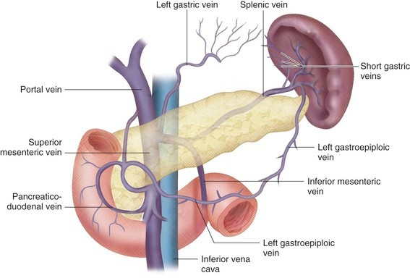
Blood supply of the spleen
Venous drainage

