Slide 1
The practical of the 5th week
Sigmoid Colon
Rectum
Anal canal
Posterior abdominal wall

Slide 2

Sigmoid Colon
The students should know and identify the :
  Site and Position
  Peritoneal Relations
  Features
  Relations
  Blood supply

Slide 3
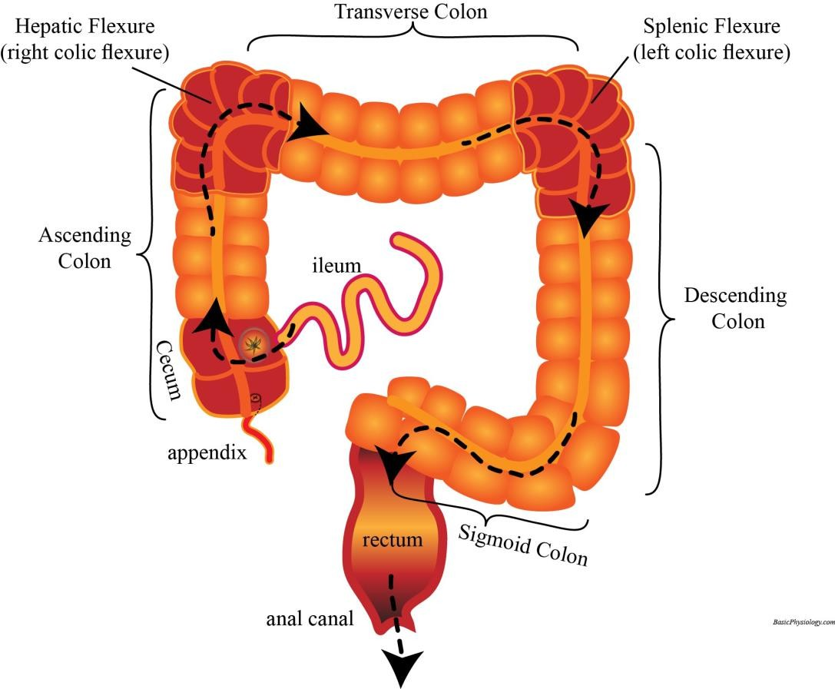
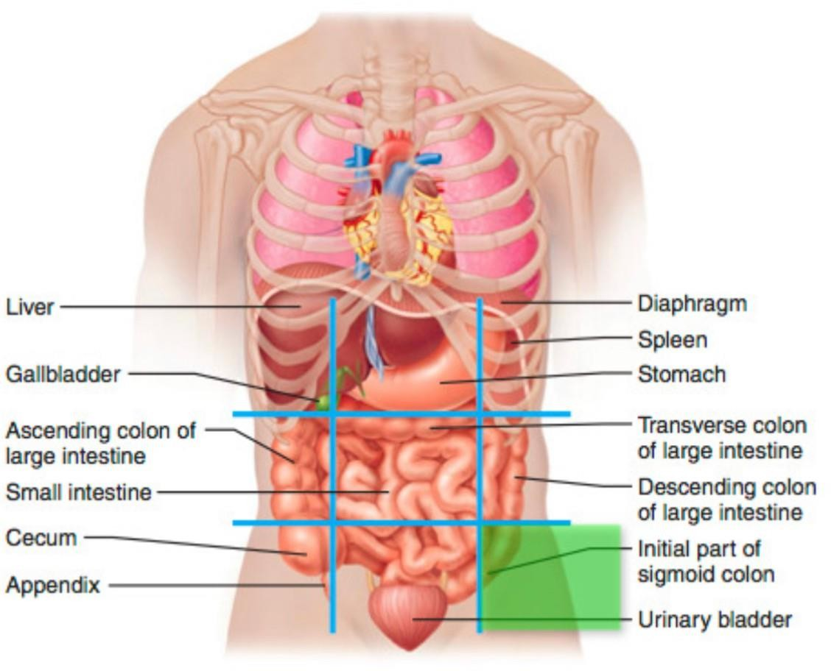
Site and Position of the Sigmoid Colon

Slide 4
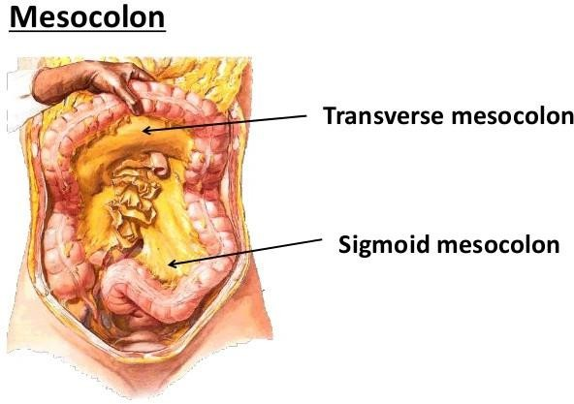
Peritoneal Relations (sigmoid mesocolon)

Slide 5
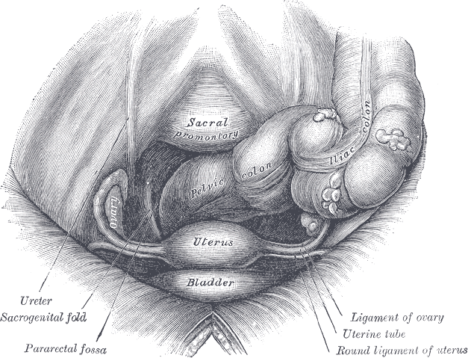
Taenia coli

Slide 6
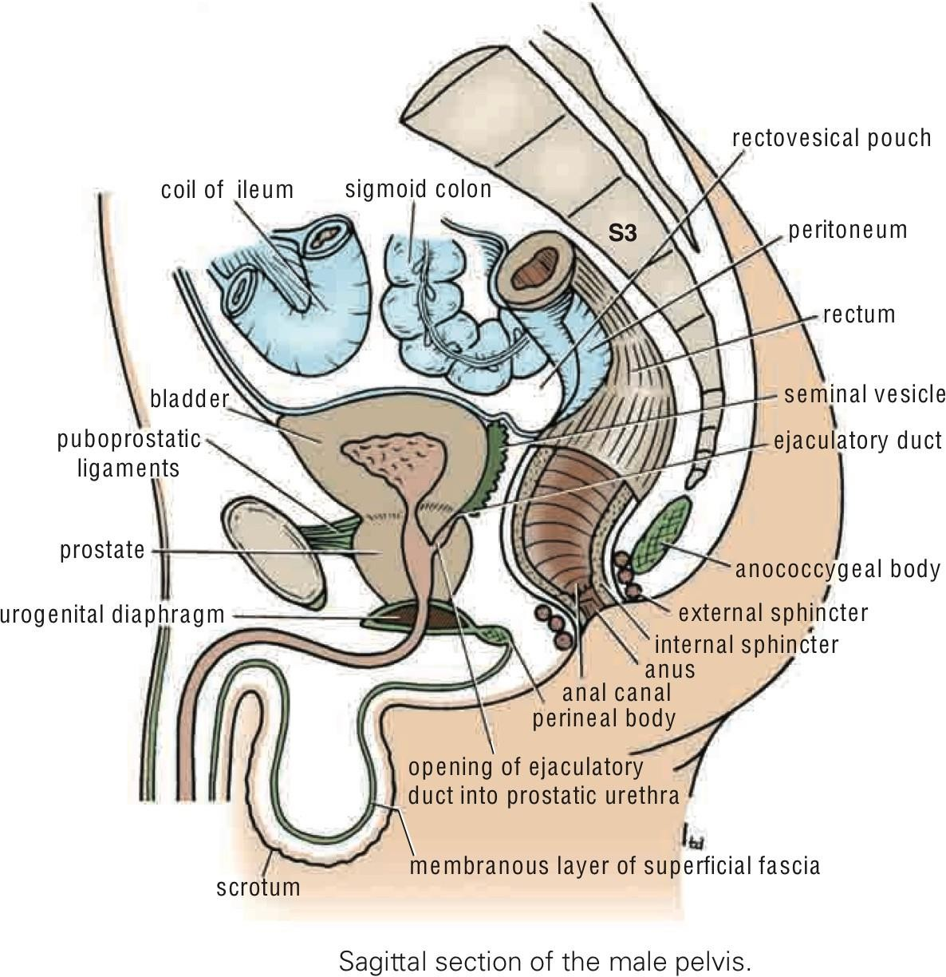
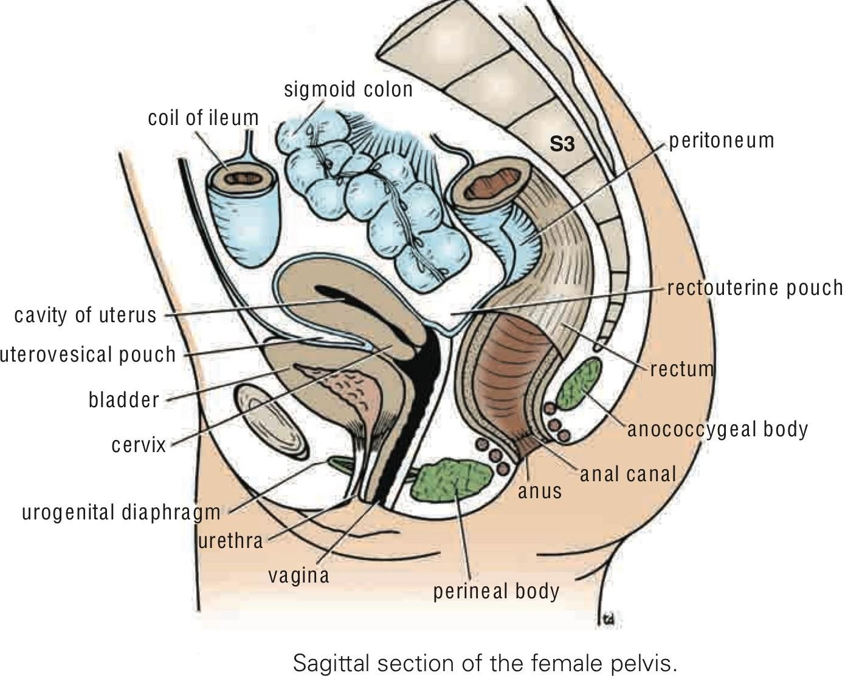
Relations of Sigmoid colon
  Anterior relations :
1. In the male, the urinary bladder;
Posteriorly:
1. The rectum
2. In the female, the posterior surface of the uterus and the upper part of the vagina
the sacrum.
lower coils of the terminal part of the ileum.

Slide 7
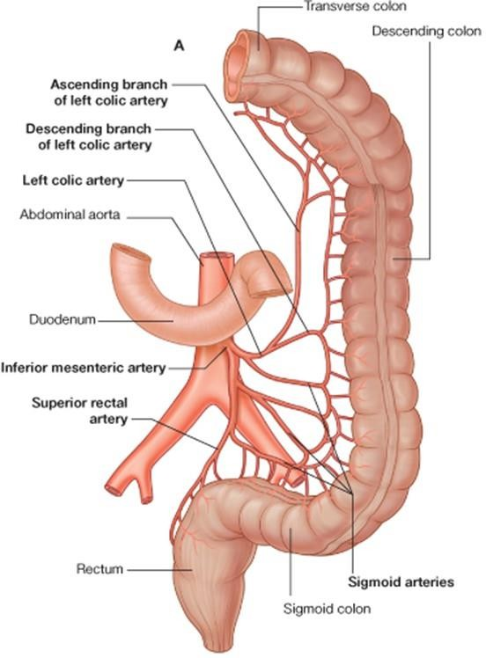
Blood supply of the Sigmoid colon
Arterial supply

Slide 8
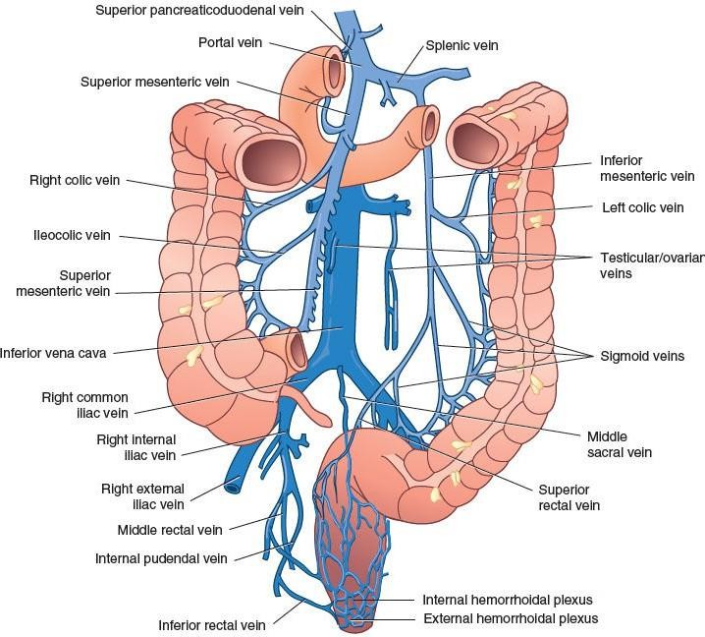
Blood supply of the Sigmoid colon
Venous drainage

Slide 9

Rectum
The students should know and identify the :
  Site and Position
  Peritoneal Relations
  Relations
  Blood supply

Slide 10
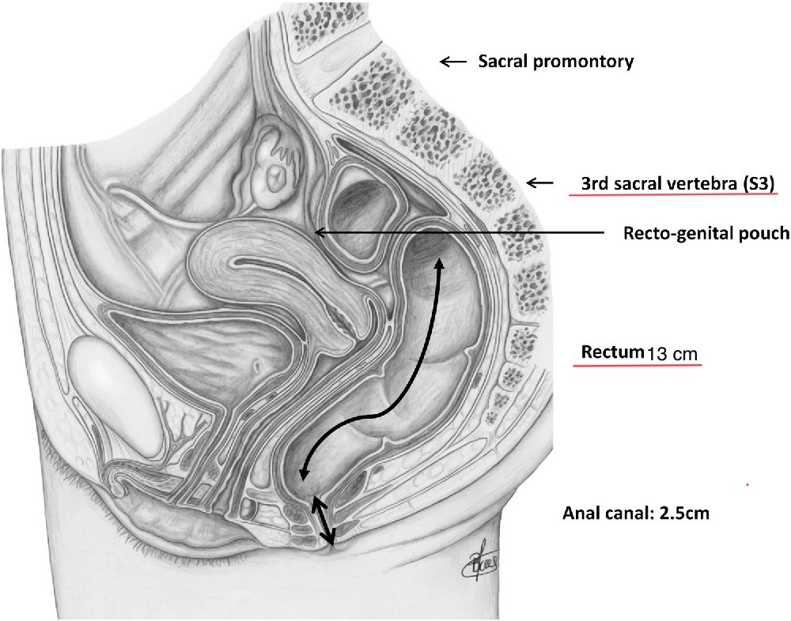
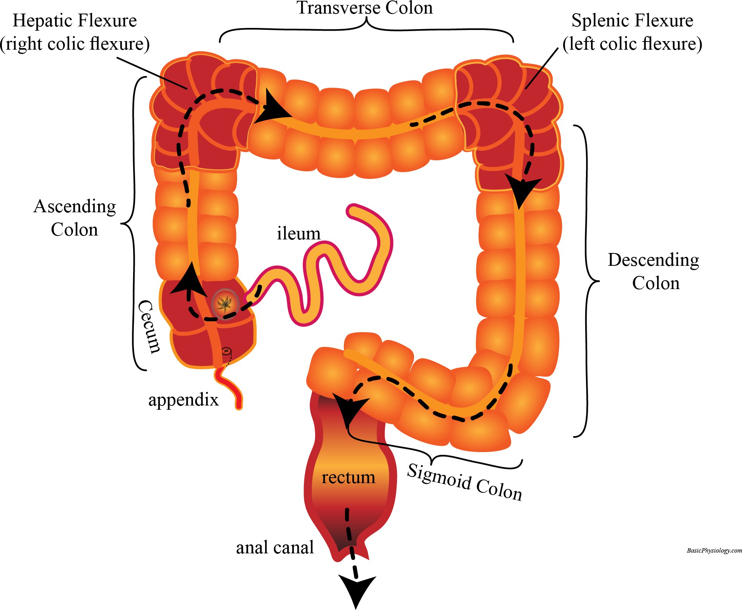
Site and Position of the rectum

Slide 11
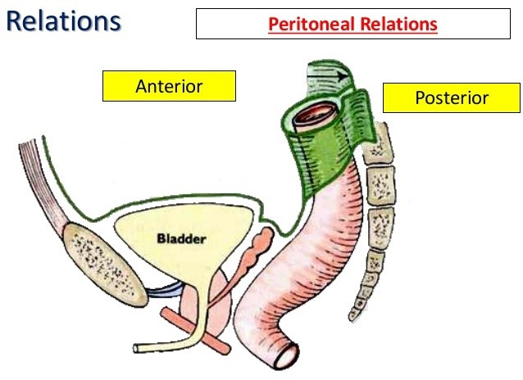
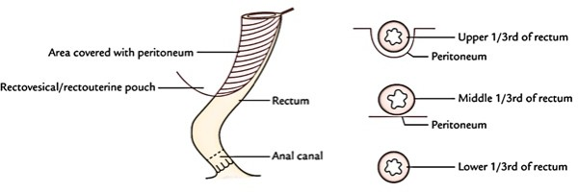
Peritoneal Relations of the rectum

Slide 12
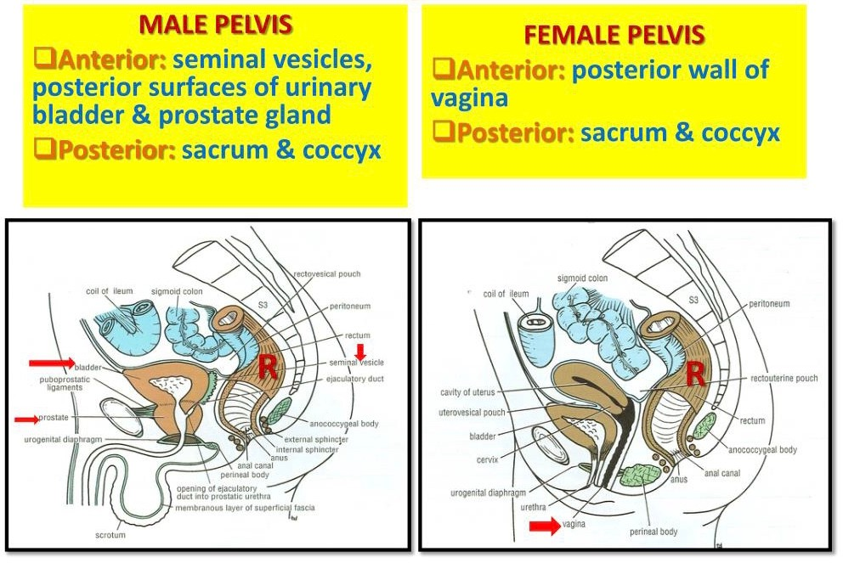
Relations of the rectum

Slide 13
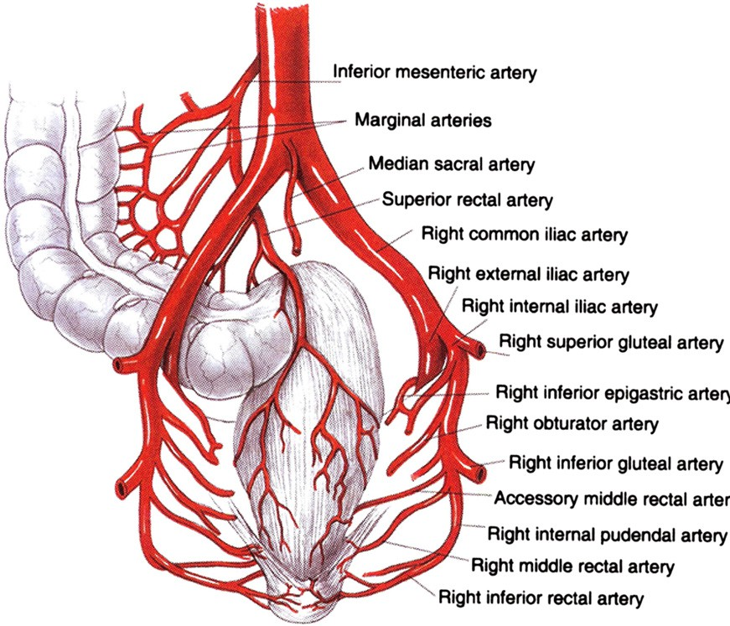
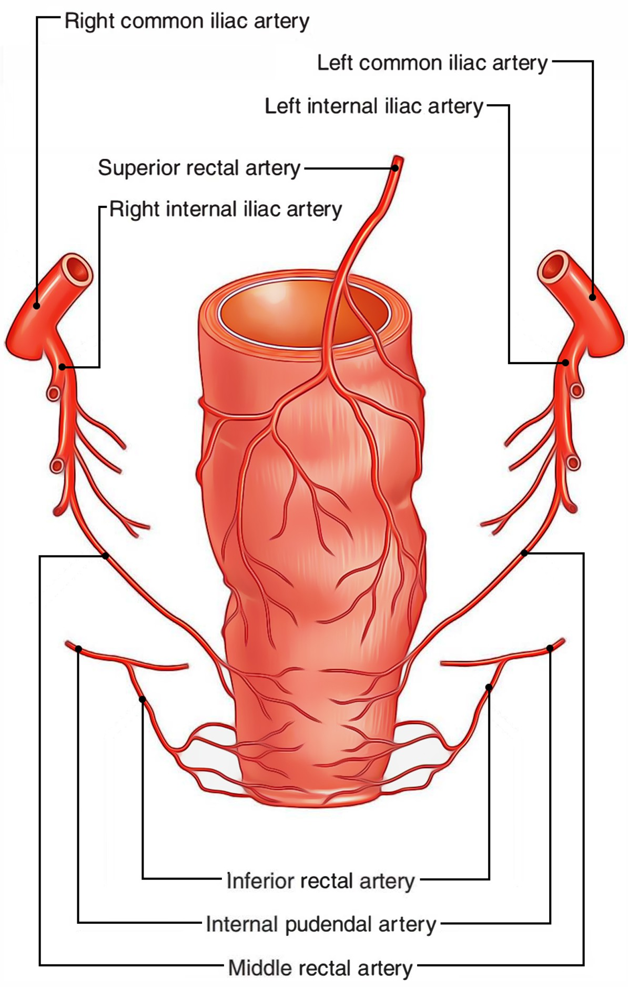
Blood supply of the rectum
Arterial supply

Slide 14
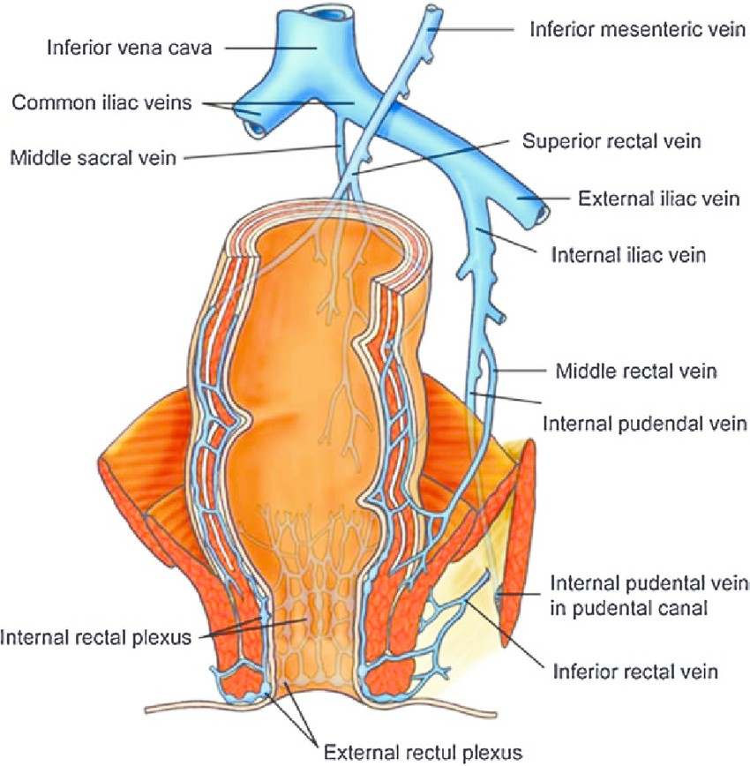
Blood supply of the rectum
Venous drainage

Slide 15
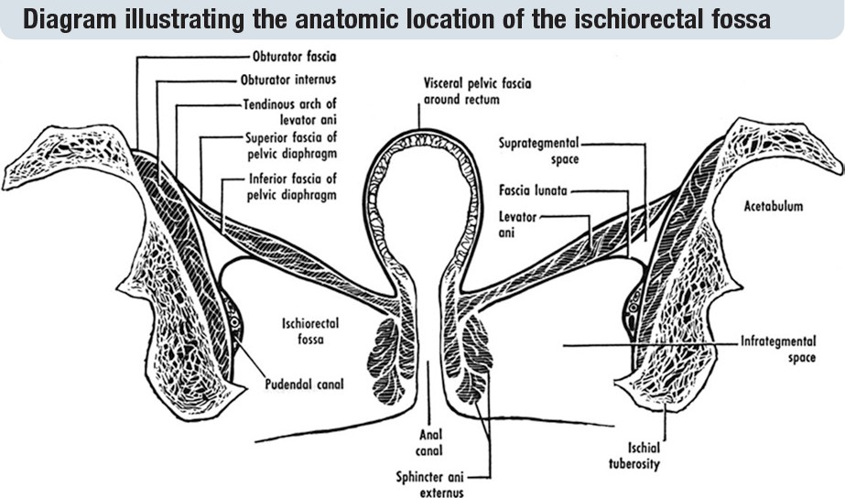
Ischiorectal Fossa
Boundaries

Slide 16
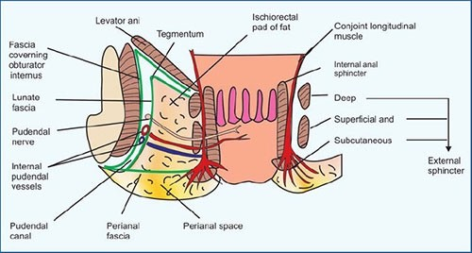
Ischiorectal Fossa
Contents

Slide 17
Anal canal
The students should know and identify the :
  Site and Position
  Peritoneal Relations
  Relations
  Blood supply

Slide 18
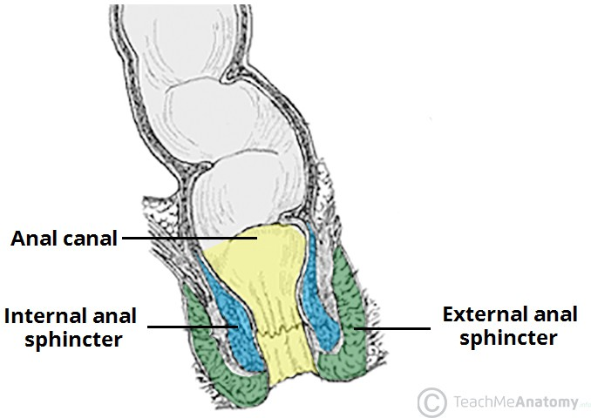
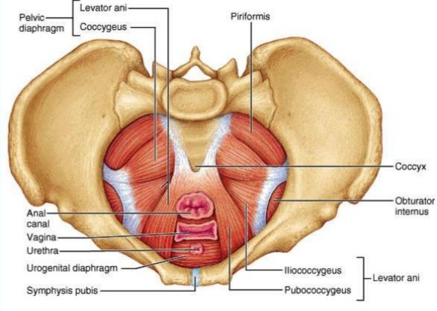
Site and Position of the Anal canal

Slide 19
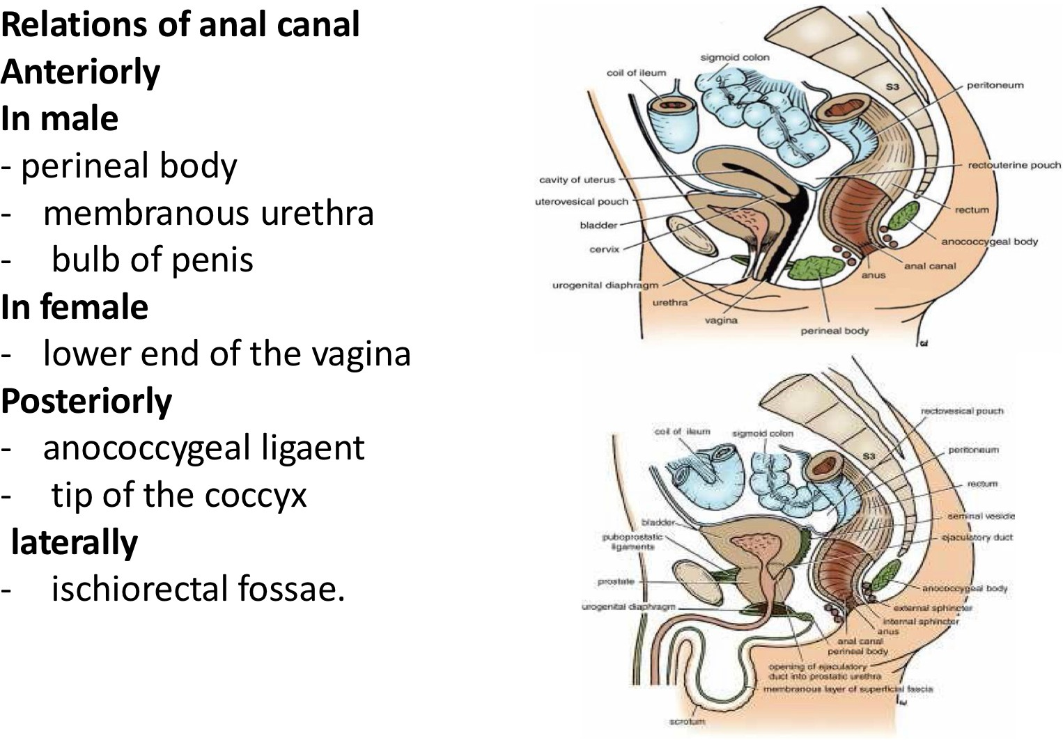
Peritoneal Relations of the Anal canal

Slide 20
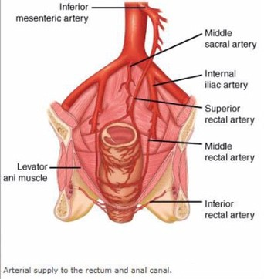
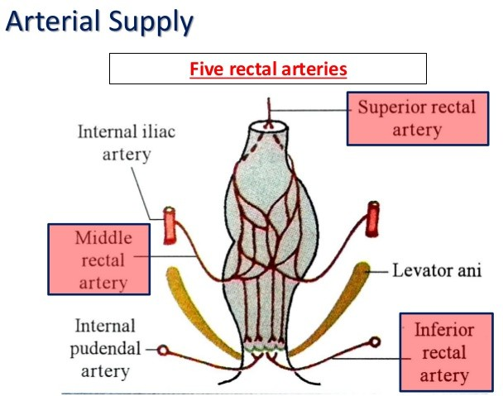
Blood supply of the Anal canal
Arterial supply

Slide 21
Blood supply of the Anal canal
Venous drainage

Slide 22

Posterior Abdominal wall
The students should know and identify the :
  Muscles
  Blood supply
  Nerves

Slide 23
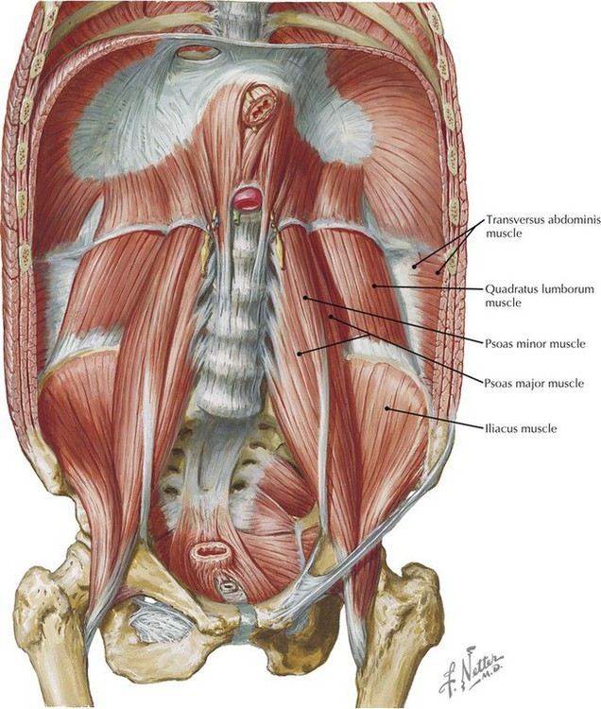
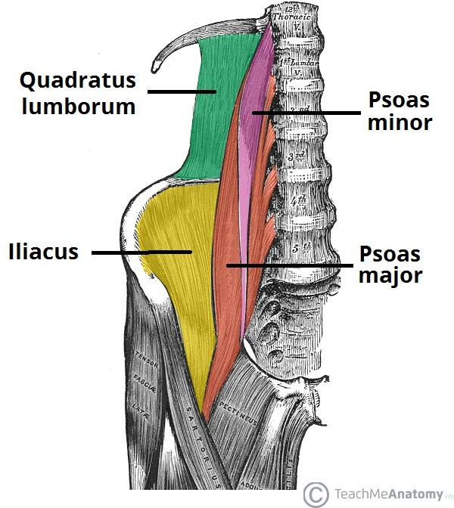
Muscles of post.abdominal wall

Slide 24
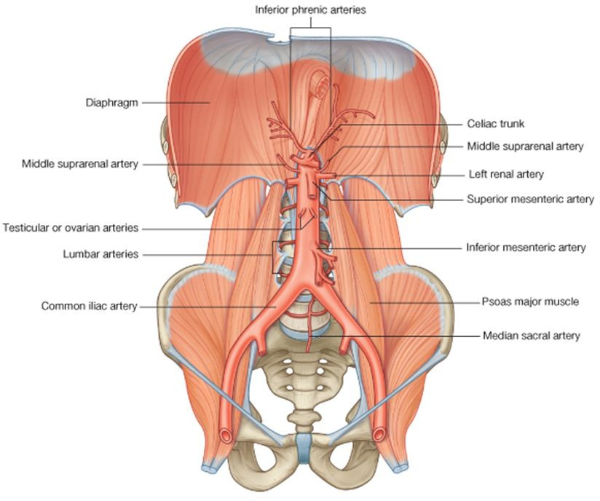
Arteries on the Posterior Abdominal Wall

Slide 25
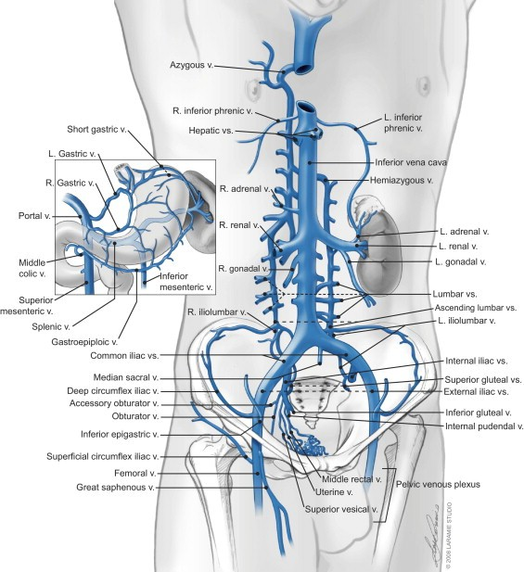
Veins on the Posterior Abdominal Wall

Slide 26
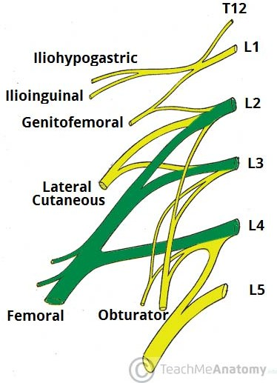
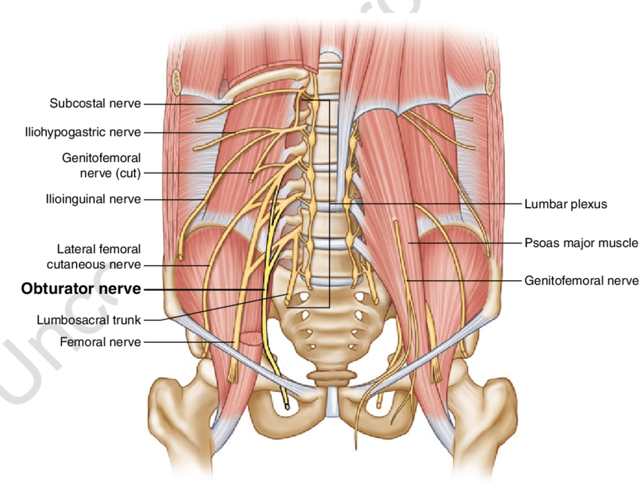
Nerves on the Posterior Abdominal Wall
Lumbar Plexus

Slide 27
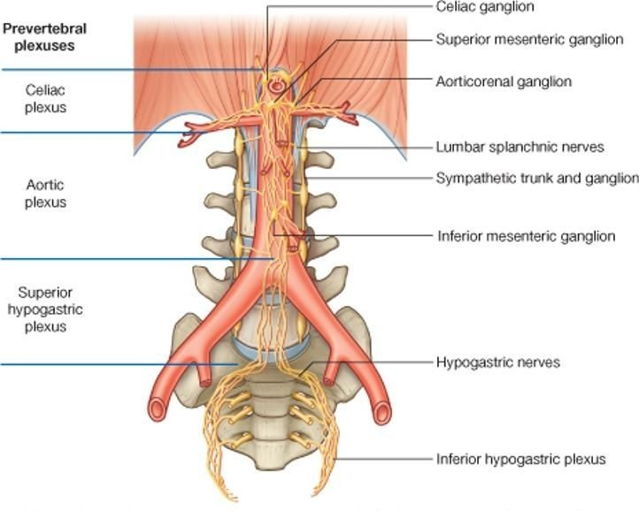
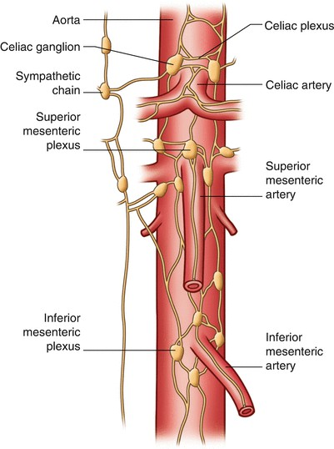
Nerves on the Posterior Abdominal Wall
Sympathetic Trunk (Abdominal Part)

