Slide 1
The practical of the third week
Anterior abdominal wall.
Rectus sheath
Inguinal canal
Inguinal triangle
Peritonium

Slide 2

Anterior abdominal wall.
A. Muscles of the anterior abdom
•
The students should know and identify the origin/ insertion/ nerve supply / and a
following muscles :
External oblique muscle
Internal oblique muscle
Transversus Abdominis muscle
Rectus Abdominis muscle
Pyramidalis muscle

Slide 3

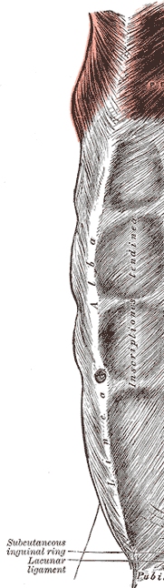
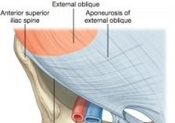
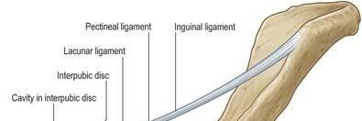
1. External oblique muscle
•
The students should observe the following :
Direction of the muscles fibers.
The attachment of the aponeuroses part.
The superficial inguinal ring.
The inguinal ligament
lacunar and pectineal ligaments

Slide 4

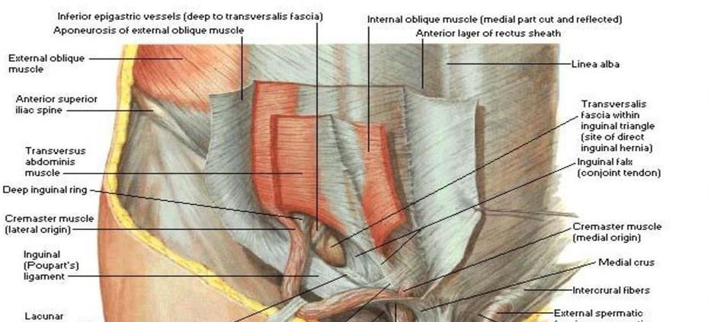
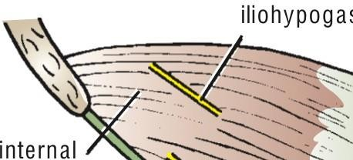
2. Internal oblique muscle
•
The students should observe the following :
Direction of the muscles fibers.
The conjoint tendon
The roof of inguinal canal .

Slide 5
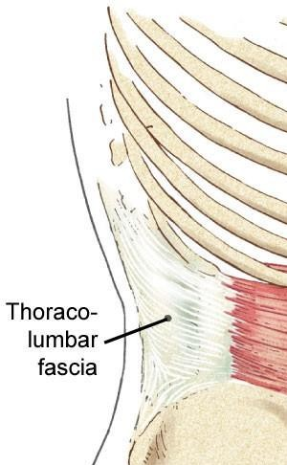
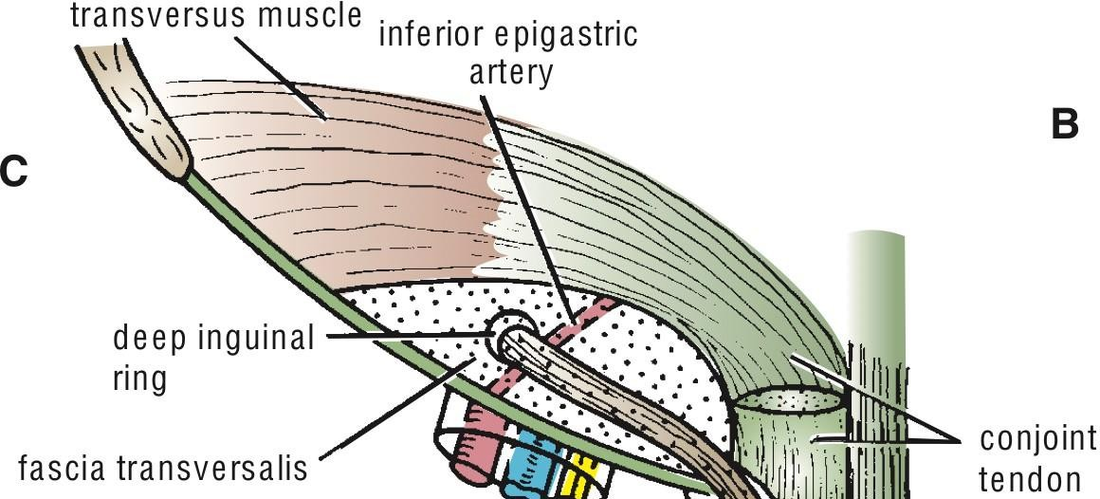
3. Transversus Abdominis muscle
•
The students should observe the following :
Direction of the muscles fibers.
The conjoint tendon

Slide 6
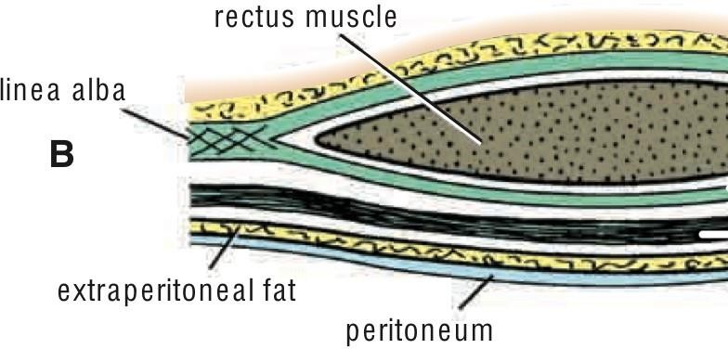
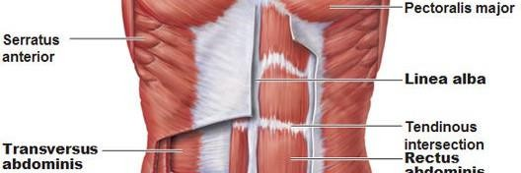
4. Rectus Abdominis muscle
•
The students should observe the following :
Direction of the muscles fibers.
Tendinous intersections
It lies in the rectus sheath.

Slide 7
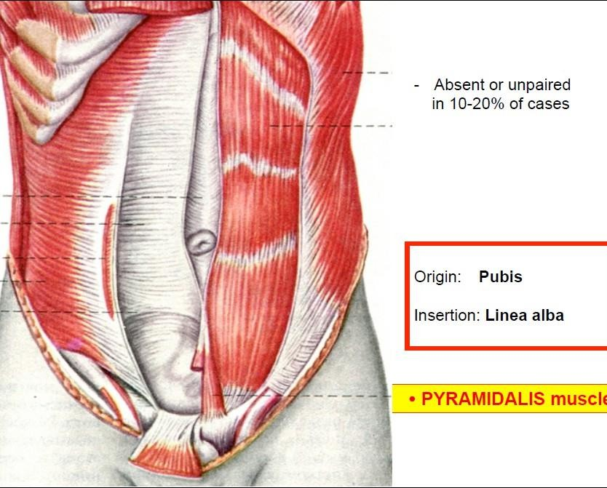
5. Pyramidalis muscle
•
The students should observe the following (if it is present) :
Attached to linea alba.
it lies anterior to rectus abdomenis inside the rectus sheath

Slide 8

Anterior abdominal wall.
B. Rectus Sheath
•
There is three levels of rectus sheath, the students should notice the anterior an each level.
Example : above and below the umbilicus, the anterior wall is formed by ???
The student should observe the adherent of the tendinous intersection with the sheath
•
•

Slide 9
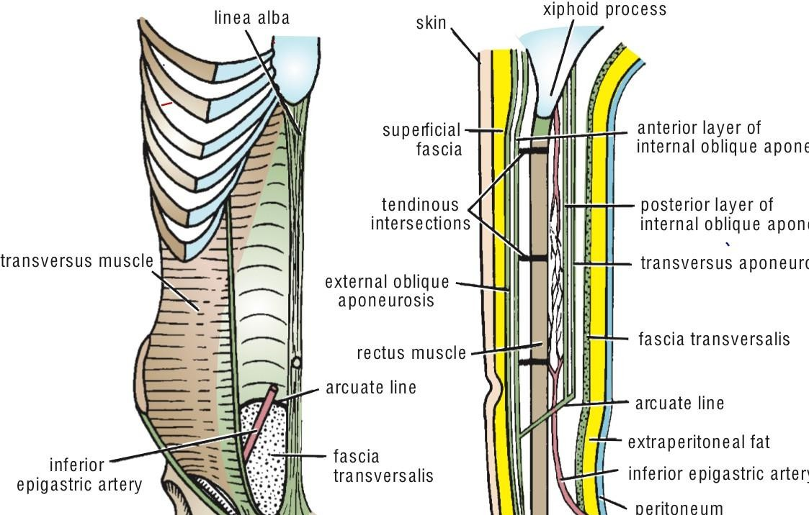
Anterior abdominal wall.
B. Rectus Sheath

Slide 10
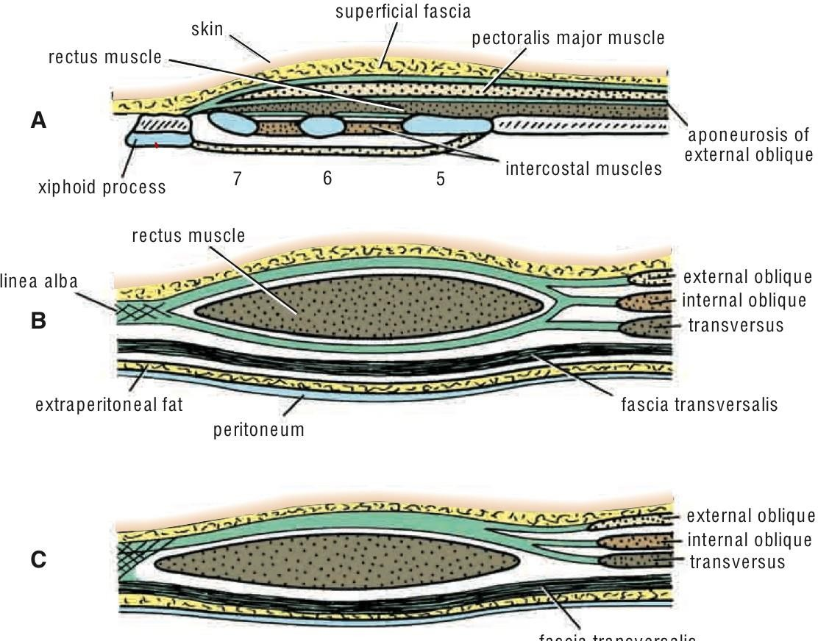
Anterior abdominal wall.
B. Rectus Sheath

Slide 11

Inguinal canal.
•
The students should know and identify the :
1.
2.
3.
4.
deep and superficial inguinal rings boundaries of Inguinal canal contents of Inguinal canal
clinical points ( hernia)

Slide 12

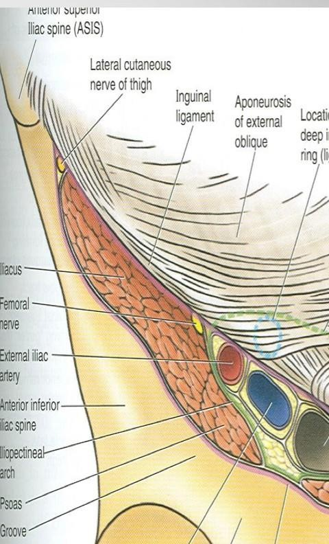
1. Deep and superficial inguinal rings
•
The students should observe the following :
relation of deep ring to femoral artery.
relation of the superficial inguinal ring to pubic tubercle
the structures which crosses each ring ???

Slide 13
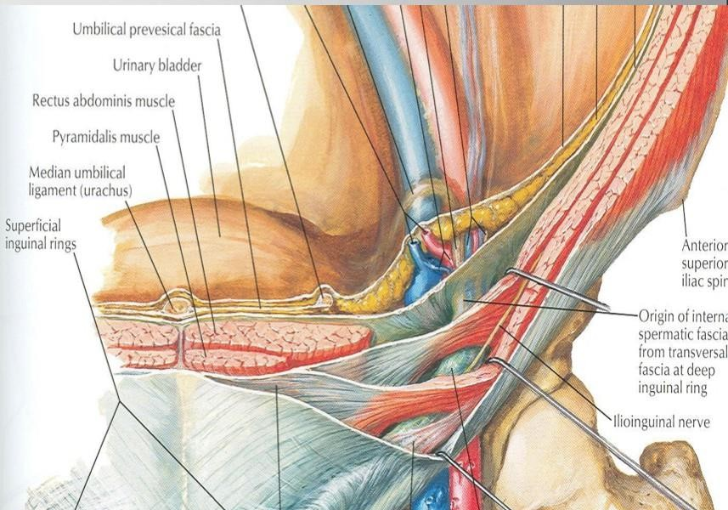
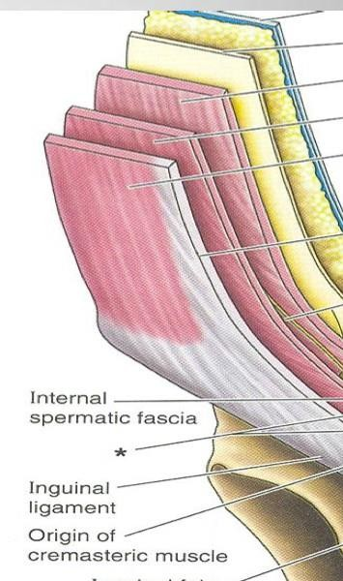
2. Boundaries of Inguinal canal
•
The students should observe the following :
1. The boundaries of inguinal canal ( ant wall, post wall, roof and floor )

Slide 14
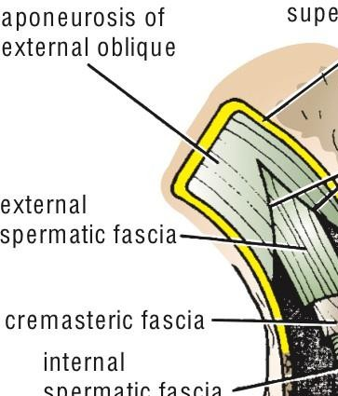
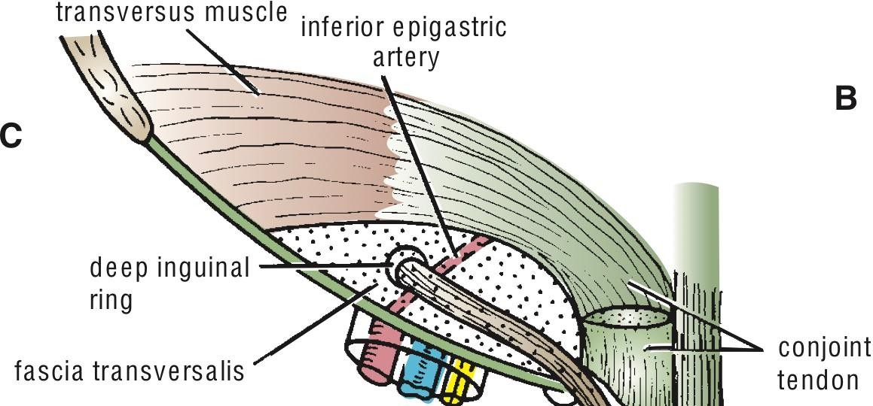
3. contents of Inguinal canal
•
The students should observe the following :
The contents of inguinal canal
The relation of deep ring to inferior epigastric vessels

Slide 15
3. contents of Inguinal canal

Slide 16
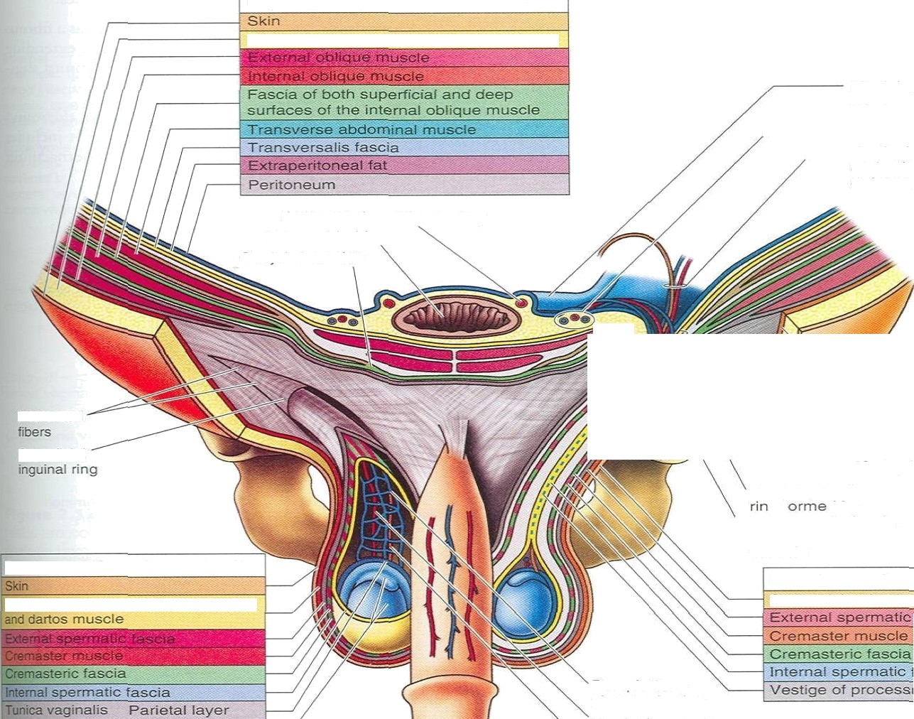


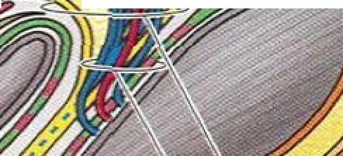
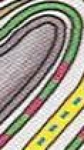


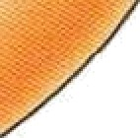





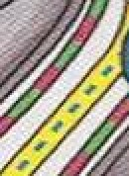

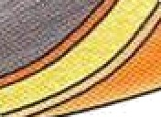
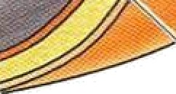





C
or responding Layers of the Anteric r Abdom inaI Wa ll,
and Spermatic Card
Layers of Anterior Abdom inaI Wa II
Subcutaneous tissue or supedic\aI fascia
Medial u
Interior
e pi‹gastri
TesGcul
ciefe rena
Osl ite rated um Di1.ca I a rte ry M rina bladõe r
Me obra laye r tscarpa
Intercrura!
Superi!c\al
Fany |a)
(Carnpe
'naI
Deep nÇ
gT d Dy
G
tran sve rsal ic fascia re mast e r.c
ves ssel
Coveriogs of Spai Scrotum (anel scrot
Scrotum Cand overin gs of Testis
Subcutaneous tissue (oartos fascia)
9 ã
Dt M ifo r m
pt ex s of vei ns

Slide 17
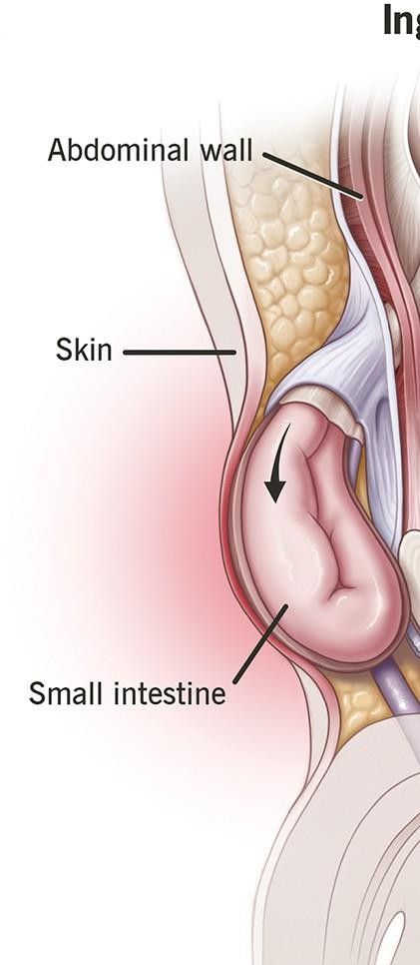
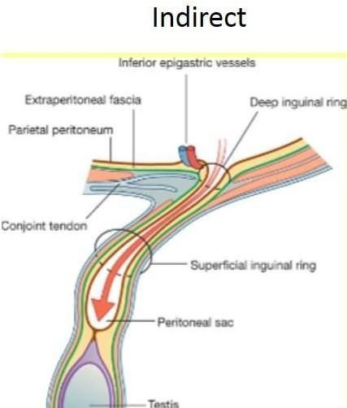
4. Indirect inguinal hernia
•
The students should know the following :
Type of the hernia.
its relations to inferior epigastric vessels
the direction of hernia and it may reach the
scrotum

Slide 18

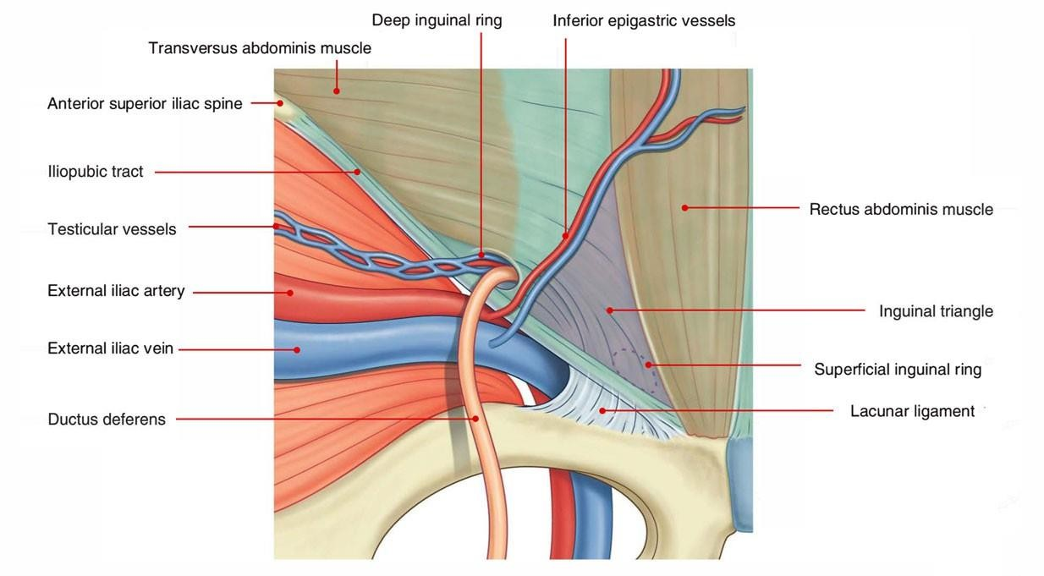
•
The students should know and identify the :
Boundaries of inguinal triangle
Type of hernia ( direct inguinal hernia )
its relations to inferior epigastric vessels
the direction of hernia and it has no relation with the inguinal canal
note: know the differences between direct and indirect inguinal hernia

Slide 19
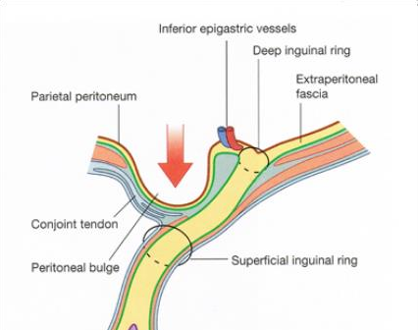
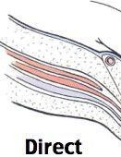
Inguinal triangle.

Slide 20

The Peritoneum.
The students should know and identify the :
  Parietal peritoneum
  Visceral peritoneum
  The relationship between viscera and peritoneum
  The peritoneal reflection :
( omenta, mesentery and ligaments)

Slide 21
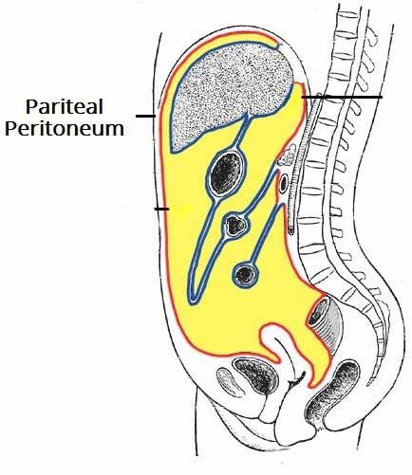
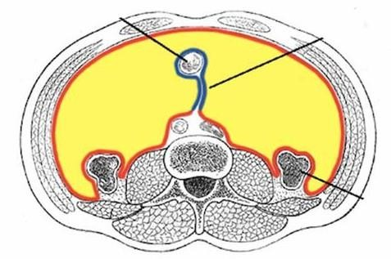
1. Parietal peritoneum
The students should know the following :
  It line the Ant. Abdominal wall.
  covers the pelvic viscera
  line the diaphragm superiorly
  line and attached to post
Abdominal wall

Slide 22
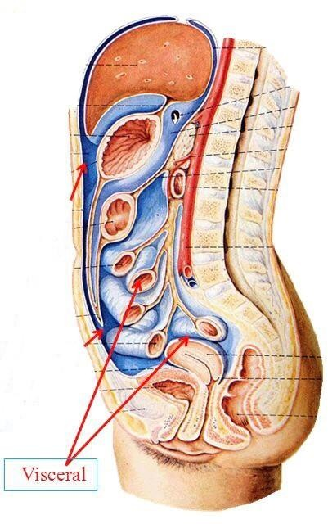
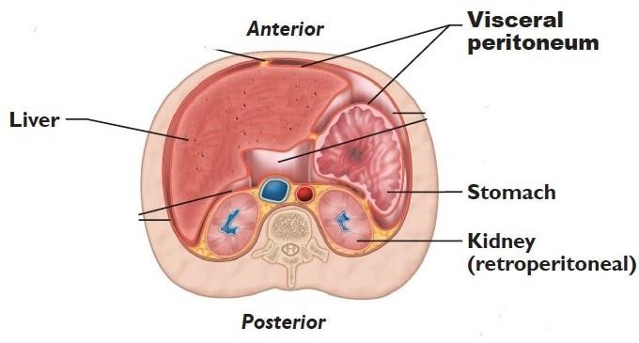
2. Visceral peritoneum
The students should know the following :
  it cover the abdominal viscera

Slide 23

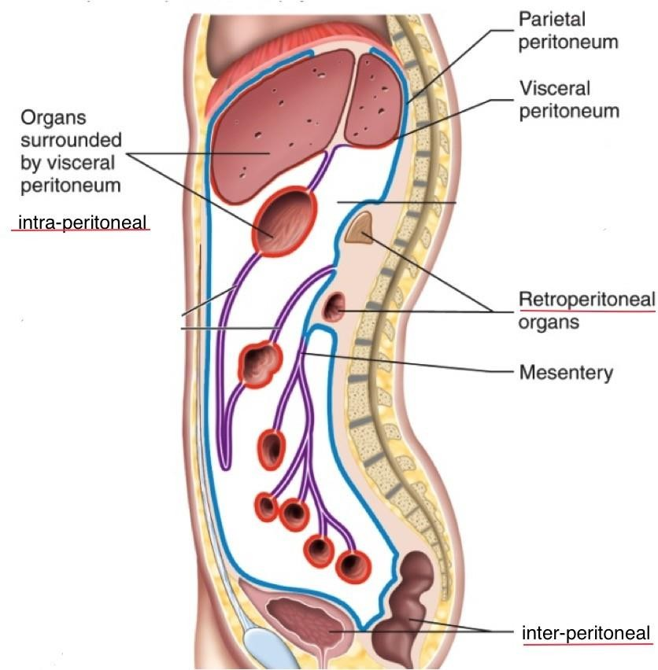
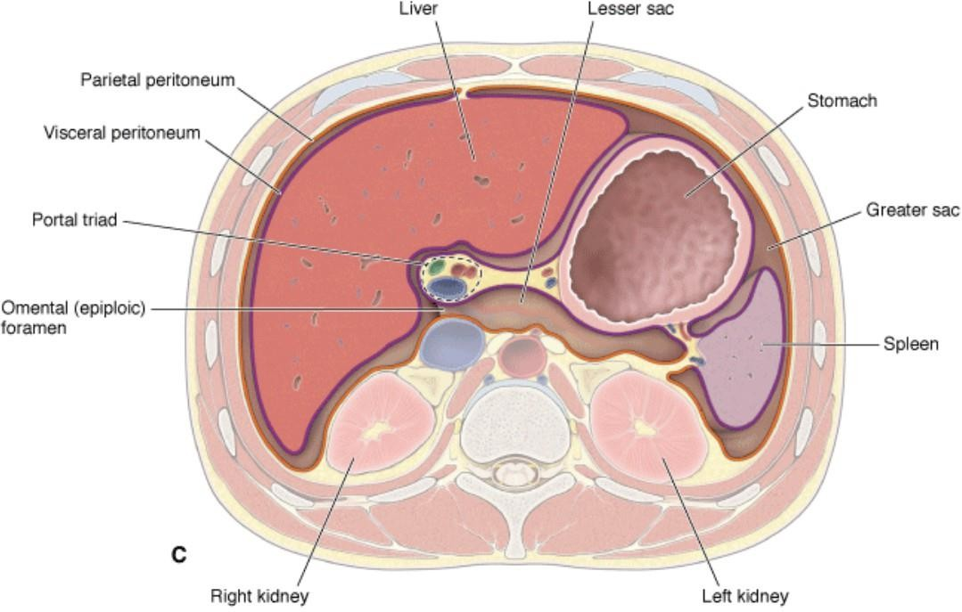
3. The relationship between viscera and peritoneum
The relationship between viscera and peritoneum classified as :
  Intraperitoneal viscera
    example: stomach, jejunum, ileum
  Retroperitoneal viscera
    example: kidney, pancreas
  Interperitoneal viscera
    example: liver, gallbladder, urinary
bladder

Slide 24
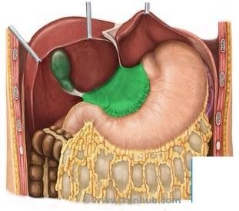
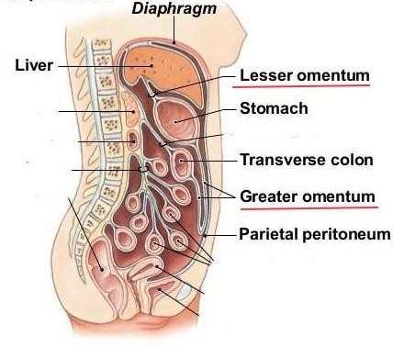
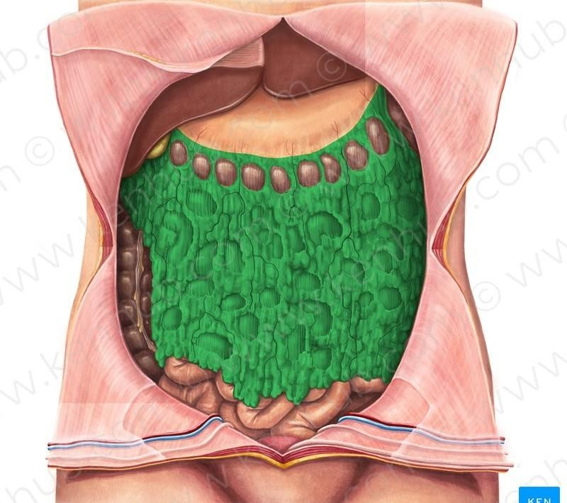
4. The peritoneal reflection
A. Omenta
The students should observe the following :
  Attachment and content of Lesser omentum
  Attachment and content of Greater omentum

Slide 25
4. The peritoneal reflection
B. Mesentery
The students should observe the following :
  Attachment and content of Mesentery of small intestine
  Attachment and content of Mesoappendix
  Attachment and content of Mesocolon ( transverse and sigmoid )

Slide 26
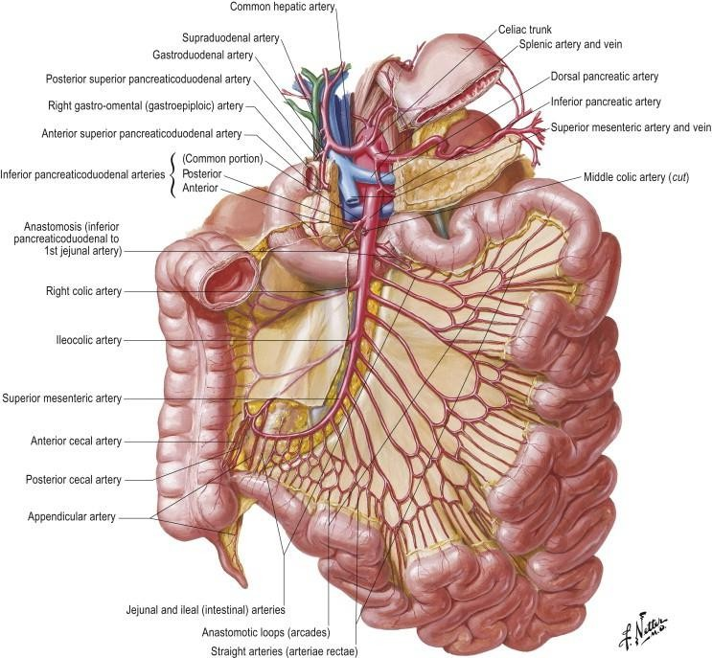
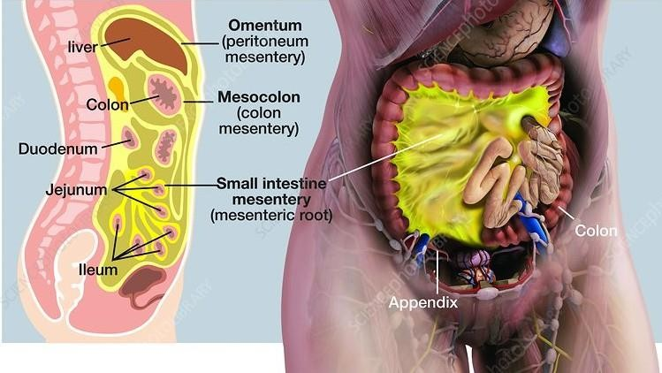
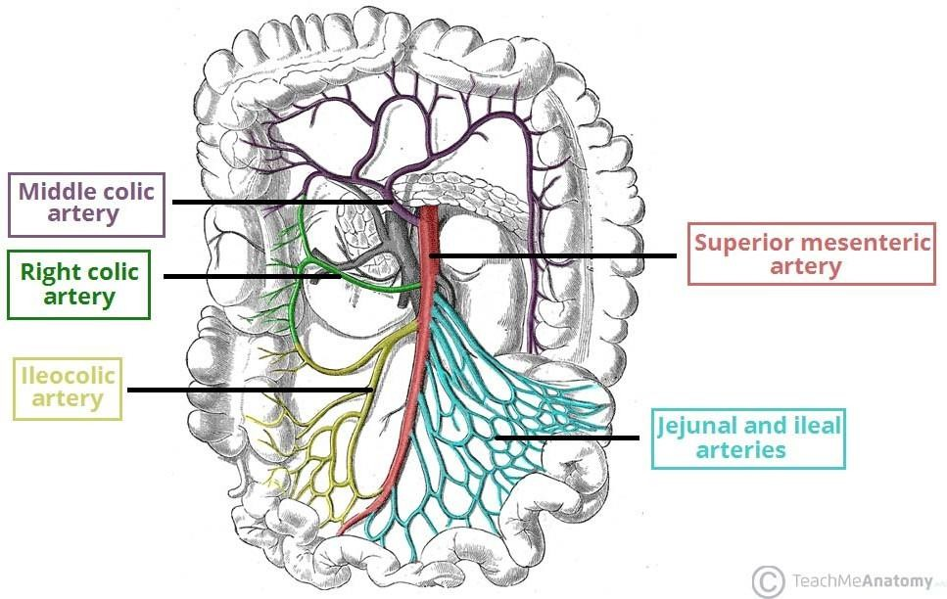
4. The peritoneal reflection
B. Mesentery
1. Attachment and content of Mesentery of small intestine

Slide 27
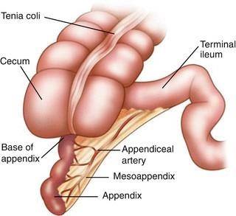
4. The peritoneal reflection
B. Mesentery
2. Attachment and content of Mesoappendix

Slide 28
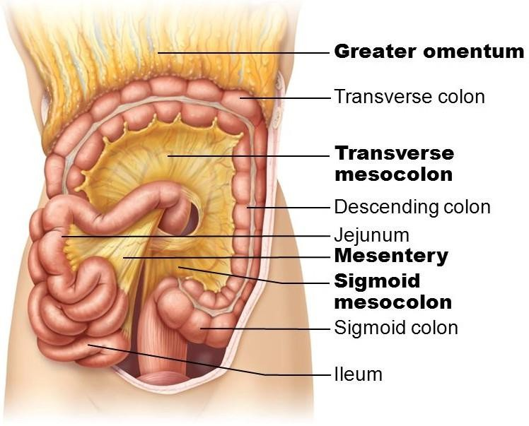
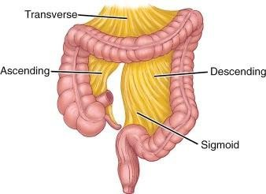
4. The peritoneal reflection
B. Mesentery
3. Attachment and content of Mesocolon ( transverse and sigmoid )

Slide 29
4. The peritoneal reflection
C. Ligaments
The students should observe the following :
  The ligaments of the liver.
  The ligaments of the stomach.
  The ligaments of the spleen.
  The suspensory ligament of duodenum.

Slide 30

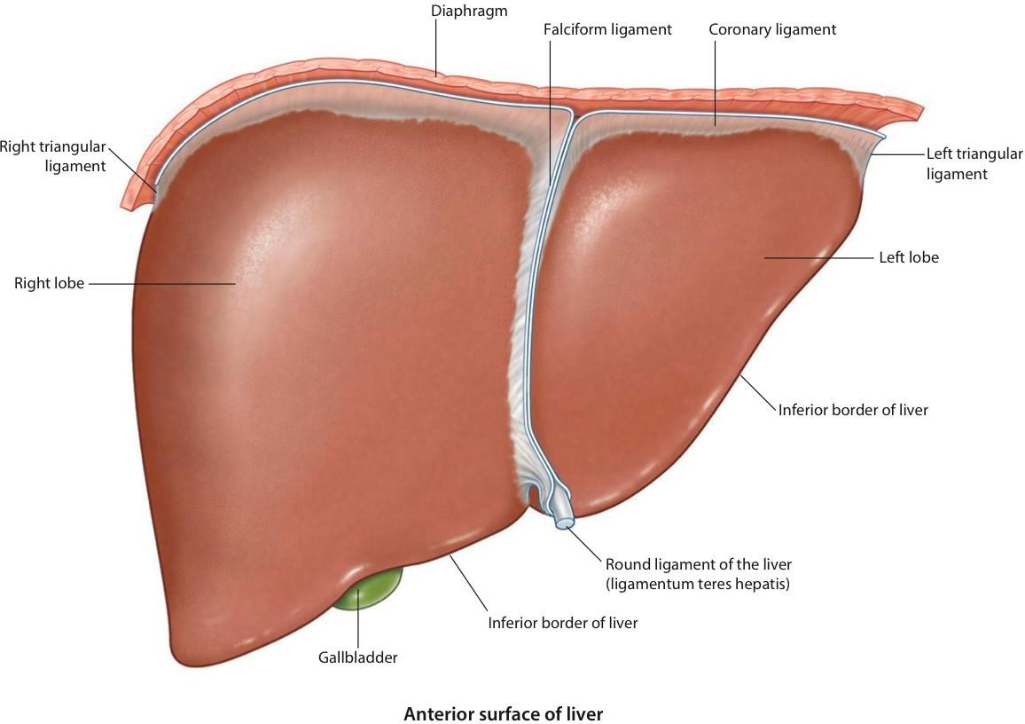
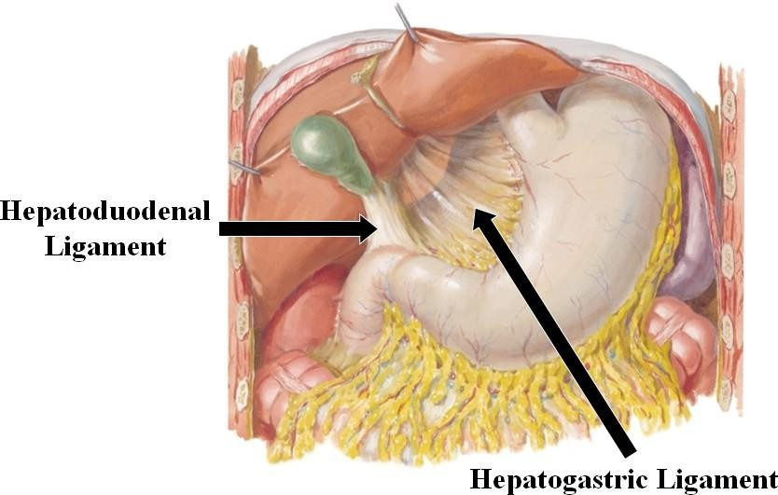
4. The peritoneal reflection
C. Ligaments
1. The ligaments of the liver.
The students should observe the following :
  The falciform ligament of liver
  The ligamentum teres hepatis
  The coronary ligament
  The right triangular ligament
  The left triangular ligament
The hepatogastric ligament
The hepatoduonedenal ligament

Slide 31
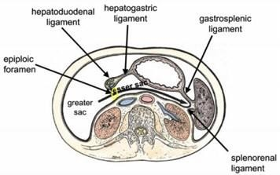
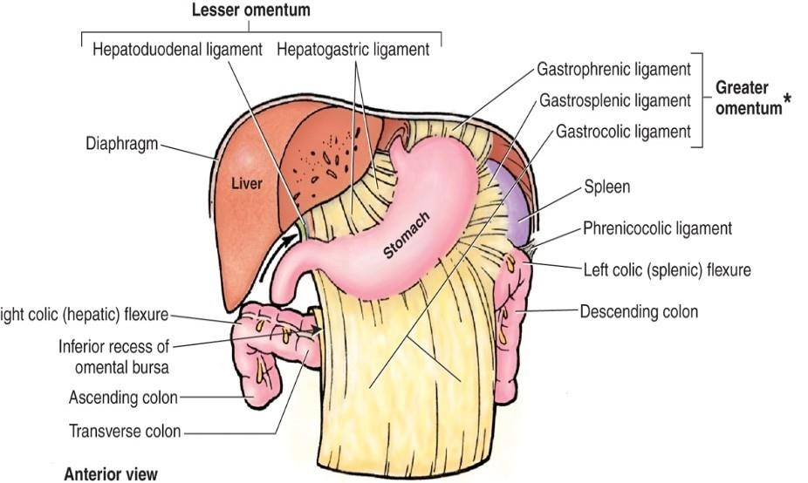
.4The peritoneal reflection
C. Ligaments
2. The ligaments of the stomach.
The students should observe the following :
  Hepatogastric ligament
  Gastrosplenic ligament
  Gastrophrenic ligament
  Gastrocolic ligament
  Gastropancrestic ligament

Slide 32
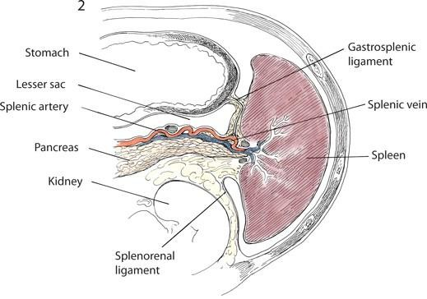
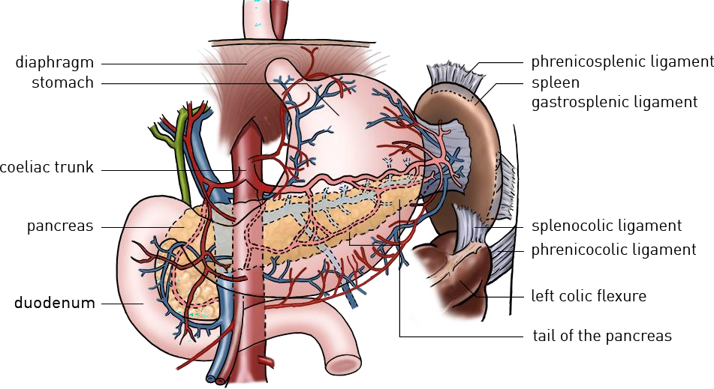
4. The peritoneal reflection
C. Ligaments
3. The ligaments of the spleen.
The students should observe the following :
  Gastrosplenic ligament
  Splenorenal ligament
  Phrenicosplenic ligament
  Splenocolic ligament

Slide 33



4. The peritoneal reflection
C. Ligaments
4. The suspensory ligament of duodenum( Treitz)

