Slide 1
CASE DISCUSSIONS
MSS (CASES 4-7)
2026 Al-Abbadi
University of Jordan School of Medicine

Slide 2
CASE 4
A 28-year-old man presents with 3 months of back pain, low-grade fever, night sweats, and weight loss. Examination shows localized tenderness over the lower thoracic spine and mild kyphosis. ESR is elevated. MRI spine shows destruction of T9–T10 vertebral bodies with paravertebral abscess formation. FNA done.

Slide 3
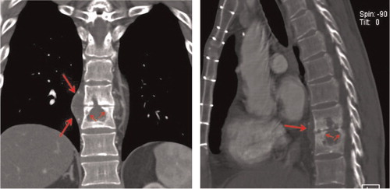
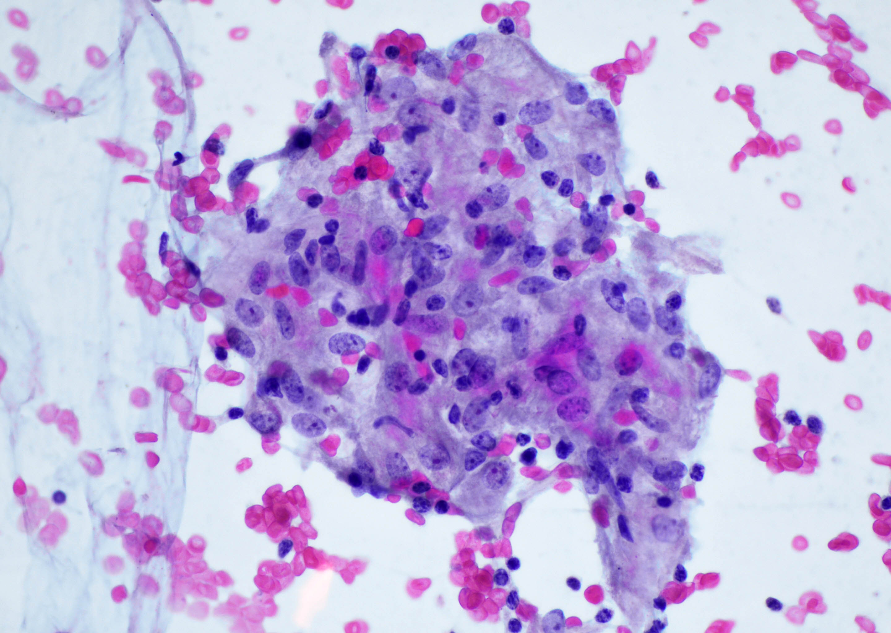
MRI & FNA SMEAR:

Slide 4
Discussion points:
Q1. What is the most likely diagnosis?
Q2. What is the most common route of spread to the spine?
Q3. Which spinal region is most commonly
affected?
Q4. What is the characteristic imaging
finding?
Q5. What is the mainstay of treatment?

Slide 5
CASE 5
A 42-year-old woman presents with morning stiffness lasting >1 hour and symmetric pain in MCP and PIP joints for 6 months. Exam shows joint swelling and tenderness. Labs show positive RF and anti-CCP antibodies. X-ray shows periarticular osteopenia and marginal erosions.

Slide 6
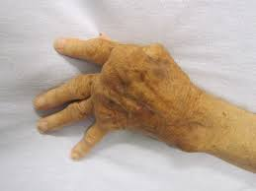
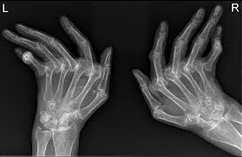
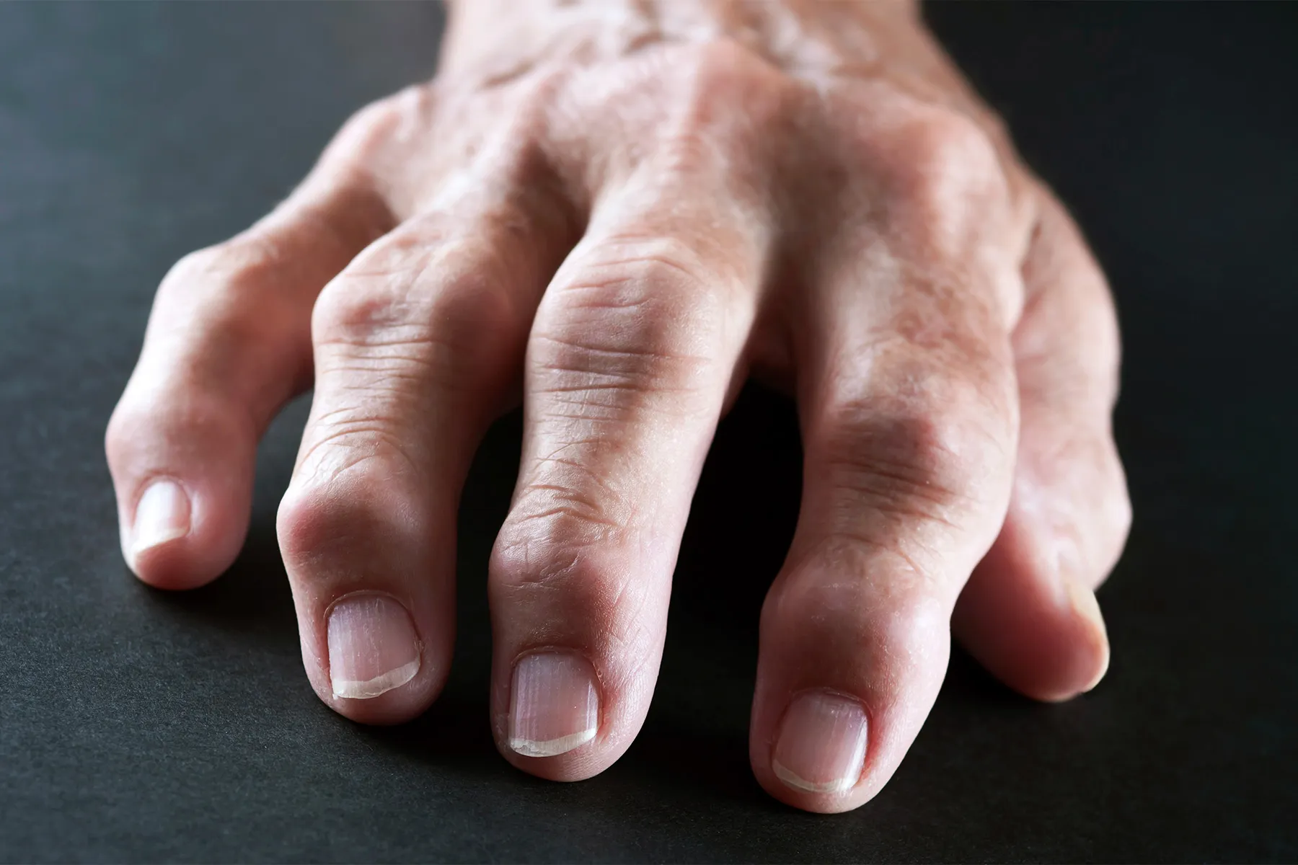

Slide 7
DISCUSSION POINTS:
Q1. What is the pathologic hallmark lesion in RA?
Q2. Which antibodies are most specific for RA?
Q3. What cytokine plays a major role in RA pathogenesis and is targeted by biologics?
Q4. What is the most common extra-articular manifestation?
Q5. What is first-line disease-modifying therapy?

Slide 8
Case 6
A 16-year-old boy presents with progressive pain and swelling around the knee. X-ray shows a metaphyseal lesion in distal femur with sunburst periosteal reaction and Codman triangle. Biopsy shows malignant cells producing osteoid.

Slide 9
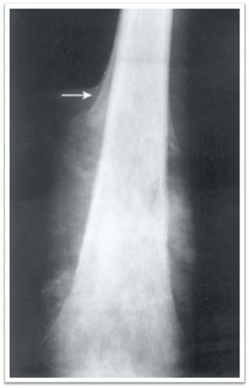
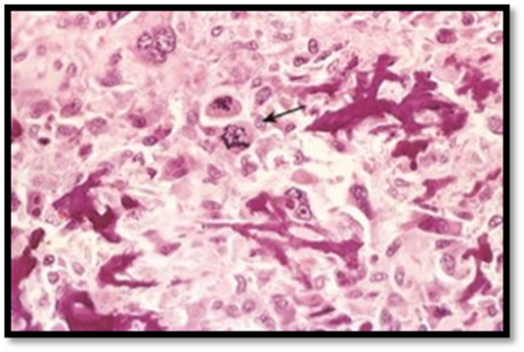

Slide 10
DISCUSSIONS POINTS:
Q1. What is the most common primary malignant bone tumor in adolescents?
Q2. What is the most common site?
Q3: What genetic mutations are associated with OS?
Q4. What is the most common site of metastasis?
Q5. What is the diagnostic histologic feature?

Slide 11
Case 7:
A 12-year-old boy presents with fever, bone pain, and swelling in the mid-shaft of the humorous. X-ray shows a lamellated (onion-skin) periosteal reaction. Biopsy shows small round blue cells. Cytogenetics reveals t(11;22).

Slide 12
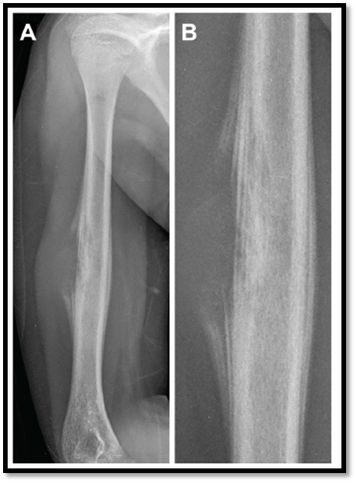
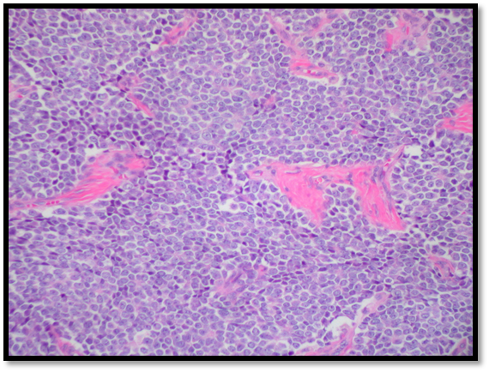

Slide 13
DISCUSSIONS POINTS:
Q1. What is the most likely diagnosis?
Q2. What is the most characteristic genetic abnormality?
Q3: What bones are commonly involved?
Q4. Why it is commonly mistaken for infection?
Q5. What immunohistochemical marker is usually positive?

