Slide 1
Intracellular accumulations and calcifications
cell injury and adaptations
Manar Hajeer, MD, FRCPath
University of Jordan , school of medicine

Slide 2
INTRACELLULAR ACCUMULATIONS
1)Inadequate removal of a normal substance (fatty change in the liver)
2)Accumulation of an abnormal endogenous proteins due to folding defect (α1-antitrypsin defficiency)
3)Failure to degrade a metabolite due to inherited enzyme deficiencies (lysosomal storage diseases and glycogen storage diseases)
4)Deposition and accumulation of an abnormal exogenous substance (carbon and selica)

Slide 3
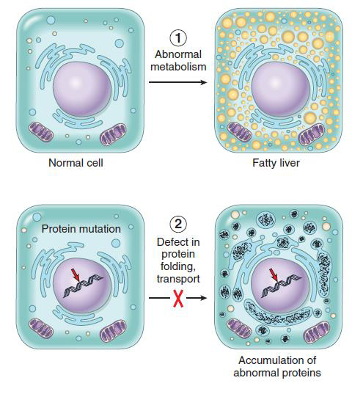
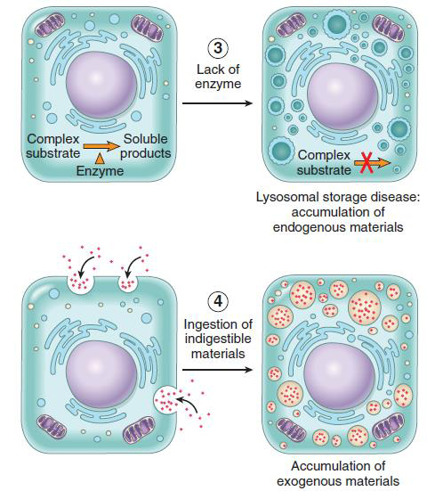

Slide 4
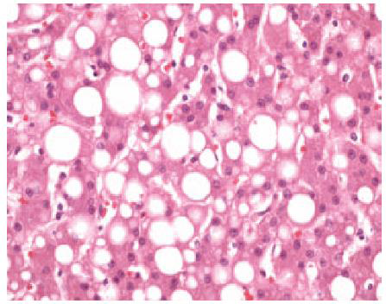
fatty change: steatosis
Most common in liver
Triglycerides
Also in heart, kidney, muscle
Causes: toxins, protein malnutrition, DM, obesity, anoxia
Alcohol abuse and DM+obesity are the most common causes of fatty liver

Slide 5
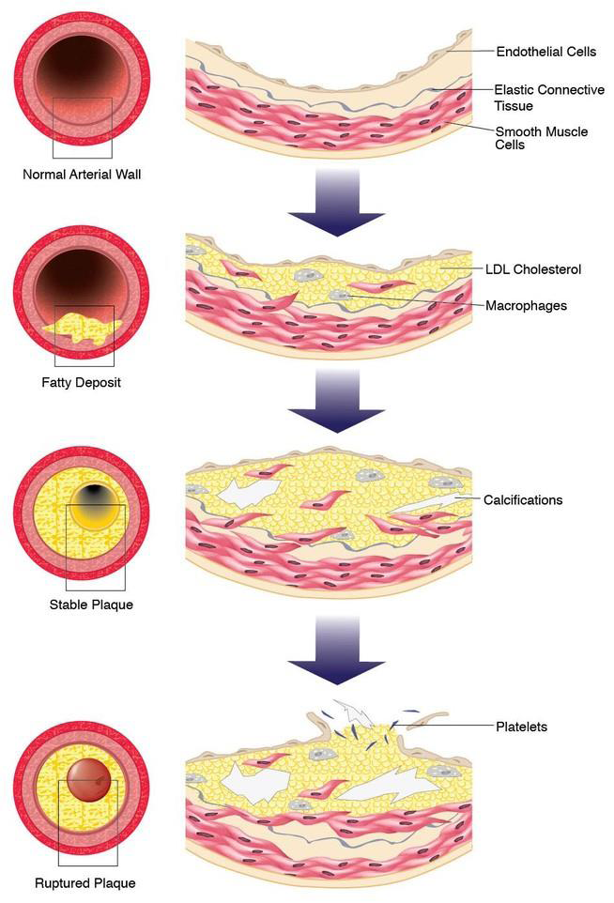
Cholesterol and Cholesteryl Esters
Phagocytic cells become overloaded with lipid (triglycerides, cholesterol, and cholesteryl esters)
Due to Increased intake or decreased catabolism
Atherosclerosis

Slide 6
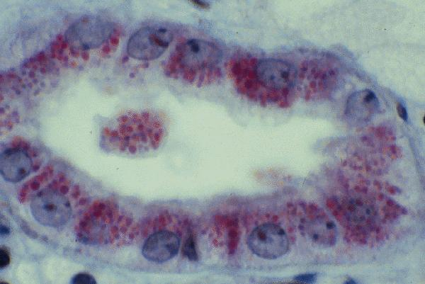
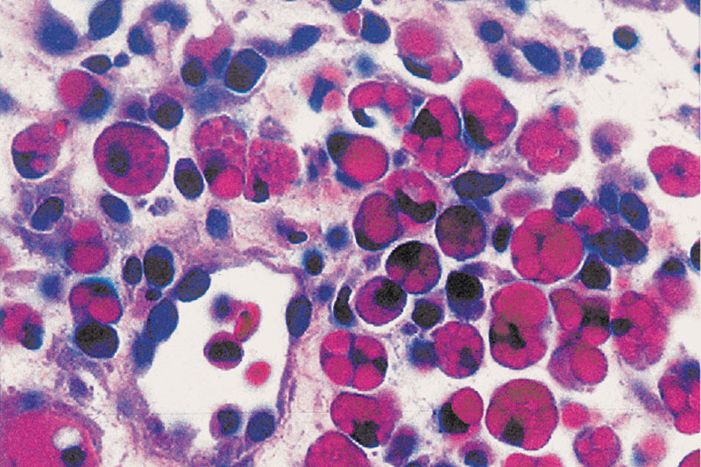
Proteins
Much less common than lipid accumulations
Either excess external or internal synthesis
Proximal renal tubules in nephrotic syndrome
Russell bodies in plasma cells.
Alcoholic hyaline in liver.
Neurofibrillary tangles in neurons

Slide 7
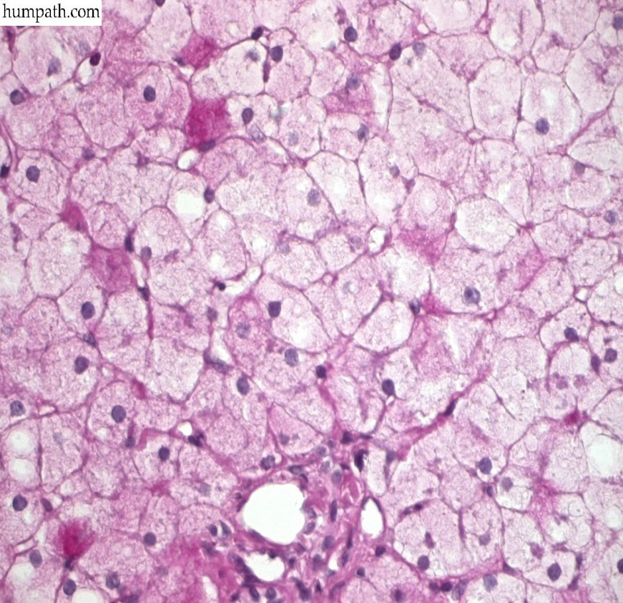
Glycogen
Abnormality in glucose or glycogen metabolism
DM (in renal tubules, heart, B cells of pancreas).
Glycogen storage diseases

Slide 8
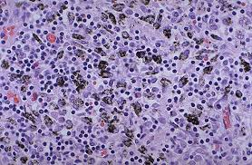
Pigments
Exogenous
Most common exogenous, carbon (coal dust, air pollution)
Alveolar macrophages → lymphatic channels → tracheobronchial LN
Anthracosis

Slide 9
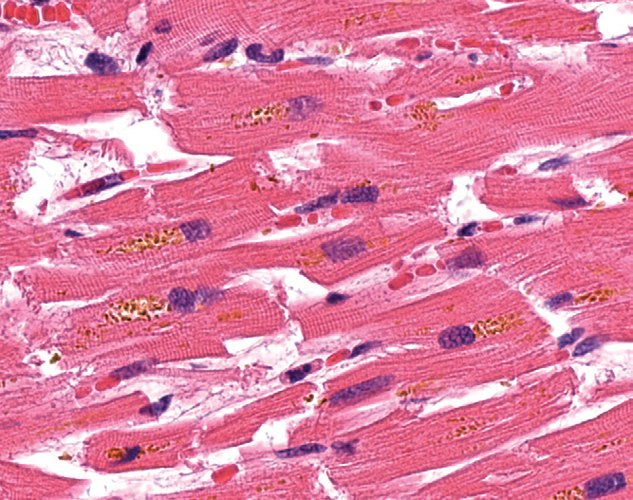
Pigments
Endogenous
Lipofuscin
“wear-and-tear pigment”
Age/atrophy
Heart, liver, and brain
Lipid and protein
Marker of past free radical injury
brown atrophy

Slide 10
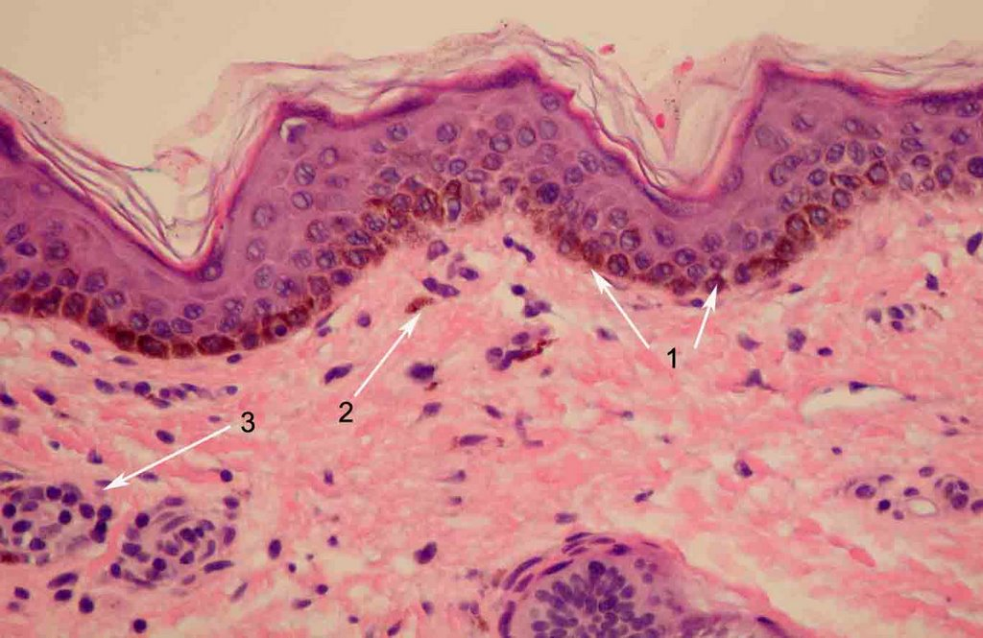
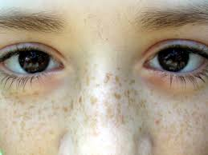
Pigments
Endogenous
Melanin
Source: melanocytes
UV protection
Accumulates in dermal macrophages and adjacent keratinocytes
Freckles

Slide 11
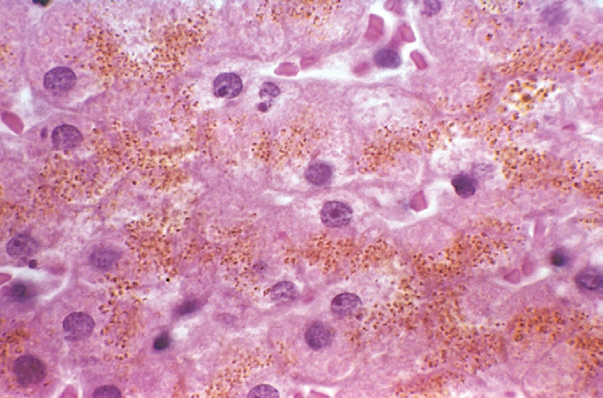
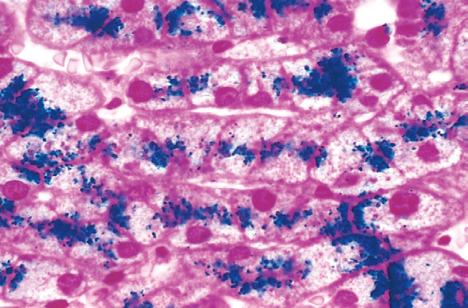
pigments
Hemosiderin
Hb-derived granular pigment
Iron +apoferritin==ferritin micelles
Physiologic in the mononuclear phagocytes of the BM, spleen, and liver, from RBC turnover
Bruise: local pathologic deposition from hemorrhage
Hemosiderosis: systemic pathologic deposition of hemosiderin (hemochromatosis, hemolytic anemias, repeated blood transfusions)

Slide 12
PATHOLOGIC CALCIFICATION
Abnormal deposition of calcium salts, together with smaller amounts of iron, magnesium, and other mineral
Dystrophic Calcification
Deposition in dead/injured tissues
Normal Ca2+ metabolism
Exacerbated by Hypercalcemia
Metastatic Calcification
Deposition in normal tissues
Almost always abnormal Ca2+ metabolism (hypercalcemia)

Slide 13
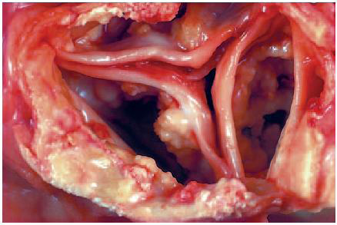
Dystrophic calcification
Necrosis of any type
Atherosclerosis, aging or damaged heart valves, aortic stenosis, tuberculosis)
Incidental finding indicating insignificant past cell injury
Or May be a cause of organ dysfunction.

Slide 14
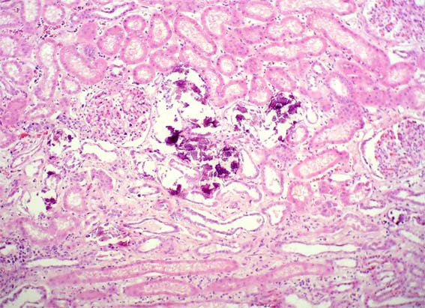
Metastatic Calcification
Hyperparathyroidism (primary and parathyroid hormone related protein)
Bone destruction (metastasis, MM, leukemia, Pagets, immobilization)
Vit-D intoxication,
Sarcoidosis.
Renal failure with 2ry hyperparathyroidism.
VESSELS, LUNG, KIDNEY

