Slide 1
Apoptosis and autophagy
cell injury and adaptations
Manar Hajeer, MD, FRCPath
University of Jordan , school of medicine
.

Slide 2
Definition
“Programmed cell death”
“a genetically determined process of cell self-destruction”
“ pathway of cell death in which cells activate enzymes that degrade the cells’ own nuclear DNA and nuclear and cytoplasmic proteins.”
The dead cell and its fragments are cleared with little leakage of cellular contents, NO inflammatory reaction.

Slide 3
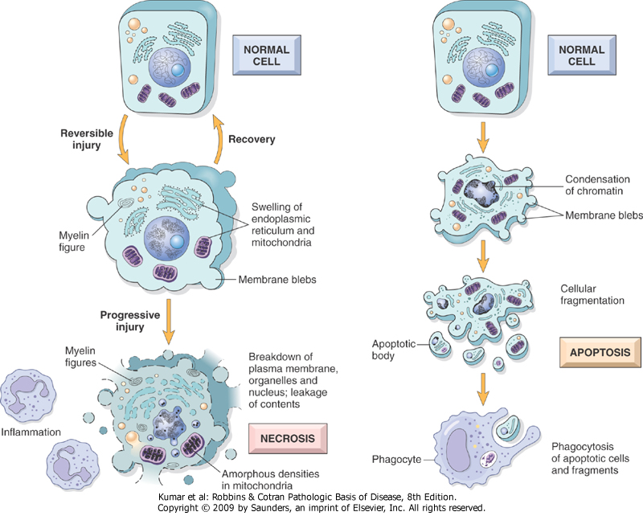

Slide 4
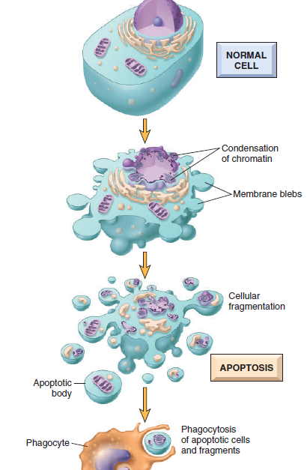

Slide 5
Feature | necrosis | Apoptosis
Cell size | Enlarged(swelling) | Reduced(shrinkage)
Nucleus | Pyknosis, Karyorrhexis, karyolysis | Fragmentation into nucleosome- size fragments
Plasma membrane | Disrupted | Intact, altered structure, especially orientation of lipids
Cellular content | Enzymatic digestion, may leak out of cell | Intact, may be released in apoptotic bodies.
Adjacent inflammation | Frequent | No
Physiologic or pathologic role | Invariably pathologic | often physiologic and may be pathologic
However, apoptosis and necrosis sometimes coexist, and apoptosis induced by some pathologic stimuli may progress to necrosis, like in ischemia.

Slide 6
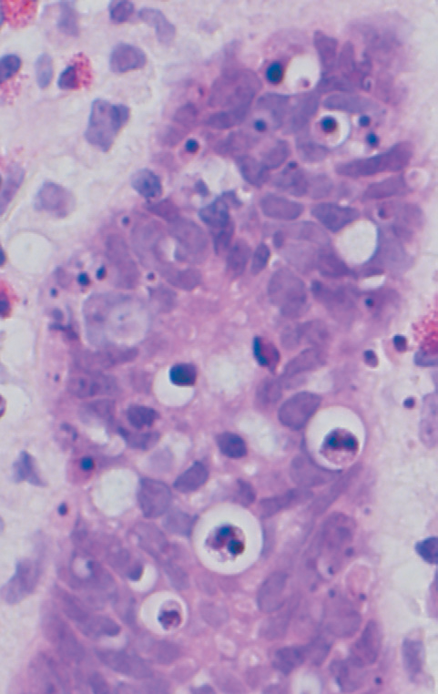

Slide 7
Causes of apoptosis
Physiologic apoptosis
Apoptosis in pathologic conditions

Slide 8
Causes of Apoptosis
Physiologic
During embryogenesis
Involution of tissues upon hormone deprivation (endometrium, lactating breast)
Steady state population (Gut, Skin)
End of function/life (neutrophils at end of inflammation)
Self reacting lymphocytes

Slide 9
Pathologic: (damaged cells beyond repair)
DNA damage (Rx, chemoTx, tempreture, UV, hypoxia)
Accumulation of misfolded proteins
Some infections (adenovirus, HIV, hepatitis viruses)

Slide 10
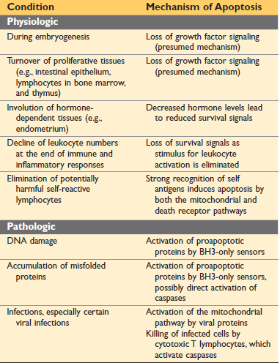

Slide 11
Mechanisms of Apoptosis
Activation of enzymes called caspases
Two distinct pathways can lead to caspase activation:
1) The mitochondrial pathway
2) The death receptor pathway

Slide 12
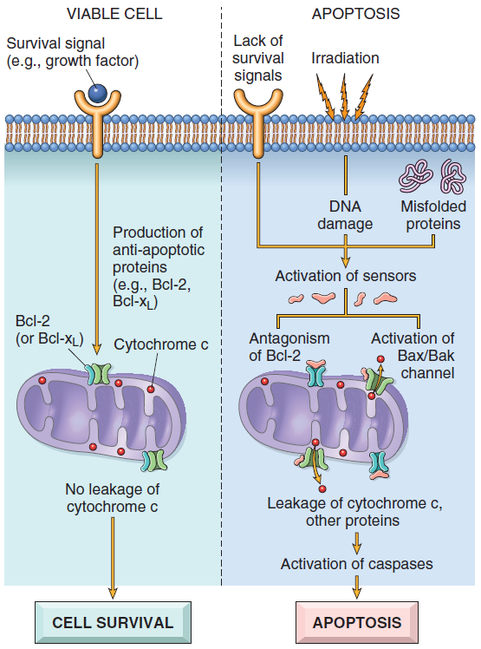
Mitochondrial (intrinsic)
Responsible for apoptosis in most physiologic and pathologic situations
Bcl2 family of proteins control mitochondrial membrane permeability
Bcl2 antiapoptotic
Bax/Bak proapoptotic
BH3 sensors
Cytochrome c activates caspase-9

Slide 13
Death receptor (extrinsic)
TNF receptor family, cytoplasmic death domain
Prototypes: Type 1 TNF receptor and Fas
Fas ligand on activated T lymphocytes
Fas –FasL interaction activates death domain which in turn activates caspase 8
Used in:
Elimination of self-reactive lymphocytes
killing of target cells by some cytotoxic T lymphocytes (CTLs)

Slide 14
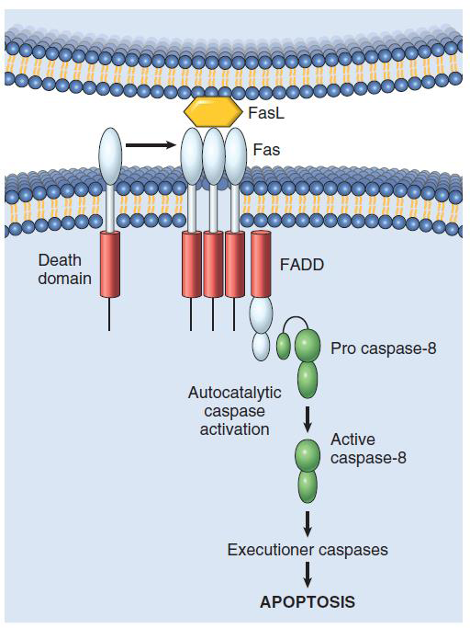

Slide 15
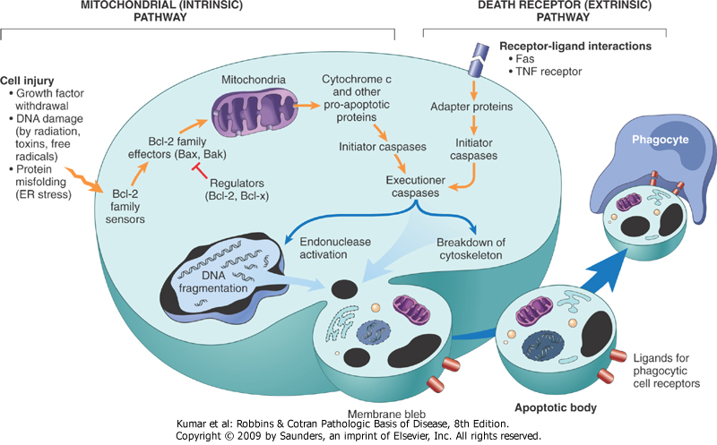

Slide 16
Autophagy
Self-eating
Lysosomal digestion of the cells own components
Survival mechanism in times of nutrient deprivation.
Recycling cells contents to provide nutrients and energy
ER-derived autophagic vacuole
Vacuole fuses with lysosome >>>autophagolysosome
May lead to atrophy.
Failure of adaptation >>>apoptosis

Slide 17
