Slide 1
MECHANISMS OF CELL INJURY
cell injury and adaptations
Manar Hajeer, MD, FRCPath
University of Jordan , school of medicine

Slide 2
MECHANISMS OF CELL INJURY
Principles
The cellular response to injury depends on:
type of injury
duration
severity
The consequences of injury also depend on:
type,
status,
adaptability, and genetic makeup of the injured cell (precision medicine concept)
Cell injury results from functional and biochemical abnormalities in one or more of several essential cellular components.
Same injury may trigger more than one mechanism.

Slide 3
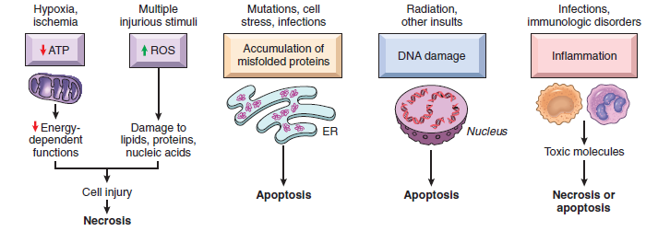
The principal biochemical mechanisms and sites of damage in cell injury

Slide 4
Hypoxia and Ischemia
One of the most frequent causes of injury.
Defective oxidative phosphorylation >>Failure of ATP generation>>>depletion of ATP in cells
Failure of energy dependent pathways (membrane transport, protein synthesis, lipogenesis and phospholipid turnover)
Anaerobic glycolysis.
Liver cells and skeletal muscle cells Vs brain and heart.

Slide 5
Hypoxia effects:
Reduced activity of membrane ATP dependent sodium pumps>> cell swelling
Lactic acid accumulation >> decreased PH>> failure of enzymes.
Disruption of the ribosomes>> decreased protein synthesis.
Accumulation of ROS
Damage to mitochondrial and lysosomal membranes.
Necrosis is the end result.
Apoptosis can contribute.

Slide 6
Ischemia-Reperfusion Injury
Paradoxical cell injury after restoration of blood flow to ischemic but viable tissues.
After myocardial and cerebral ischemia.
Increased generation of ROS from:
Injured cells with damaged mitochondria & defective antioxidant mechanisms.
Infiltrating new leukocytes.
Inflammation induced by influx of leukocytes, plasma proteins and complement

Slide 7
Oxidative Stress
Cellular abnormalities induced by ROS (free radicals)
Chemical species with single unpaired electron (extremely unstable)
ROS generated in:
Chemical injury (CCL4)
Radiation injury (UV, Xray)
Hypoxia
Cellular aging
Inflammation
Ischemia-reperfusion injury.

Slide 8
Generation and Removal of Reactive Oxygen Species
1-Normally produced in small amounts in all cells during the redox reactions.
Oxygen is reduced to produce water.
Small amounts of highly reactive but short-lived toxic intermediates are generated.
Superoxide (O2 • ), hydrogen peroxide (H2O2), hydroxyl radical •OH.

Slide 9
2-Produced in phagocytic leukocytes (neutrophils and macrophages) during inflammation.
In phagosomes and phagolysosomes to kill microbes.
O2 >> superoxide >> H2O2 >> hypochlorite.
Myeloperoxidase (H2O2 into hypochlorite ).

Slide 10
Removal of free radicals
Decay spontaneously
Superoxide dismutase (SOD).
Glutathione (GSH) peroxidases.
Catalase (one of most active enzymes known)
Endogenous or exogenous anti-oxidants (e.g., vitamins E, A, and C and β-carotene)

Slide 11
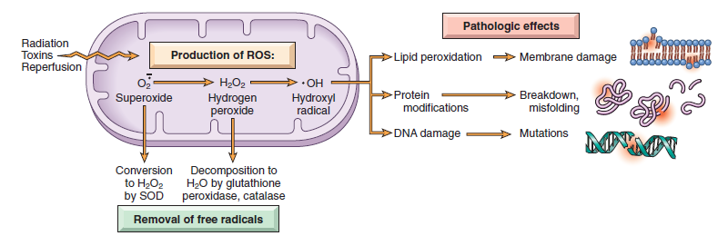

Slide 12
Effects or ROS:
1-Lipid peroxidation of membranes.
(plasma, lysosomal & mitochondrial membranes)
2-Crosslinking and other changes in proteins.
( degradation, fragmentation, loss of enzymatic activity & misfolding).
3-DNA damage.
Single strand breaks, mediate: apoptosis, aging, malignant transformation
4-Killing of microbes.

Slide 13
Cell Injury Caused by Toxins
Environmental chemicals & substances produced by infectious pathogens.
Direct-acting toxins
Latent toxins.

Slide 14
Direct-acting toxins
Act directly by combining with a critical molecular component or cellular organelle.
Mercuric chloride poisoning
Contaminated seafood
Mercury binds to sulfhydryl groups of membrane proteins>>inhibit ATP-dependent transport and increase permeability.
Chemotherapeutic agents
Toxins from microorganisms.

Slide 15
Latent toxins
Not intrinsically active
Must be converted to reactive metabolites, then act on target cells.
Via cytochrome P-450 in SER of the liver.
Damage mainly by formation of free radicals>>membrane phospholipid peroxidation.
CCl4 and acetaminophen.
Membrane peroxidation>>>>damage
ER membranes >> detachment of ribosomes>>decline in synthesis of enzymes and proteins +decreased synthesis of apoproteins >> fatty liver
Mitochondrial membranes>> decreased ATP >> cell swelling >> cell death.

Slide 16
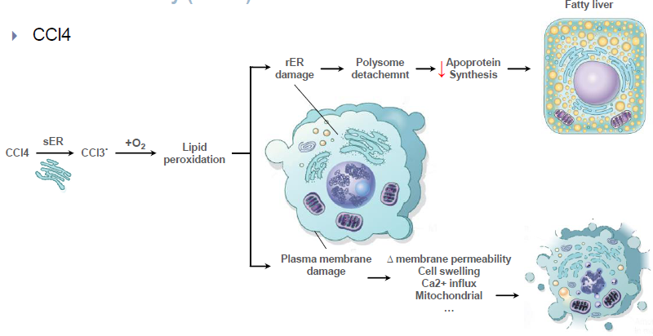
CCL4 toxicity

Slide 17
Endoplasmic Reticulum Stress
Chaperones in ER control proper protein folding
Misfolded proteins >> ubiquinated >> targeted to proteolysis
Unfolded protein response (adaptive response):increase chaperones production, decrease protein translation and increase destruction.
If failed >> proapoptotic sensor activation (BH3-only family) + direct activation of caspases >>apoptosis by the mitochondrial pathway.

Slide 18
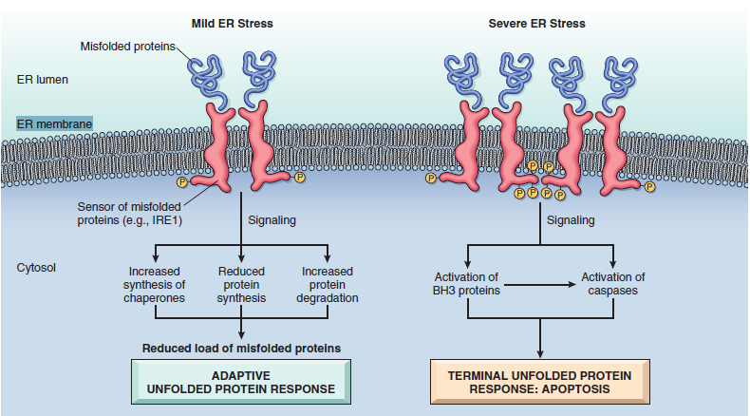

Slide 19
Causes of misfolding
Gene mutations
Aging (decreased capacity to correct misfolding)
Infections, especially viral infections (microbial proteins)
Increased demand for secretory proteins such as insulin in insulin-resistant states
Changes in intracellular pH
Neurodegenerative diseases
Deprivation of glucose and oxygen in ischemia and hypoxia.

Slide 20
Protein misfolding causes disease by:
Deficiency of an essential protein due to degradation
Cystic fibrosis
Inducing apoptosis of the affected cells
Neurodegenerative disorders (Alzheimer disease, Huntington disease & Parkinson disease), type 2 diabetes and prions disease.
Inducing both:
Alpha 1 antitrypsin deficiency.
Improperly folded proteins accumulation in extracellular tissues
Amyloidosis

Slide 21
DNA Damage
Radiation
Chemotherapeutic agents
Intracellular generation of ROS
Mutations
DNA damage >> p53 activation >>arrest cell cycle at G1 phase for repair >> if repair is impossible >> apoptosis.
In P53 mutations >> mutated cells replicate >> neoplastic change.

Slide 22
Inflammation
Pathogens
Necrotic cells,
Dysregulated immune responses (autoimmune diseases and allergies)
Inflammatory cells (neutrophils, macrophages, lymphocytes) secrete products that destroy microbes and damage host tissues.

Slide 23
Common Events in Cell Injury From Diverse Causes
Mitochondrial Dysfunction
Defects in Membrane Permeability

Slide 24
Mitochondrial Dysfunction
Energy factory
Hypoxia, toxins, radiation.
In necrosis and apoptosis.
Consequences:
Failure of oxidative phosphorylation, ATP depletion.
Abnormal oxidative phosphorylation, formation of ROS
Mitochondrial permeability transition pores, loss of membrane potential.
Release of cytochrome c >> apoptosis

Slide 25
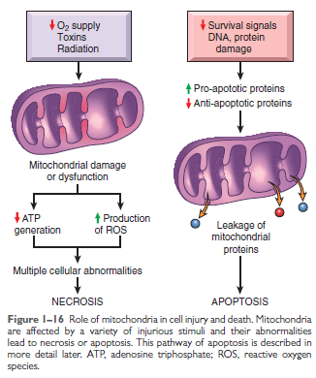
Mitochondrial Damage and Dysfunction

Slide 26
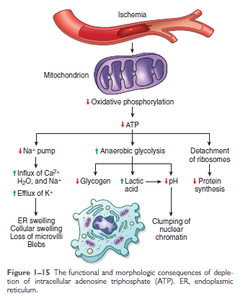
Depletion of ATP

Slide 27
Defects in Membrane Permeability
Mitochondrial membrane damage: decreased ATP
Plasma membrane damage: loss of osmotic balance, influx of fluids, leak of contents
Lysosomal membranes: leakage of enzymes >> cellular digestion.

