Slide 1
Cellular Adaptations
cell injury and adaptations
Manar Hajeer, MD, FRCPath
University of Jordan , school of medicine

Slide 2
Outlines:
Adaptive mechanisms
Hypertrophy
Hyperplasia
Atrophy
Metaplasia
Causes of cell injury.

Slide 3
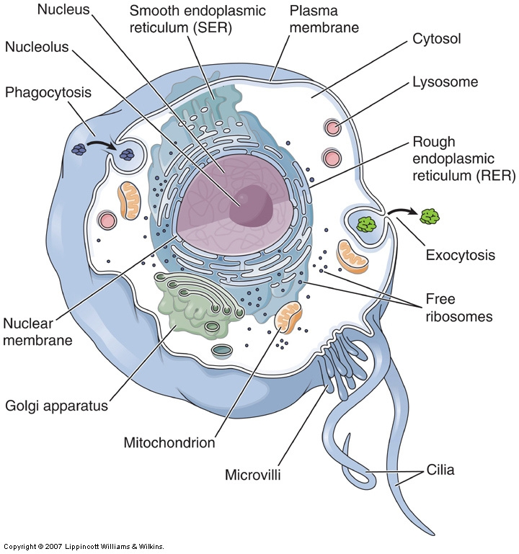

Slide 4
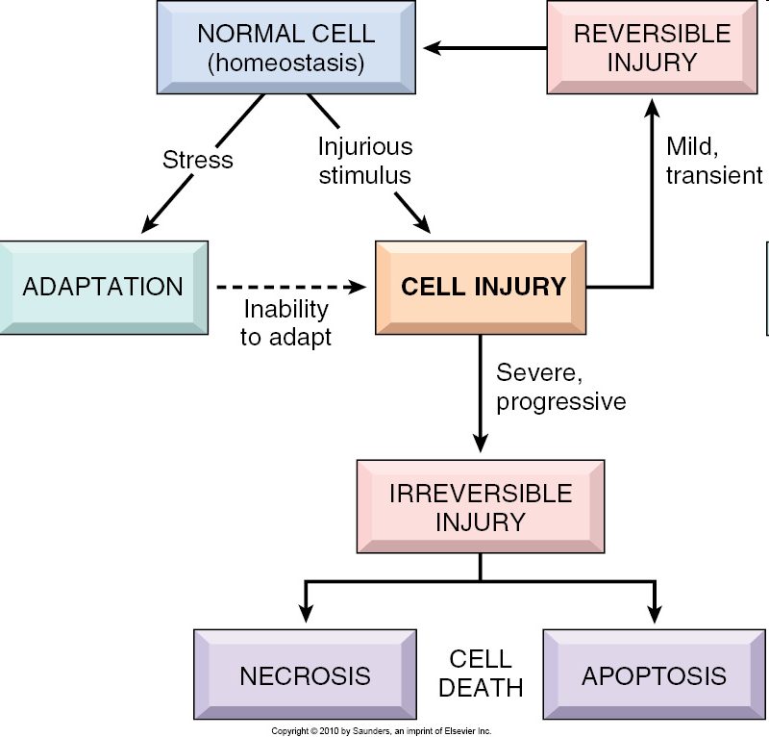
Notes:
FIGURE 1–1 Stages of the cellular response to stress and injurious stimuli.

Slide 5
Adaptations
Physiologic adaptation
Pathologic adaptation.

Slide 6
Adaptations
Many forms:
Increase in cell size.
Decrease in cell size.
Increase in number of cells.
Change into another type of cell
Adaptation to stress can progress to cell injury if the stress is not relieved.

Slide 7
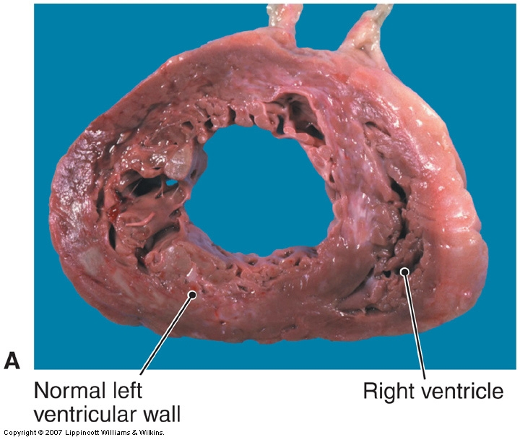
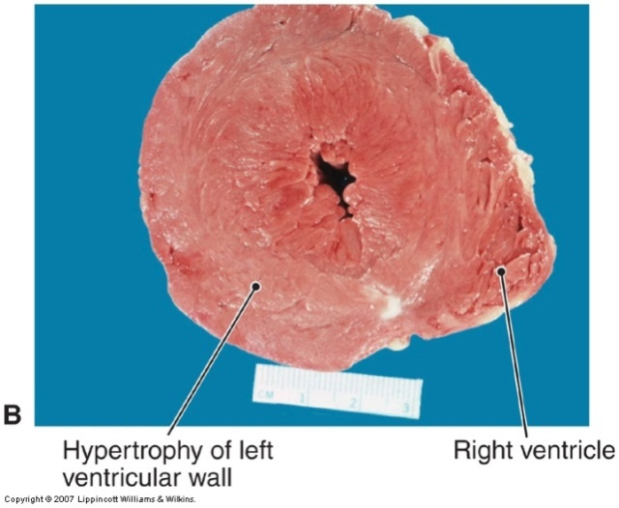
Hypertrophy
Increased size & functional capacity
Pure or mixed
Increased structural proteins and organelles.
Pathologic vs physiologic
Due to
  hormonal stimulation
  Growth factor stimulation
  increased functional demand

Slide 8
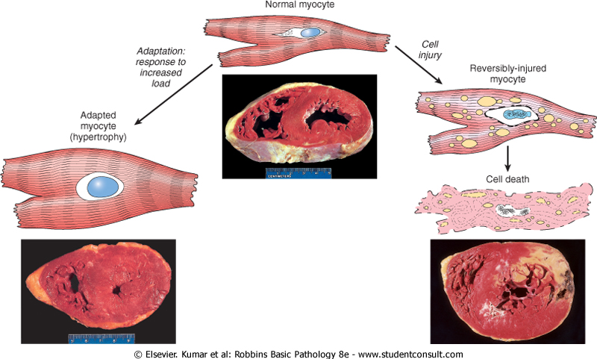
Pathologic cardiac muscle in hypertension and aortic stenosis

Slide 9
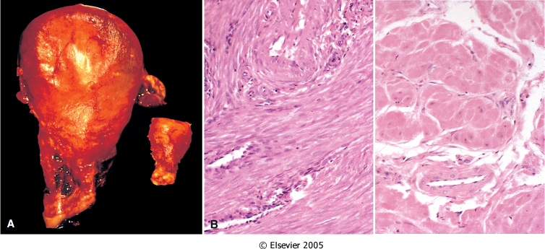
Physiologic uterine smooth muscle in pregnancy

Slide 10
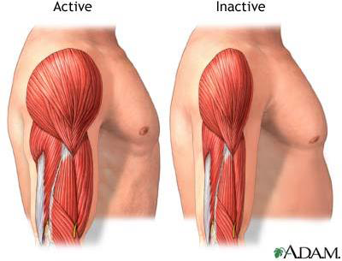
Physiologic skeletal muscle in athletes

Slide 11
Hyperplasia
Increase in number of cells
Tissues that have proliferative ability
Pure vs Mixed
Physiologic vs Pathologic vs cancer
Physiologic hyperplasia:
  hormonal stimulation
  Compensatory
Pathologic hyperplasia
  excessive hormonal stimulation
  Viral Infections
Pathologic hyperplasia constitutes a fertile soil in which cancers may eventually arise. (endometrial)

Slide 12
Physiologic
Breast in puberty and pregnancy
Liver after partial resection
Pathologic
Endometrial hyperplasia, estrogen induced.
Benign prostatic hyperplasia, androgen induced.
Warts (HPV).

Slide 13
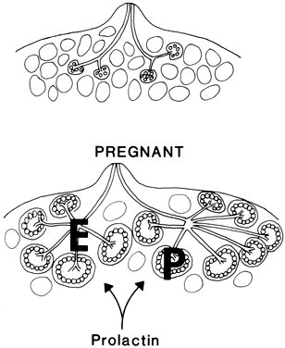
Physiologic breast in pregnancy and lactation

Slide 14
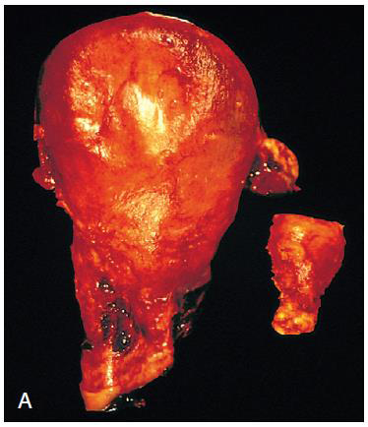
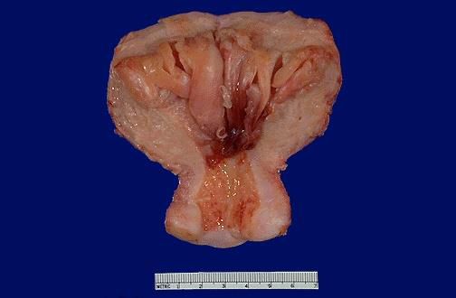
Pathologic endometrial hyperplasia, estrogen induced

Slide 15
Atrophy
Decreased cell size & function
Mechanism: ↓ Protein synth
↑ Degradation
↑ Autophagy
Atrophic cells can still function

Slide 16
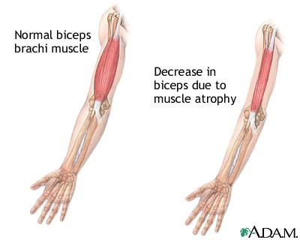
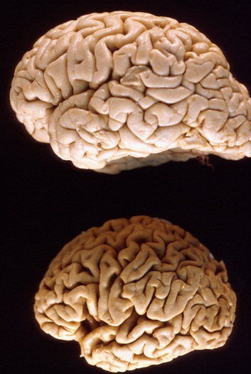
Causes:
Decreased workload (immobilization of a limb after fracture)
Loss of innervations
Diminished blood supply,
Inadequate nutrition
Loss of endocrine stimulation
Aging (senile atrophy)

Slide 17
Physiologic
Loss of hormone stimulation in menopause (endometrial atrophy)
Pathologic
Denervation injury.
Chronic ischemia.

Slide 18
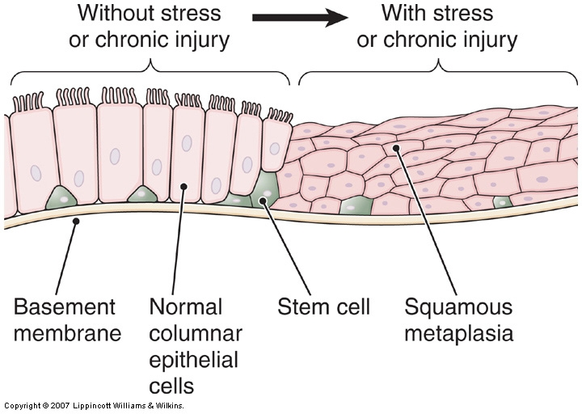
Metaplasia
Change from one cell type to another
Reprogramming of stem cells NOT differentiated cells
Persistent change increases risk of cancer
New cell type copes better with stress but function less.
Reversible
Causes: Smoking , Vitamin A deficiency, GERD.
Vitamin A is needed for normal epithelial differentiation, deficiency leads to squamous metaplasia of the bronchi)

Slide 19
Cell injury and death

Slide 20
CAUSES OF CELL INJURY
Oxygen Deprivation (Hypoxia Vs ischemia)
Chemical Agents
Infectious Agents
Immunologic Reactions
Genetic Factors
Nutritional Imbalances
Physical Agents
Aging

Slide 21
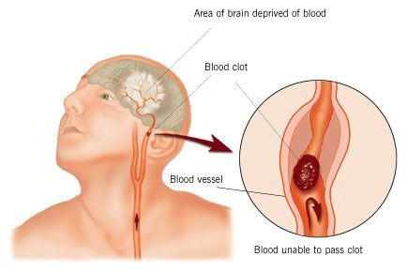

Oxygen Deprivation

Slide 22
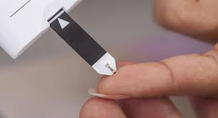
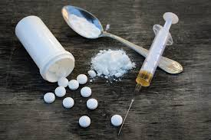

Chemical Agents

Slide 23
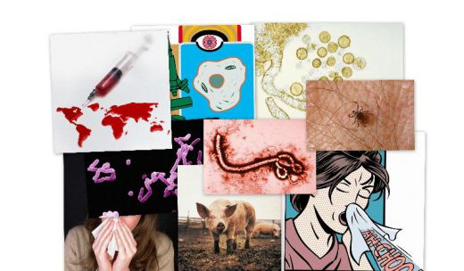
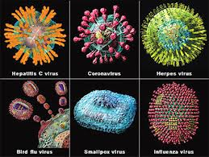
Infectious Agents

Slide 24
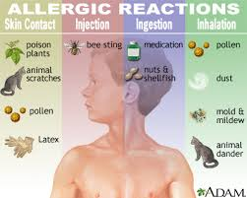
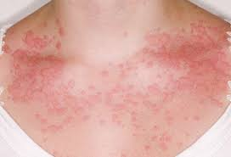
Immunologic Reactions autoimmune, allergic, microbes

Slide 25
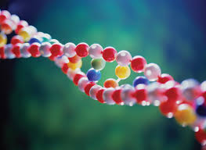
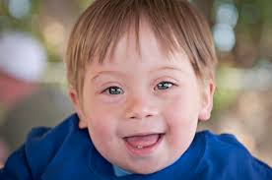
Genetic Factors

Slide 26
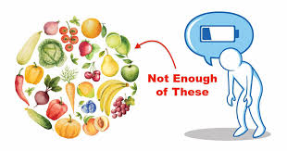
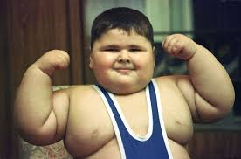

Nutritional Imbalances

Slide 27
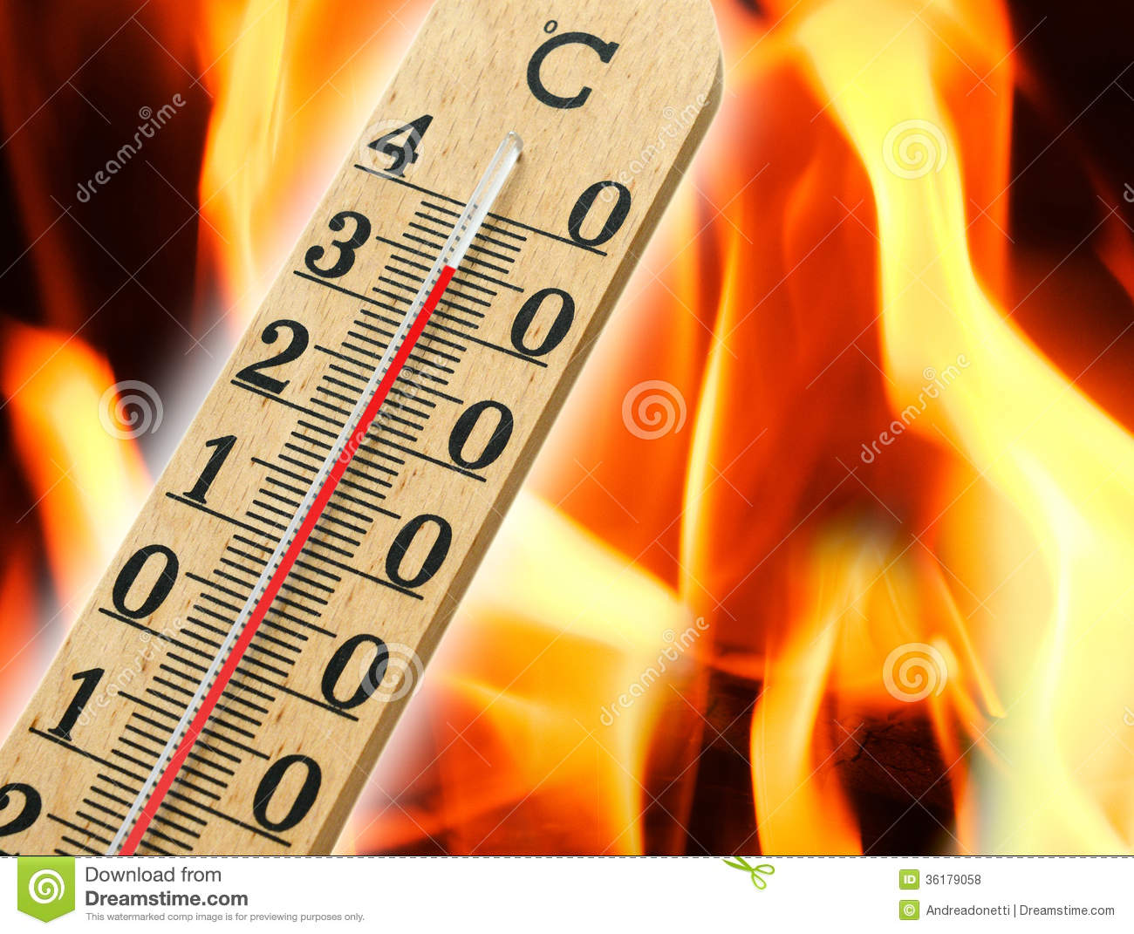
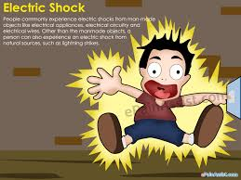
Physical Agents

