Slide 1
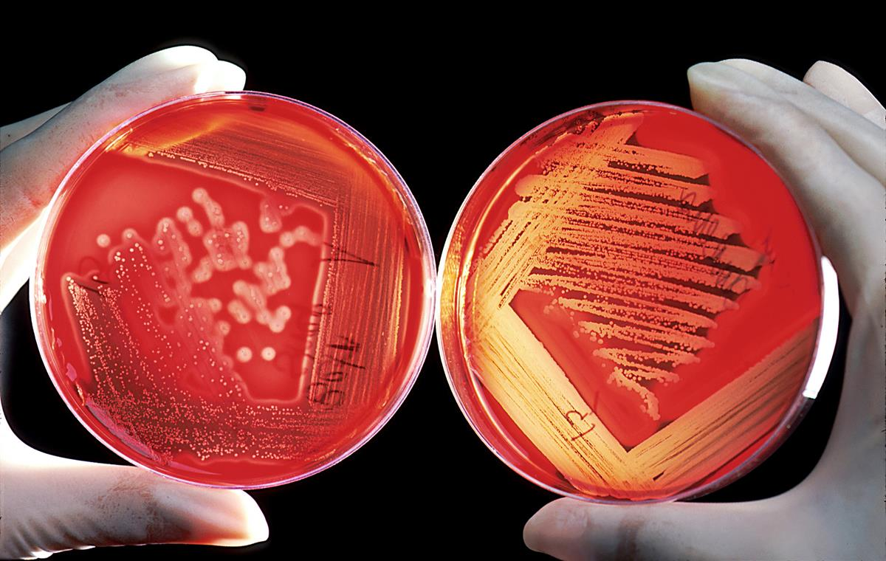
Introduction to Microbiology
Anas Abu-Humaidan M.D. Ph.D.
Human microbiota

Slide 2
Microbiota
Throughout thousands of years, humans of various origins and lifestyles collected a unique array of non-pathogenic microorganisms, Mostly bacteria, and recently recognized fungi and even viruses.
This microbiota is established early in life and changes throughout life. Some are considered resident and some are transient.
Almost 1.3:1 bacteria:human cell number. Previously said to be 10:1.
Not all bacteria are bad, some are even beneficial.
Each organ has its unique microbiota.
Studying and characterizing our microbiota is a burgeoning field of research !
Notes:
Can be changed with a simple handshake
Scrubbing can momentarily change microbiota

Slide 3
Microbiota
A microbiota is an "ecological community of commensal, symbiotic and pathogenic microorganisms” found in and on all multicellular organisms studied to date from plants to animals.
The synonymous term microbiome describes either the collective genomes of the microorganisms that reside in an environmental niche or the microorganisms themselves.
Notes:
Can be changed with a simple handshake
Scrubbing can momentarily change microbiota

Slide 4
Where is the human microbiota primarily found in the body?
a) Only on the skin surface
b) Exclusively in the gastrointestinal tract
c) Distributed across various body sites such as the skin, oral cavity, gastrointestinal tract, and more
d) Mainly in the respiratory system

Slide 5

The human microbiome project
In a broad attempt to understand the role played by resident microbial ecosystems in human health and disease, in 2007, the National Institutes of Health launched the Human Microbiome Project. One of the main goals of this project is to understand the range of human genetic and physiologic diversity of the microbiome, and the factors that influence the distribution and evolution of the constituent microorganisms.
Microbial communities will be investigated using small-subunit (16S) ribosomal RNA gene sequencing. Other tools could include Mass spectrometry. Culturing could be difficult and would under represent the variation since not all microbes are culturable.
How stable and resilient is an individual’s microbiota throughout one day and during his or her lifespan? How similar are the microbiomes between members of a family or members of a community or across communities in different environments?
Do all humans have an identifiable “core” microbiome, and if so, how is it acquired and transmitted? What affects the genetic diversity of the microbiome, and how does this diversity affect adaptation by the microorganisms and the host to markedly different lifestyles and to various physiological or pathophysiological states?

Slide 6
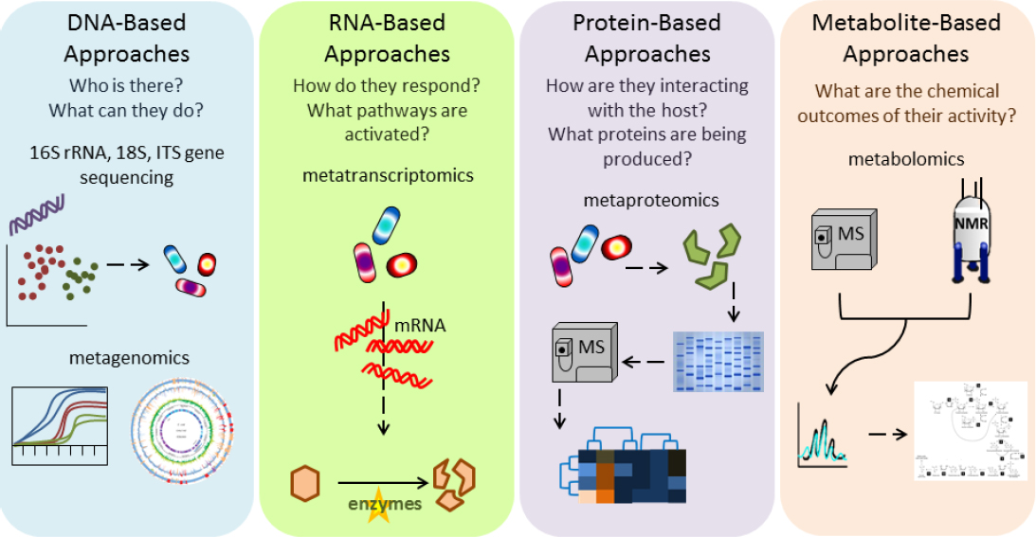
The human microbiome project

Slide 7
The most commonly used way to investigate the diversity of bacterial microbiota species in a sample from the human gut is:
Use of selective culture media
Use of differential culture media
Biochemical testing
DNA-based approaches (e.g. metagenomics)

Slide 8
The skin microbiota
Despite the harsh physical landscape of skin, particularly the desiccated, nutrient-poor, acidic environment, fatty acids in sebaceous secretions, and the presence of lysozyme and antimicrobial peptides, the skin is colonized by a diverse microbiota.
The skin is particularly apt to contain transient microorganisms. Nevertheless, there is a constant and well-defined resident flora, modified in different anatomic areas by secretions, habitual wearing of clothing, or proximity to mucous membranes (mouth, nose, and perineal areas.)
The predominant resident microorganisms of the skin are aerobic and anaerobic diphtheroid bacilli (eg, Corynebacterium, Propionibacterium); nonhemolytic aerobic and anaerobic staphylococci (Staphylococcus epidermidis and other coagulase-negative staphylococci).
The skin microbiota is thought to help in fighting pathogenic bacteria, Disturbance of the skin barrier can lead to infections that might involve resident microbiota.
Notes:
Hand shake can transmit micriobiota

Slide 9
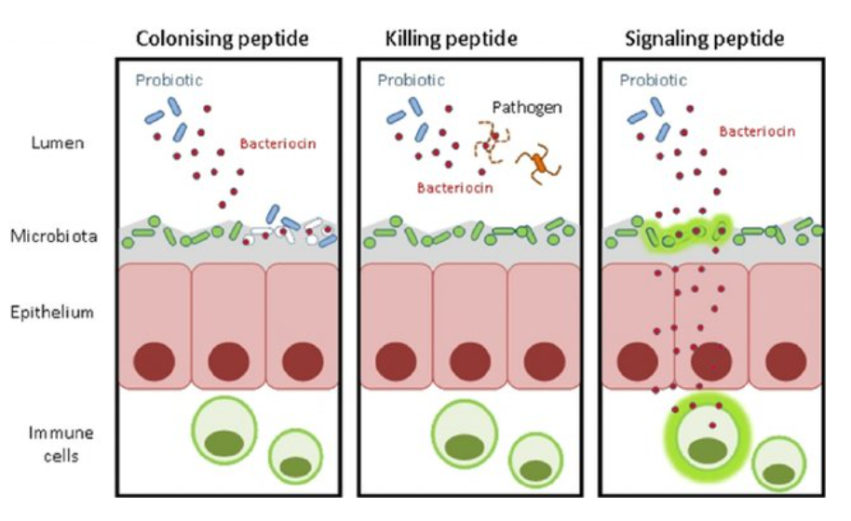
The skin microbiota
The commensal microbiota of the skin contributes to host health and is thought to play a role in protecting the host against a wide range of infections. One such defence mechanism is the production of bacteriocins.

Slide 10
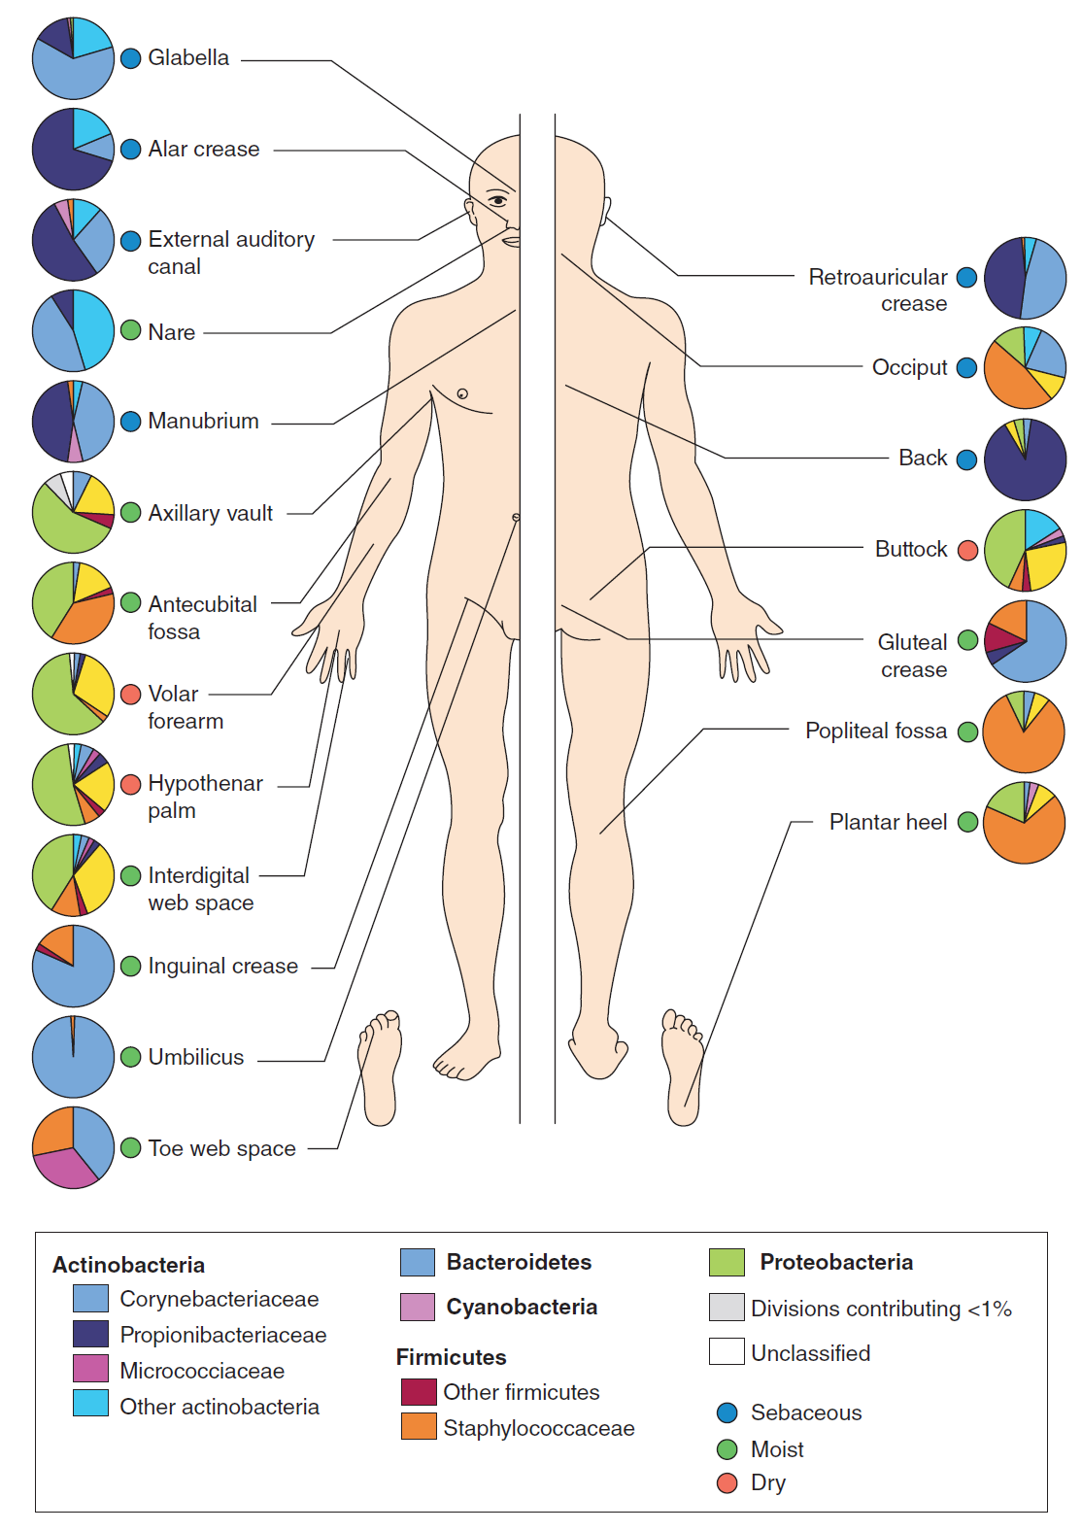
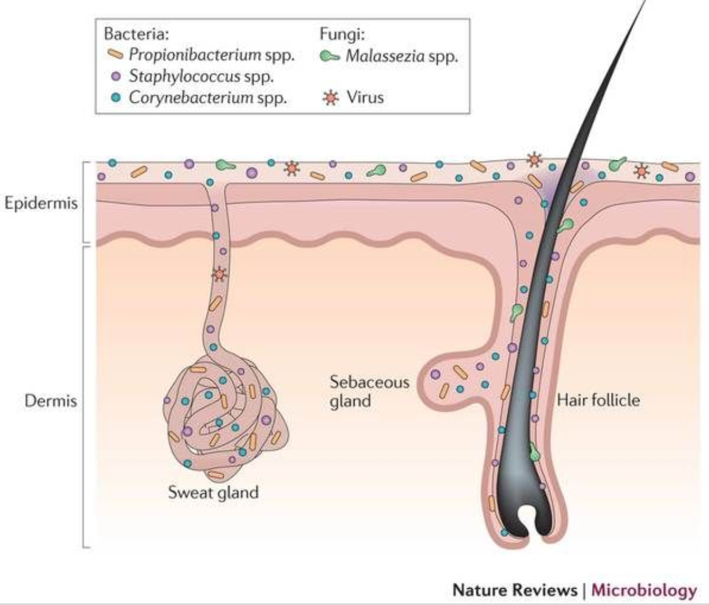

Slide 11
The skin microbiota contributes to the body's immune system by:
a) Triggering allergies
b) Producing vitamin D
c) Competing with potential pathogens
d) Controlling blood sugar levels

Slide 12
The gut microbiota
Among the different non-sterile cavities, the human gut harbors the most complex microbiota, with a strong impact on host homeostasis and immunostasis, being thus essential for maintaining the health condition.
The GIT microbiota exhibits a huge diversity, being individually shaped by numerous and incompletely elucidated factors, such as host genetics, gender, age, immune system, health/disease condition, geographic and socio-economical factors (urban or rural, sanitary conditions), treatments, diet.

Slide 13
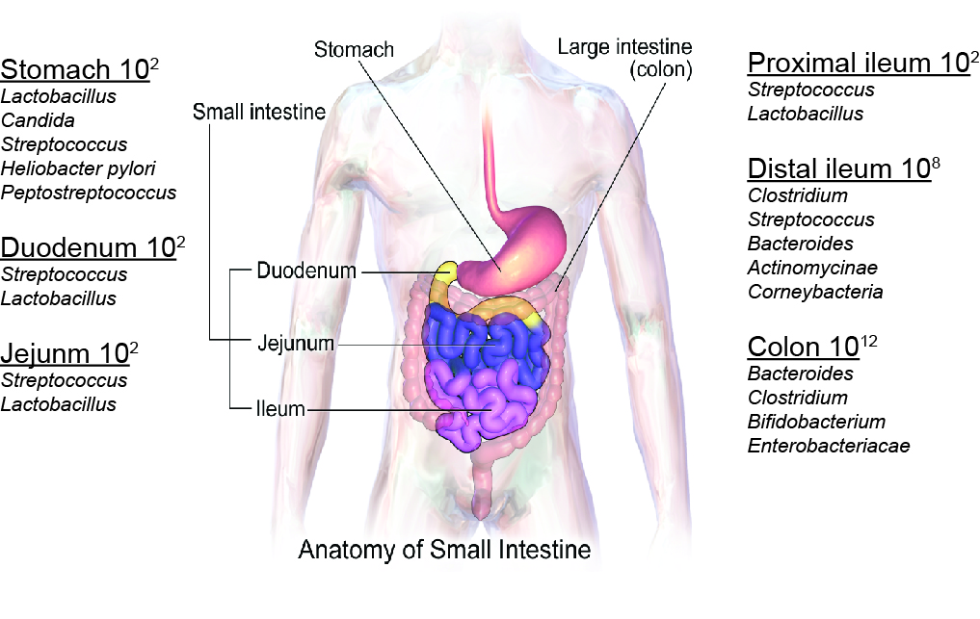
The gut microbiota
The GIT contains at least 10¹⁴ microorganisms belonging to >1,000 species
Anaerobes outnumber facultative organisms in the colon by 1000-fold.

Slide 14
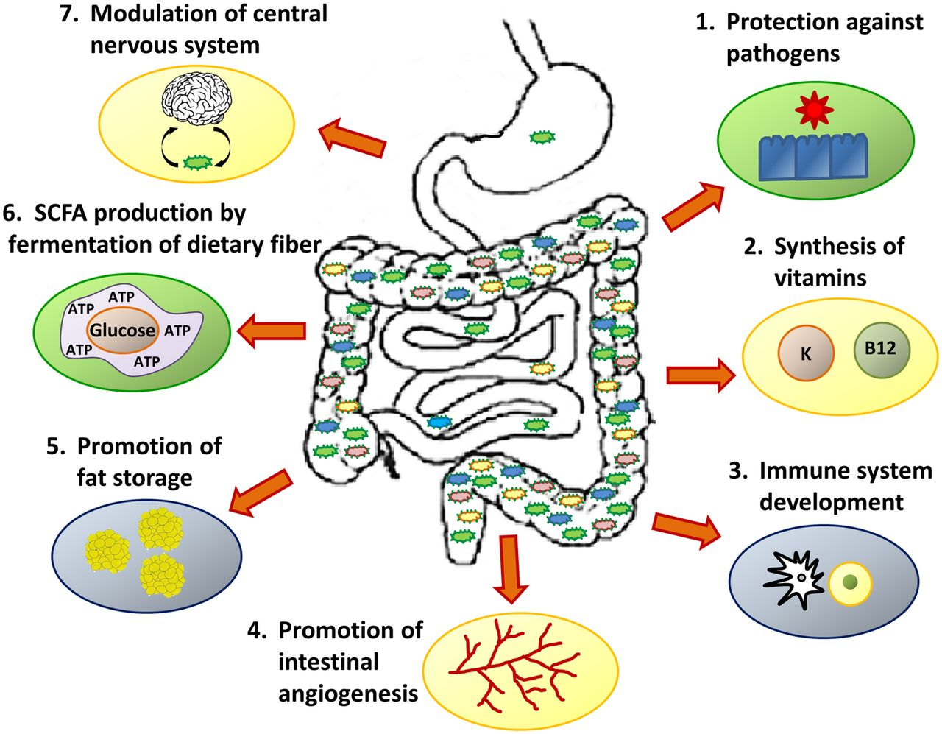
The gut microbiota
“Gut microbiota have beneficial effects offered to the host including providing essential nutrients by metabolizing indigestible dietary compounds, defending against opportunistic pathogen colonization by nutrient competition and antimicrobial substance production, and contributing to intestinal epithelial barrier. ”

Slide 15
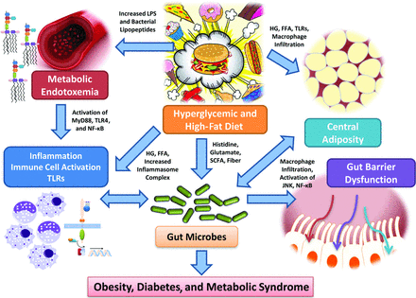
The gut microbiota
Food can affect the type of microbiome we have

Slide 16
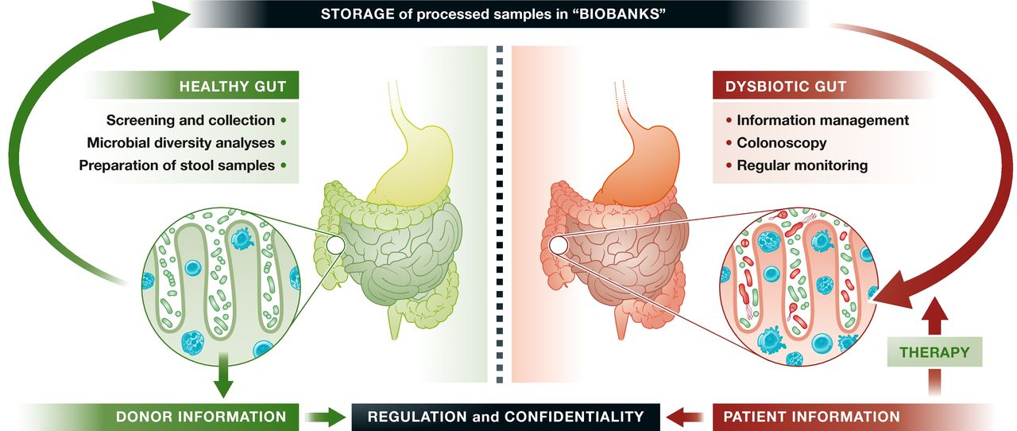
The gut microbiota
Effectiveness of Fecal matter transplant (FMT) has been established in clinical trials for the treatment of Clostridium difficile infection (CDI).
Future perspectives in microbiome studies involve finding the ”healthy” microbiome for individuals.
Notes:
he US Food and Drug Administration (FDA) has recently issued a draft guidance document for using FMT to treat infec
he effectiveness of FMT has been established in clinical trials for the treatment of Clostridium difficile infection (CDI),^{[2][3]} whose effects can range from diarrhea to pseudomembranous colitistions with C. difficile that do not respond to standard therapie
Or probiotics

Slide 17
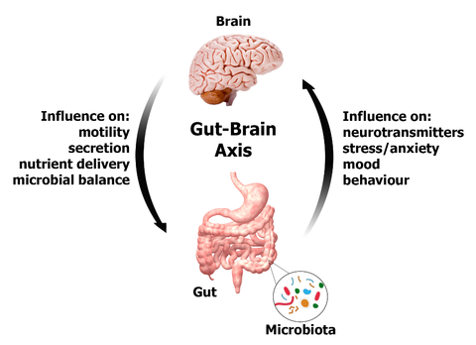
The gut microbiota
The altered bidirectional neurohumoral communication system between gut and brain – known as the gut-brain axis – may cause a series of diseases, such as autoimmune and CNS disorders

Slide 18
The respiratory tract microbiota
The microbiota of the respiratory tract probably acts as a gatekeeper that provides resistance to colonization by respiratory pathogens.
The respiratory microbiota might also be involved in the maturation and maintenance of respiratory physiology and immunity homeostasis.
The pH gradually increases along the respiratory tract, whereas most of the increases in relative humidity (RH) and temperature occur in the nasal cavity, oxygen and carbon dioxide concentrations also vary along the respiratory tract.
inhalation results in the deposition of particles from the environment into the respiratory tract; inhaled particles that are more than 10 μm in diameter are deposited in the upper respiratory tract (URT), whereas particles less than 1 μm in diameter can reach the lungs. These particles include bacteria-containing and virus-containing particles, which are typically larger than 0.4 μm in diameter.

Slide 19
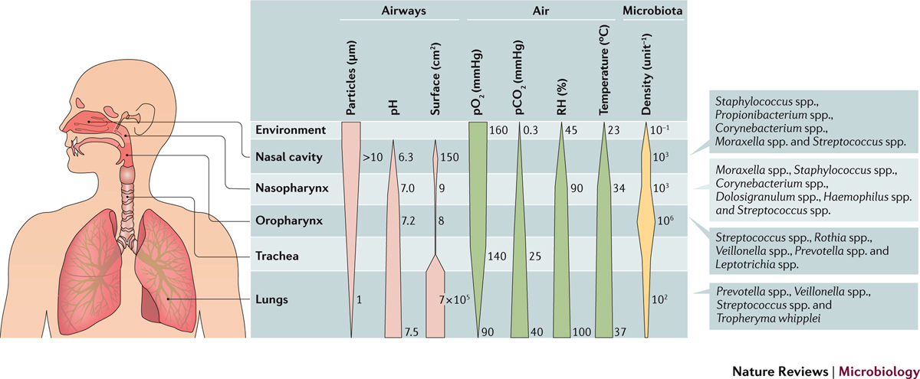
The respiratory tract microbiota
In healthy children and adults, a unique microbial community in the lungs was found that contained many of the bacteria that are common to the URT. A study in young children reported that although the lung microbiota was distinct from the microbiota of the URT, it was dominated by species that are also present in the URT, including Moraxella spp., Haemophilus spp., Staphylococcus spp. and Streptococcus spp.
In health, the lung microbiota is a community of transiently present microorganisms that are derived from the URT, rather than a thriving, resident community as is commonly found in chronic respiratory diseases.

Slide 20
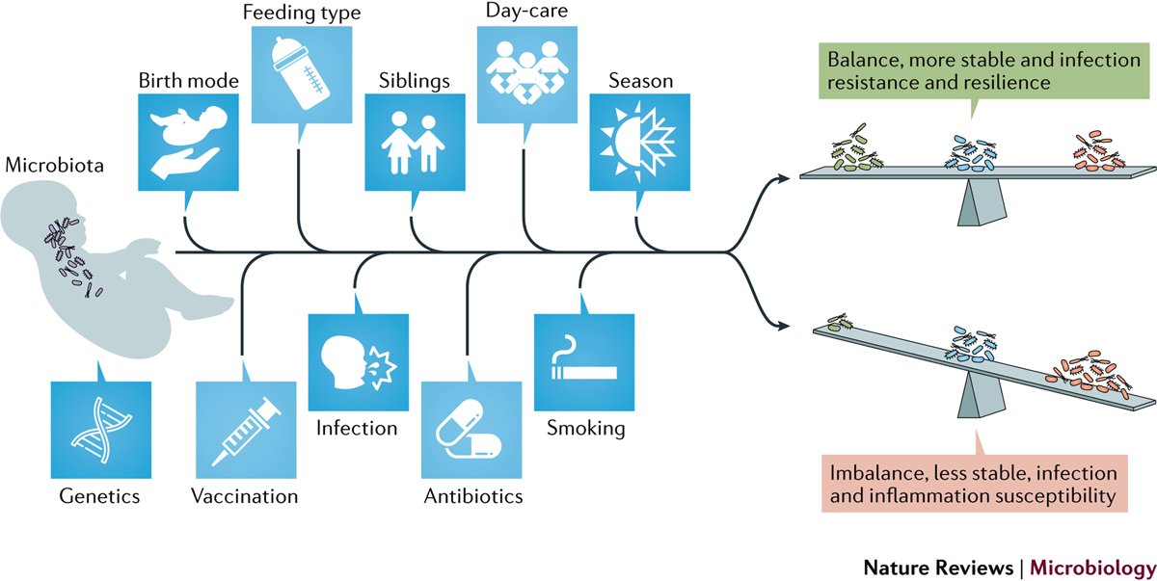
The respiratory tract microbiota

Slide 21
The urogenital tract microbiota
The tip of the urethera can contain some bacteria that might appear in urine samples, yet emerging evidence indicates urine might not be sterile after all.
Soon after birth, aerobic lactobacilli appear in the vagina and persist as long as the pH remains acidic (several weeks). When the pH becomes neutral (remaining so until puberty), a
mixed flora of cocci and bacilli is present. At puberty, aerobic and anaerobic lactobacilli reappear in large numbers and contribute to the maintenance of acid pH through the production of acid from carbohydrates.
Bacterial vaginosis is a syndrome marked by dramatic shifts in the types and relative proportions of the vaginal microbiota from a healthy environment containing Lactobacilli to a diseased one containing Actinobacteria and Bacteroidetes species.
Vaginally born infants have a microbiota containing species derived from the vaginal microbiota of their mothers. Conversely, in the case of cesarean section delivered babies, the microbiota is similar to the skin microbiota and is rich in Propionibacterium spp. and Staphylococcus spp.

Slide 22
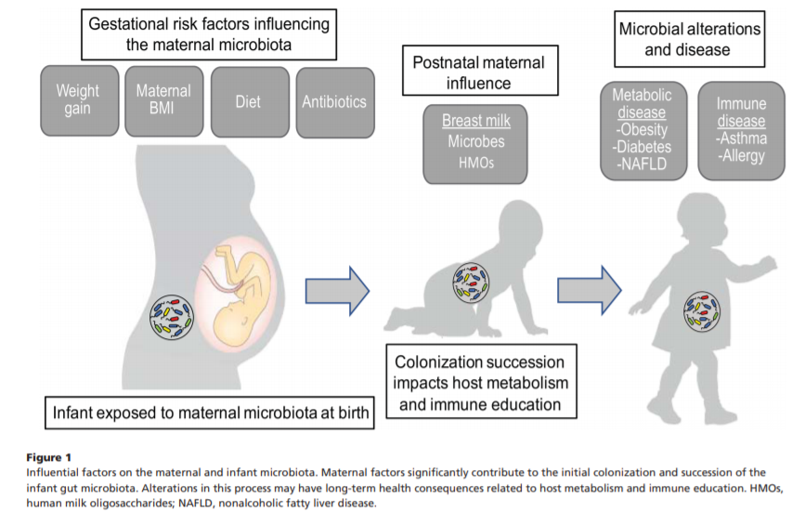
The urogenital tract microbiota
Vaginally born infants have a microbiota containing species derived from the vaginal microbiota of their mothers. Conversely, in the case of cesarean section delivered babies, the microbiota is similar to the skin microbiota and is rich in Propionibacterium spp. and Staphylococcus spp.

Slide 23
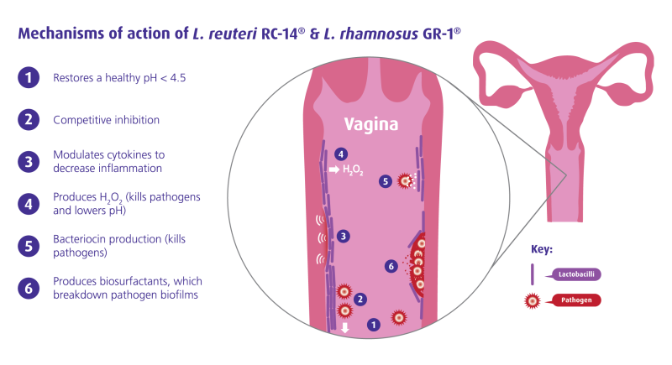
Taken from a website promoting probiotic therapy, proceed with caution!

Slide 24
The disruption of the normal balance of the microbiota is known as:
a) Dysbiosis
b) Homeostasis
c) Symbiosis
d) Eubiosis

Slide 25
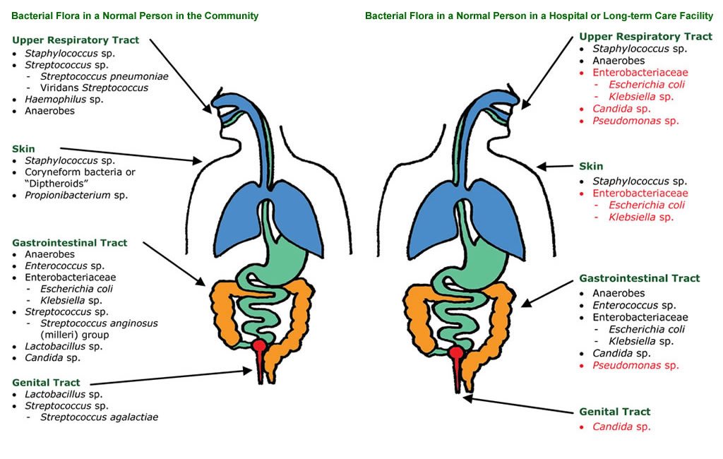
Microbiota variation in health and disease

Slide 26
Learning outcomes
For today’s lecture on human microbiota, here are four potential learning outcomes:
Describe the Composition and Diversity of Human Microbiota: Understand the various microorganisms that comprise the human microbiota, including bacteria, fungi, viruses, and archaea, and their distribution across different body sites.
Explain the Role of Microbiota in Health: Analyze the essential functions of the microbiota in maintaining physiological processes, such as digestion, immune modulation, and protection against pathogens.
Identify the Impact of Dysbiosis on Disease: Discuss how imbalances in the microbiota (dysbiosis) are associated with various health conditions, including gastrointestinal disorders, metabolic diseases, and immune dysfunction.
Explore Factors Influencing Microbiota Composition: Recognize factors that affect microbiota diversity and stability, such as diet, antibiotic use, environment, and lifestyle, and their implications for maintaining a healthy microbiome.

Slide 27
Further reading and material:
The human microbiome project
www.hmpdacc.org
Jawetz, Melnick & Adelberg's Medical Microbiology, 26th edition- Section 3: Bacteriology
Chapter 10: Normal human microbiota

