Slide 1

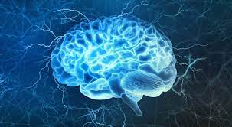
Introduction to Neurophysiology 4
Neural circuits
Fatima Ryalat, MD, PhD
Assistant Professor, Physiology and Biochemistry Department, School of Medicine, The University of Jordan

Slide 2
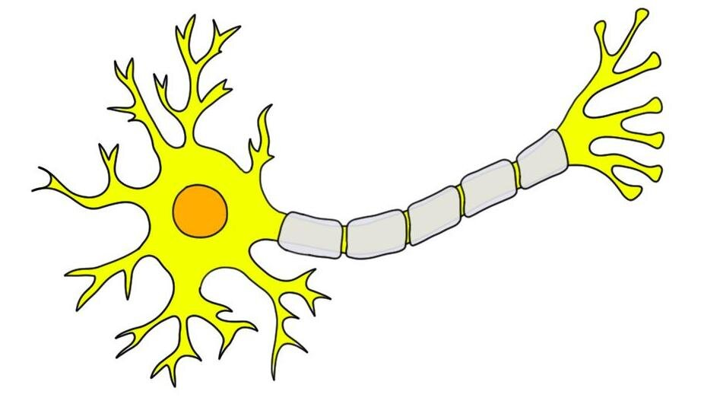
Input zone
Conductive zone
Integrative zone
https://journals.physiology.org/doi/full/10.1152/advan.00051.2003

Slide 3


threshold
Action potential
Postsynaptic potential (PSP)
Voltage gated channels
Ligand gated channels

Slide 4
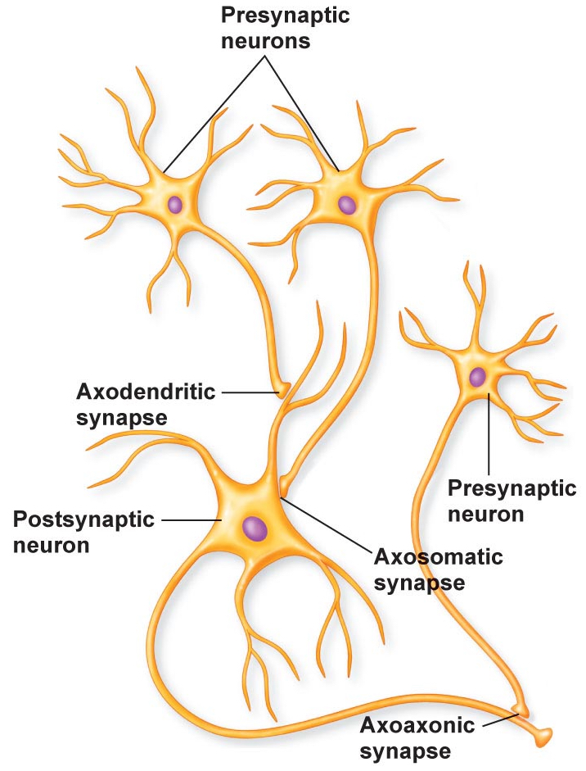

Slide 5
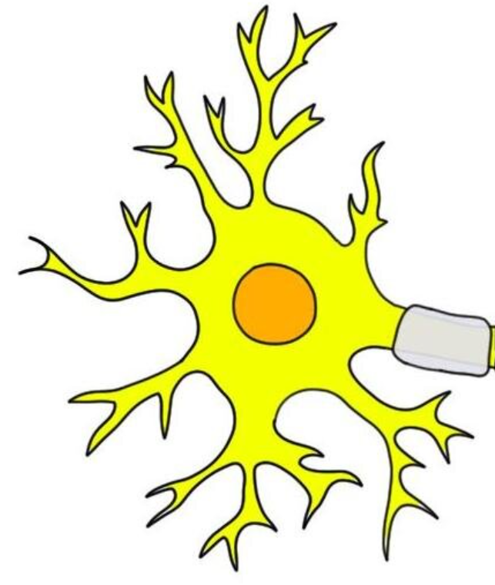
Dendrites:
Large spatial field of excitation.
A great opportunity for summation of signals from many neurons.

Slide 6
Most dendrites fail to transmit action potentials because their membranes have relatively few voltage-gated sodium channels, and their thresholds for excitation are too high for action potentials to occur.

Slide 7
Decremental conduction
The synapses that lie near the soma have far more effect in causing neuron excitation or inhibition than those that lie far away from the soma.

Slide 8
Action potential in the axon
Action potential does not begin adjacent to the excitatory synapses. Instead, it begins in the initial segment of the axon.
The main reason is that the soma has relatively few voltage gated sodium channels in its membrane, which makes it difficult for the EPSP to open the required number of sodium channels to elicit an action potential.

Slide 9
Action potential in the axon
The membrane of the initial segment of the axon has 7 times as great a concentration of voltage-gated Na+ channels as does the soma and, therefore, can generate an action potential with much greater ease than can the soma.
The threshold is lower in the axon initial segment than the soma.

Slide 10

1
2

Slide 11
IPSP -5 mV
EPSP +10 mV

Slide 12
Excitatory postsynaptic potential (EPSP)
This positive increase in voltage above the normal resting neuronal potential— that is, to a less negative value—is called the excitatory postsynaptic potential (or EPSP), because if this potential rises high enough in the positive direction, it will elicit an action potential in the postsynaptic neuron, thus exciting it.
EPSP is +20 millivolts means 20 millivolts more positive than the resting value.

Slide 13
Inhibitory postsynaptic potential (IPSP)
Opening potassium or chloride channels.
An increase in negativity beyond the normal resting membrane potential level is called an inhibitory postsynaptic potential (IPSP).
IPSP is -20 millivolts means 20 millivolts more negative than the resting value.

Slide 14
Soma: uniform distribution of electrical potential:
Large diameter (less resistance to conductance).
Highly conductive electrolytic fluid.
(change in membrane potential will be transmitted equally to all parts of the soma.)

Slide 15
Resting membrane potential of neuronal soma
Any change in potential in any part of the intra-somal fluid causes an almost exactly equal change in potential at all other points inside the soma.
This principle is important because it plays a major role in “summation” of signals entering the neuron from multiple sources.

Slide 16
Summation in neurons
Excitation of a single presynaptic terminal on the surface of a neuron almost never excites the neuron.
The reason is that the amount of transmitter substance released by a single terminal to cause an EPSP is usually no greater than 0.5 to 1 millivolt, instead of the 10 to 20 millivolts normally required to reach threshold for excitation.

Slide 18


Slide 20
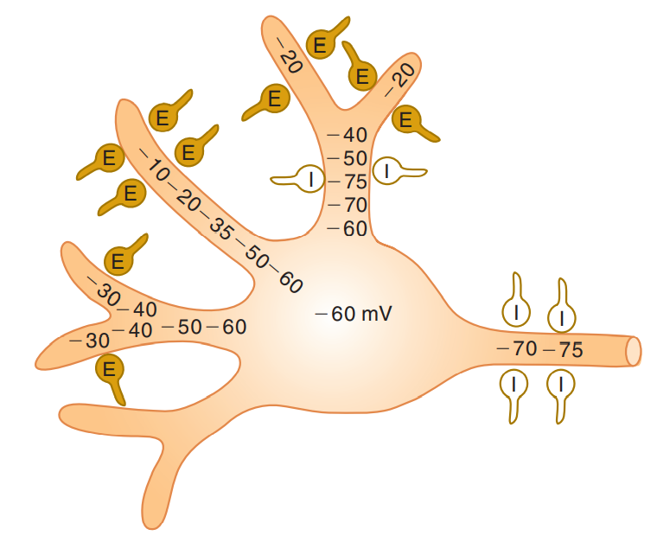

Slide 21
Presynaptic inhibition
In addition to inhibition caused by inhibitory synapses operating at the neuronal membrane, which is called postsynaptic inhibition.
Presynaptic inhibition is caused by release of an inhibitory substance onto the outsides of the presynaptic nerve fibrils before their own endings terminate on the postsynaptic neuron.
In most instances, the inhibitory transmitter substance is GABA.
This release has a specific effect of opening anion channels, allowing large numbers of Cl- ions to diffuse into the terminal fibril.

Slide 22
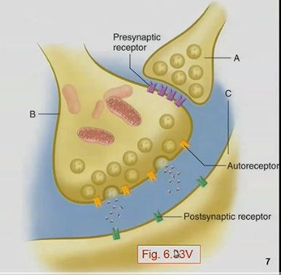

Slide 23
Presynaptic inhibition
Presynaptic inhibition occurs in many of the sensory pathways in the nervous system, such as, adjacent sensory nerve fibers often mutually inhibit one another, which minimizes sideways spread and mixing of signals in sensory tracts.

Slide 24
Facilitation of neurons
Often the summated postsynaptic potential is excitatory but has not risen high enough to reach the threshold for firing by the postsynaptic neuron.
When this situation occurs, the neuron is said to be facilitated.
That is, its membrane potential is nearer the threshold for firing than normal but is not yet at the firing level.
Consequently, another excitatory signal entering the neuron from some other source can then excite the neuron very easily.

Slide 25
EPSP 10 mV
IPSP 20 mV
RMP -65 mV
Threshold -55 mV
EPSP 5 mV

Slide 26
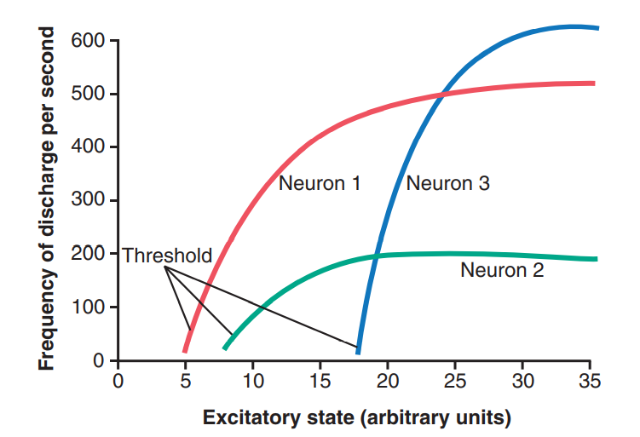

Slide 27
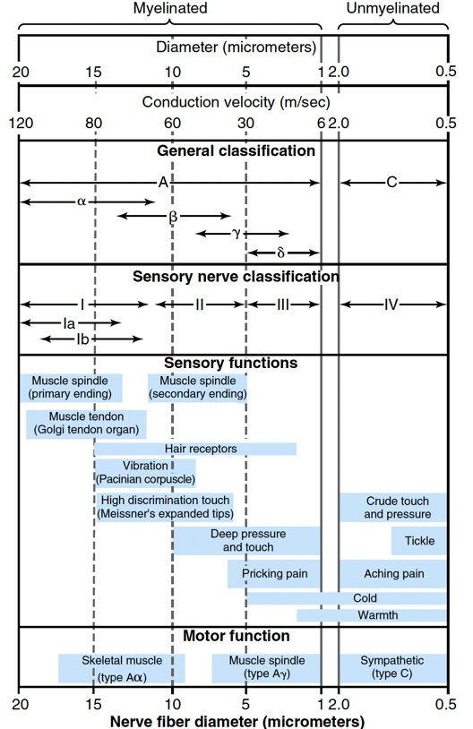

Slide 28
Neuronal pools
Functional groups of neurons occurring in the grey matter of the brain and spinal cord, which process and integrate incoming information received from other sources, such as the sense organs, and transmit the processed information to other destinations. (oxfordreference.com)
Each neuronal pool has its own special organization that causes it to process signals in its own unique way and perform certain function.

Slide 29
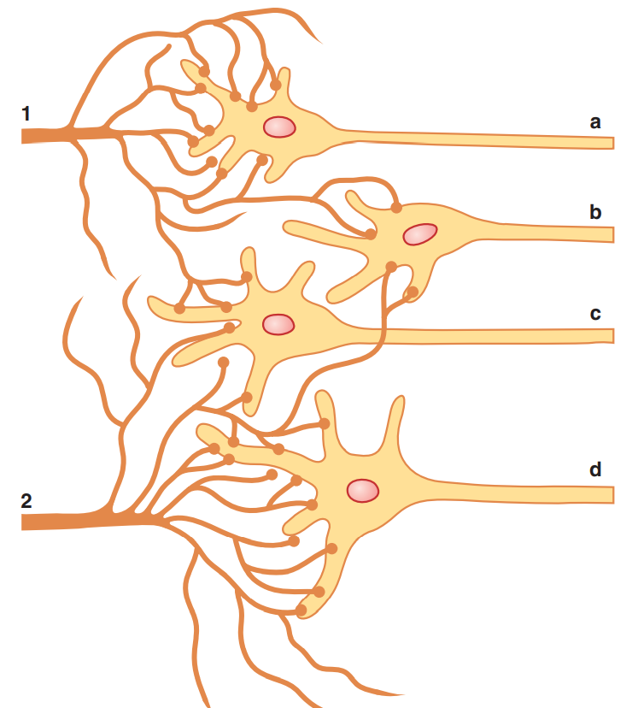
Stimulatory field:
The neuronal area stimulated by each incoming nerve fiber.

Slide 30
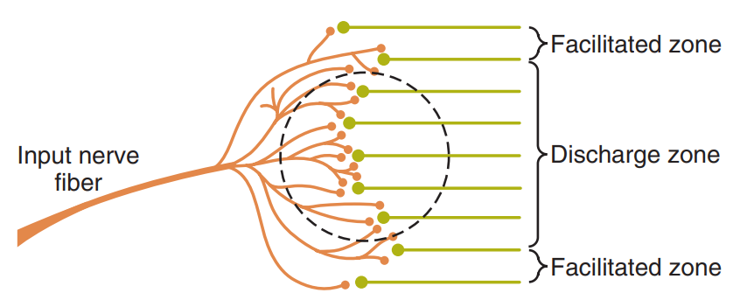

Slide 31
Inhibitory zone:
Greatest inhibition in the center of the zone.

Slide 32
Neuronal circuits
A group of interconnected neurons that perform certain function.

Slide 33
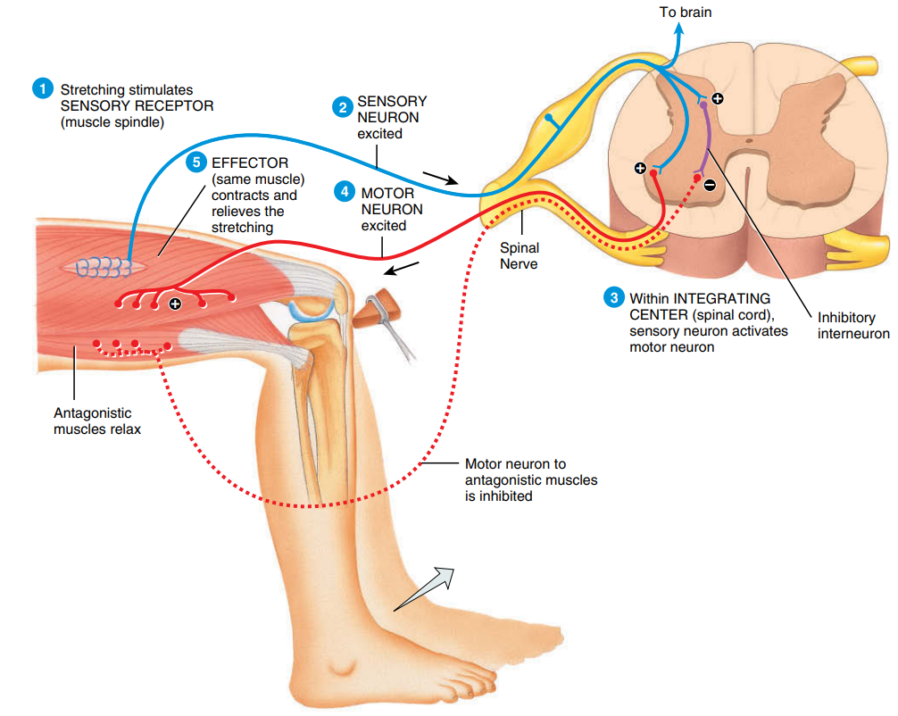

Slide 34
Reciprocal inhibition
Sometimes an incoming signal to a neuronal pool causes an output excitatory signal going in one direction and at the same time an inhibitory signal going elsewhere.
This type of circuit is characteristic for controlling all antagonistic pairs of muscles.

Slide 35
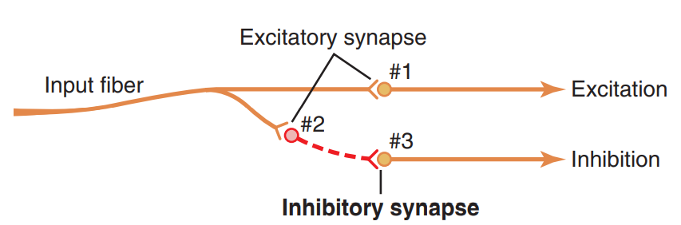
Reciprocal inhibition

Slide 36
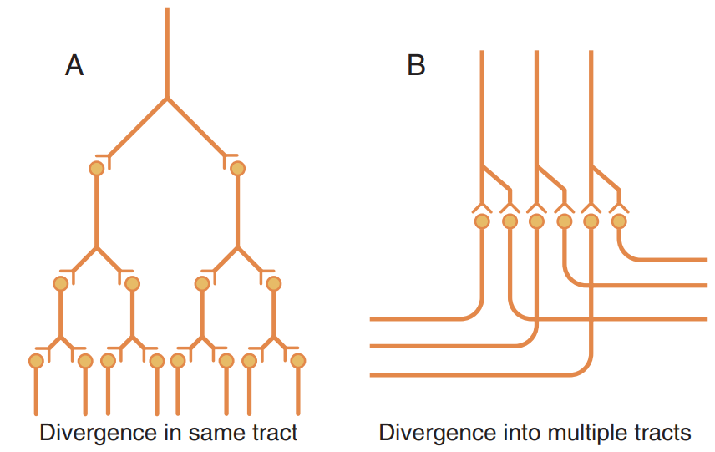

Slide 38
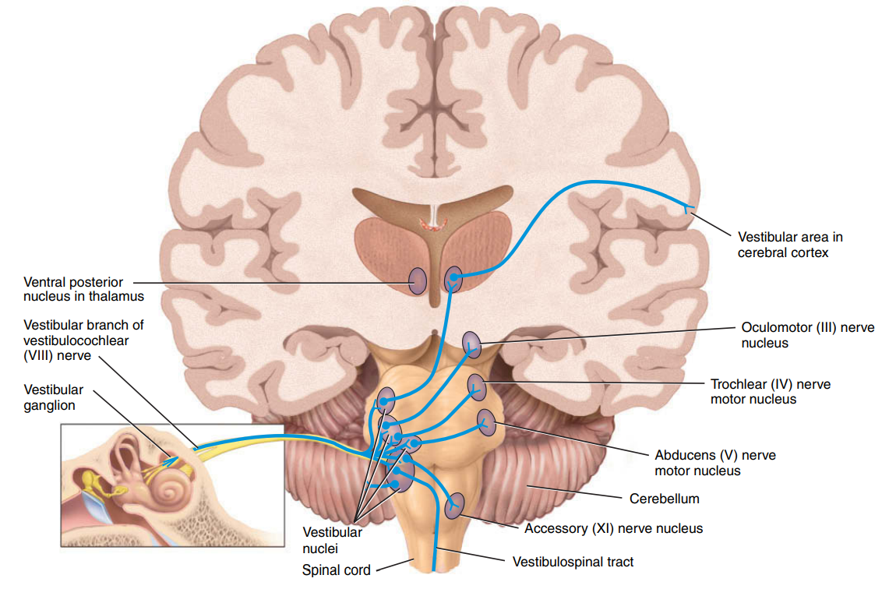
Divergence into multiple tracts

Slide 39
Amplifying divergence
Amplifying divergence means simply that an input signal spreads to an increasing number of neurons as it passes through successive orders of neurons in its path.

Slide 40
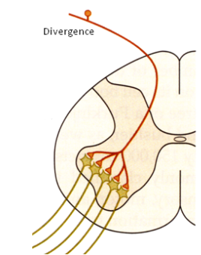
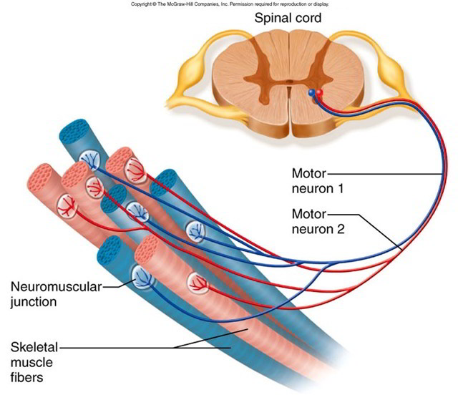
Amplifying divergence

Slide 41
Convergence
Convergence means signals from multiple inputs uniting to excite a single neuron.
The importance of this type is summation.
Convergence is one of the important means by which the central nervous system correlates, summates, and sorts different types of information

Slide 42
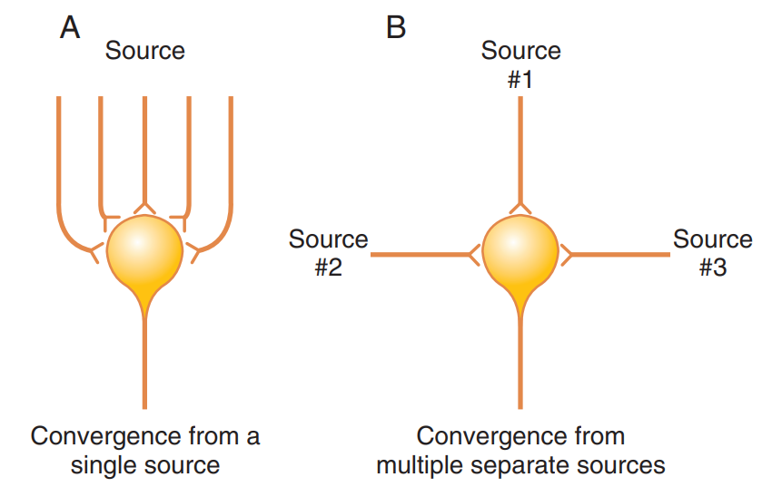

Slide 43
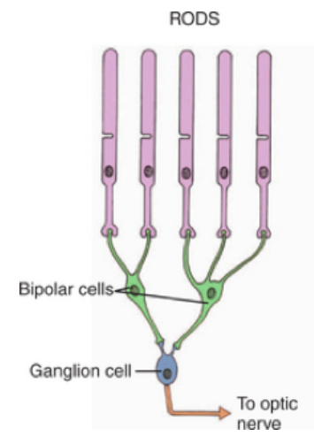
Convergence in photoreceptors (Rods)
http://veteriankey.com/retina/

Slide 44
After-discharge
A signal entering a pool causes a prolonged output discharge.
Synaptic afterdischarge: as in some neuropeptides.

Slide 45
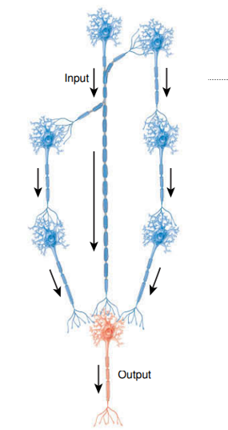
Parallel afterdischarge
Continued firing after the stimulus has stopped, so prolonged output discharge.
a neuron inputs to several chains of neurons.
Each chain is made up of a different number of neurons, but their signals converge onto one output neuron.
Reach output at varying times.
No feedback loop as in the reverberating circuit.
Saladin, K. Human anatomy (3rd ed.). McGraw-Hill. p. 364. ISBN 9780071222075.

Slide 46
Reverberatory (Oscillatory) circuits
One of the most important circuits in the nervous system.
Caused by positive feedback within the neuronal circuit that feeds back to re-excite the input of the same circuit.
Consequently, once stimulated, the circuit may discharge repetitively for a long time.

Slide 47
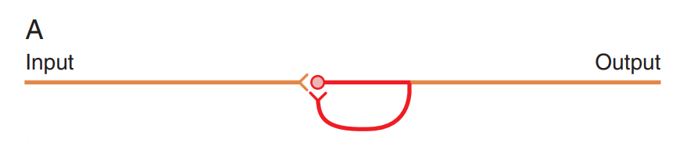
Reverberatory circuits
The output neuron sends a collateral nerve fiber back to its own dendrites or soma to restimulate itself.

Slide 48
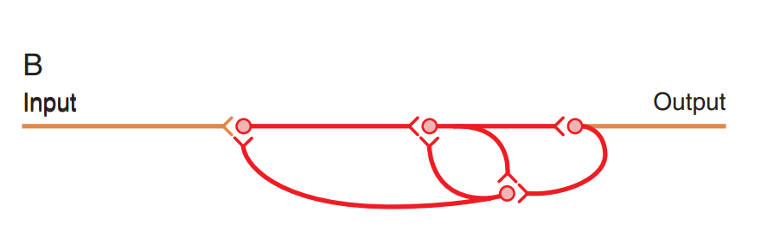
Reverberatory circuits
A few additional neurons in the feedback circuit, which causes a longer delay between initial discharge and the feedback signal.

Slide 49
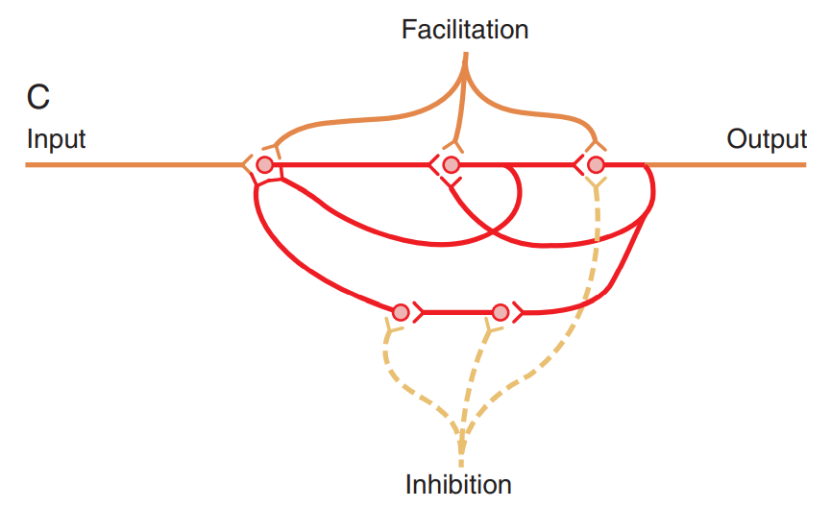
A facilitatory signal enhances the intensity and frequency of reverberation, whereas an inhibitory signal depresses or stops the reverberation.

Slide 50
Continuous signal output
Some neuronal circuits emit output signals continuously, even without excitatory input signals.
At least two mechanisms can cause this effect:
(1) continuous intrinsic neuronal discharge
(2) continuous reverberatory signals

Slide 51
Stability of neuronal circuits
Almost every part of the brain connects either directly or indirectly with every other part, which creates a serious challenge.
Two basic mechanisms that stabilize the central nervous system:
(1) inhibitory circuits
(2) fatigue of synapses.

Slide 52
Stability of neuronal circuits
INHIBITORY CIRCUITS
Two types of inhibitory circuits in widespread areas of the brain help prevent excessive spread of signals:
inhibitory feedback circuits that return from the termini of pathways back to the initial excitatory neurons of the same pathways (like in sensory nervous pathways).

Slide 53
Stability of neuronal circuits
INHIBITORY CIRCUITS
(2) some neuronal pools that exert gross inhibitory control over widespread areas of the brain (for instance, many of the basal nuclei exert inhibitory influences throughout the muscle control system).

Slide 54
Fatigue of synaptic transmission
Depletion of transmitter stores.
Progressive inactivation of postsynaptic membrane receptors.
Slow development of abnormal concentrations of ions inside the postsynaptic neuronal cell.

Slide 55
Effect of alkalosis on synaptic transmission
Most neurons are highly responsive to changes in pH of the surrounding interstitial fluids.
Alkalosis increases neuronal excitability and may cause cerebral epileptic seizures.
In a person who is predisposed to epileptic seizures, even a short period of hyperventilation, which lowers CO2 and elevates the pH, may precipitate an epileptic attack.

Slide 56
Effect of acidosis on synaptic transmission
Conversely, acidosis greatly depresses neuronal activity; a fall in pH may cause a comatose state.
For instance, in very severe diabetic or uremic acidosis, coma almost always develops.

Slide 57
Effect of hypoxia on synaptic transmission
Neuronal excitability is also highly dependent on an adequate supply of oxygen.
Cessation of oxygen for only a few seconds can cause complete inexcitability of some neurons.
This effect is observed when the brain’s blood flow is temporarily interrupted because within 3 to 7 seconds, the person becomes unconscious.

Slide 58
Effect of drugs on synaptic transmission
Many drugs are known to increase the excitability of neurons, and others are known to decrease excitability.
For instance, caffeine, theophylline, and theobromine, which are found in coffee, tea, and cocoa, respectively, all increase neuronal excitability, presumably by reducing the threshold for excitation of neurons.

Slide 59
Effect of drugs on synaptic transmission
Most anesthetics increase the neuronal membrane threshold for excitation and thereby decrease synaptic transmission at many points in the nervous system.

Slide 60
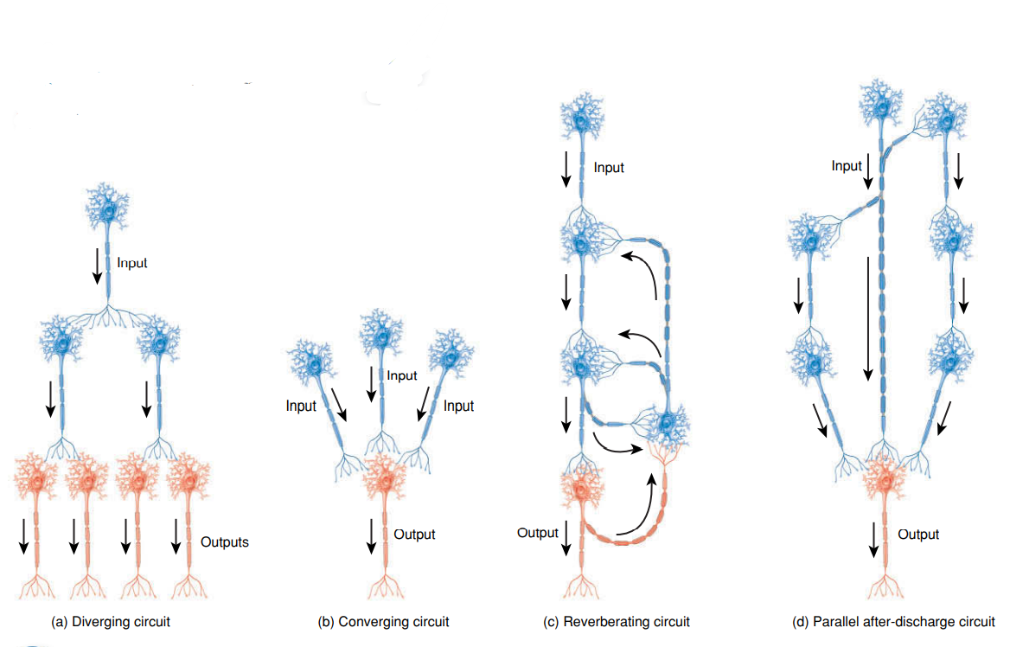
A B C D

Slide 61

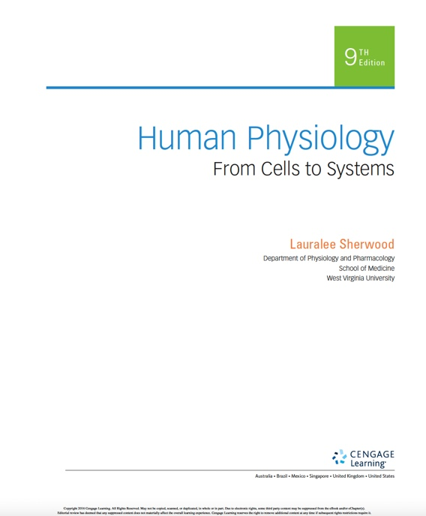
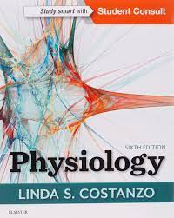
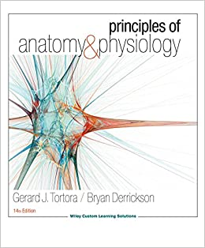
References

Slide 62


Questions? Feedback?
Thank you

