Slide 1

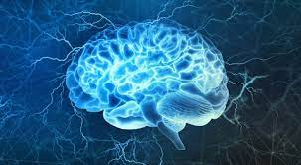
Introduction to Neurophysiology 3
Neurotransmitters and changes in membrane potential
Fatima Ryalat, MD, PhD
Assistant Professor, Physiology and Biochemistry Department, School of Medicine, The University of Jordan

Slide 2
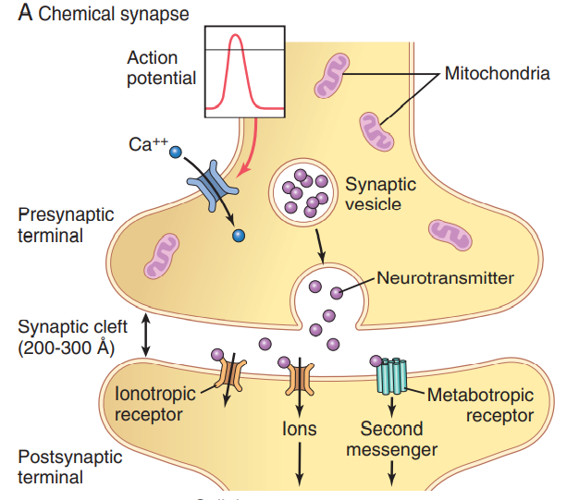


Slide 3
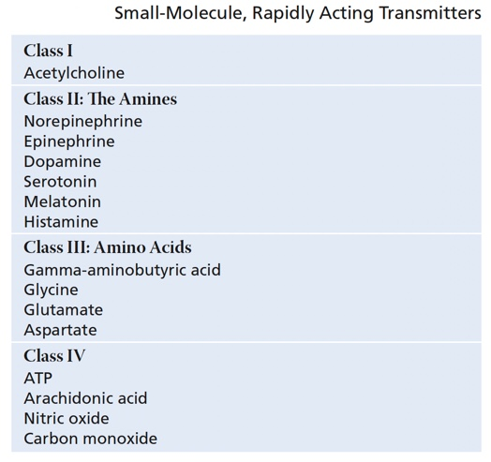

Slide 4
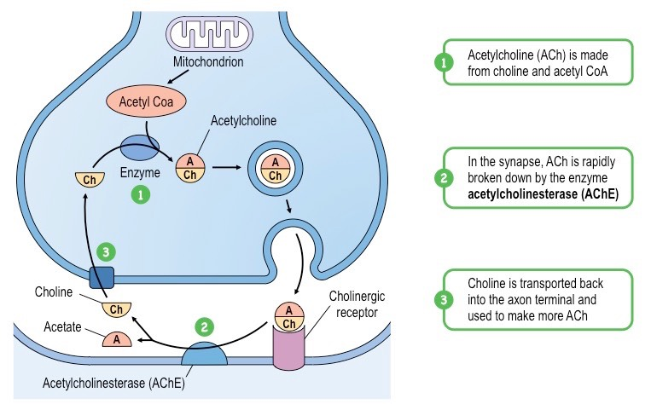
Synthesis in presynaptic terminal
Recycling
rapid

Slide 5
Types of synaptic transmitters
The small-molecule, rapidly acting transmitters: cause most acute responses of the nervous system, such as transmission of sensory signals to the brain and of motor signals back to the muscles.
The neuropeptides, in contrast, usually cause more prolonged actions, such as long-term changes in numbers of neuronal receptors, long-term opening or closure of certain ion channels, and possibly long-term changes in numbers of synapses or sizes of synapses.

Slide 6
Small-molecule, rapidly acting transmitter
In most cases, they are synthesized in the cytosol of the presynaptic terminal and are absorbed by means of active transport into the transmitter vesicles in the terminal.
Each time an action potential reaches the presynaptic terminal, a few vesicles at a time release their transmitter into the synaptic cleft. This action usually occurs within a millisecond or less.

Slide 7
Small-molecule, rapidly acting transmitter
The subsequent action on the membrane receptors of the postsynaptic neuron usually also occurs within another millisecond or less.
Most often the effect is to increase or decrease conductance through ion channels.

Slide 8
Small-molecule, rapidly acting transmitter
Vesicles that store and release small-molecule transmitters are continually recycled and used over and over again.
After they fuse with the synaptic membrane and open to release their transmitter substance, the vesicle membrane at first simply becomes part of the synaptic membrane.

Slide 9
Small-molecule, rapidly acting transmitter
Within seconds to minutes, the vesicle portion of the membrane invaginates back to the inside of the presynaptic terminal and pinches off to form a new vesicle.
The new vesicular membrane still contains appropriate enzyme proteins or transport proteins required for synthesizing and/or concentrating new transmitter substance inside the vesicle.

Slide 10
Neurotransmitters
Acetylcholine is secreted by motor neurons at neuromuscular junctions (NMJ).
Glutamate is an excitatory neurotransmitter.
Glycine and GABA are inhibitory transmitters.
Serotonin is related to mood pathways, and pain inhibitory pathways.

Slide 11
Dopamine
Dopamine is secreted by neurons that originate in the substantia nigra to control movement of muscles.
Dopamine is present in pleasure pathways.
The effect of dopamine can be inhibitory or excitatory depends on the type of the receptor.

Slide 12
Nitric Oxide
It is not preformed and stored in vesicles in the presynaptic terminal as are other transmitters.
Instead, it is synthesized almost instantly as needed and then diffuses out of the presynaptic terminals over a period of seconds rather than being released in vesicular packets.
Next, it diffuses into postsynaptic neurons nearby.

Slide 13
Nitric Oxide
In the postsynaptic neuron, it usually does not greatly alter the membrane potential but instead changes intracellular metabolic functions that modify neuronal excitability for seconds, minutes, or longer.

Slide 14
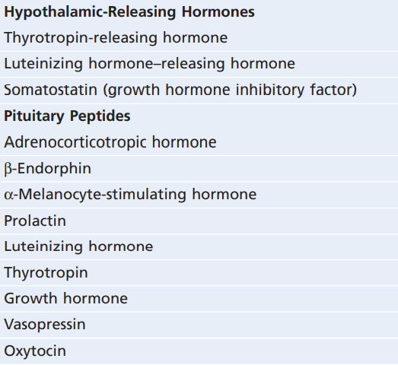
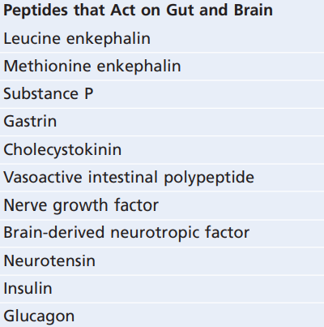
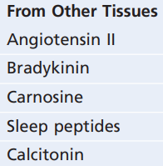
Neuropeptides

Slide 15
Neuropeptides
Actions are usually slow and in other ways quite different from those of the small-molecule transmitters.
Not synthesized in the cytosol of the presynaptic terminals but in the neuronal cell body.

Slide 16
Neuropeptides
Because of this laborious method of forming the neuropeptides, much smaller quantities of neuropeptides than of the small-molecule transmitters are usually released.
This difference is partly compensated for by the fact that the neuropeptides are generally a thousand or more times as potent as the small-molecule transmitters.

Slide 17
Neuropeptides
The vesicles are transported by axonal streaming of the axon cytoplasm, traveling at the slow rate of only a few centimeters per day.
Vesicle is autolyzed and is not reused.
Small quantities are released, but more potent.

Slide 18
Neuropeptides
Another important characteristic of the neuropeptides is that they often cause much more prolonged actions.
Some of these actions include prolonged closure of calcium channels, prolonged changes in the metabolic machinery of cells, prolonged changes in activation or deactivation of specific genes in the cell nucleus, and/or prolonged alterations in numbers of excitatory or inhibitory receptors. Some of these effects last for days, but others last perhaps for months or years.

Slide 20

+
Threshold
Depolarization : excitation : EPSP / AP
RMP
-
Hyperpolarization : inhibition : IPSP

Slide 21
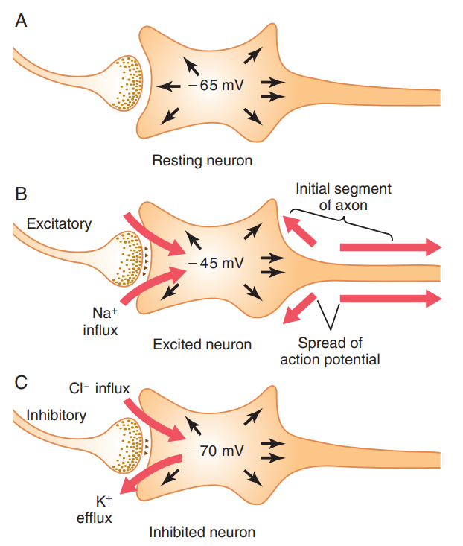





+
Threshold
Depolarization
RMP
-
Hyperpolarization

Slide 22
Resting membrane potential
The basic cause of the change in membrane potential is a change in membrane permeability of the neuron, which allows ions to diffuse more or less readily through the membrane and thereby to change the membrane potential.

Slide 23
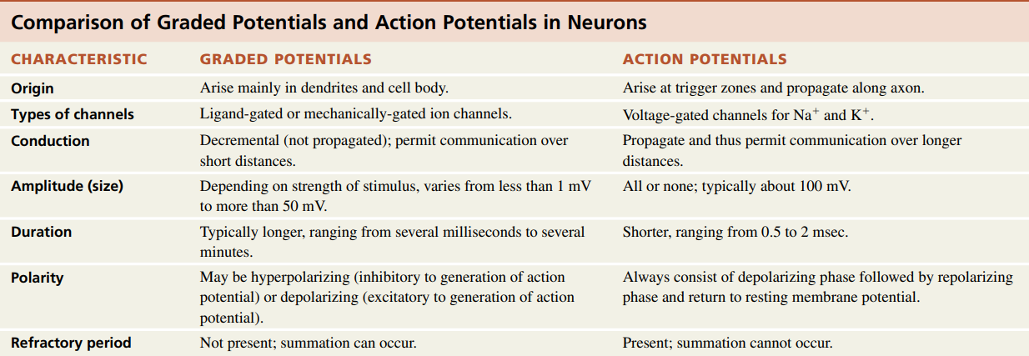
Graded potential vs Action potential

Slide 24
Graded potential vs Action potential

Slide 25
Graded potential vs Action potential

Slide 26
Graded potential vs Action potential

Slide 27
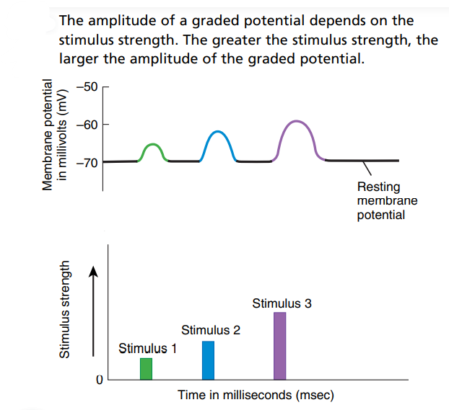

Slide 28
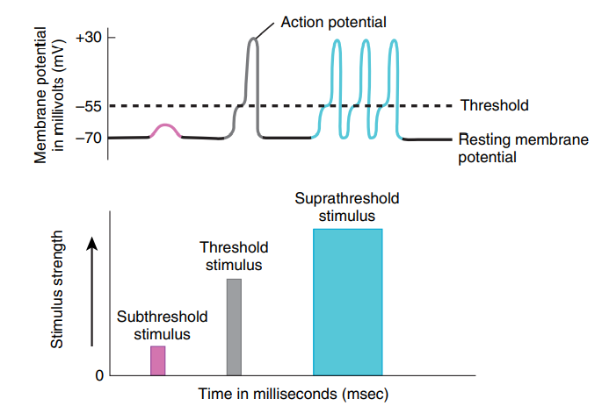

Slide 29
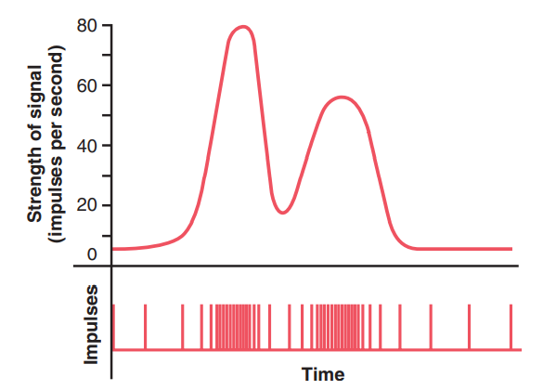
Notes:
a changing strength of signal and the actual impulses transmitted by the nerve fiber.

Slide 30
Graded potential vs Action potential

Slide 31
Graded potential vs Action potential

Slide 32
Graded potential vs Action potential

Slide 33
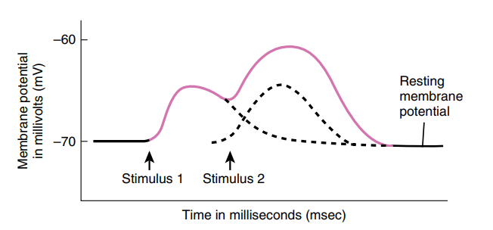
Summation in graded potential

Slide 34
Spatial summation in neurons
The effect of summing simultaneous postsynaptic potentials by activating multiple terminals on widely spaced areas of the neuronal membrane is called spatial summation.

Slide 35
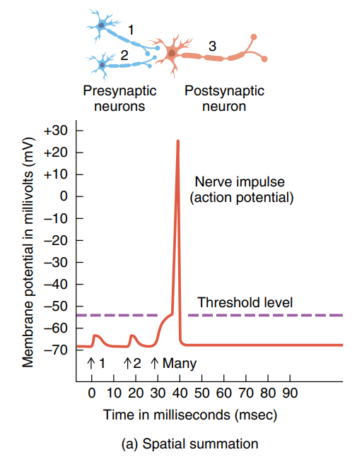

Slide 36
Temporal summation in neurons
Each time a presynaptic terminal fires, the released transmitter substance opens the membrane channels for at most a millisecond or so. However, the changed postsynaptic potential lasts up to 15 milliseconds after the synaptic membrane channels have already closed.
Therefore, a second opening of the same channels can increase the postsynaptic potential to a still greater level, and the more rapid the rate of stimulation, the greater the postsynaptic potential becomes. Thus, successive discharges from a single presynaptic terminal, if they occur rapidly enough, can add to one another; that is, they can “summate.” This type of summation is called temporal summation.

Slide 37
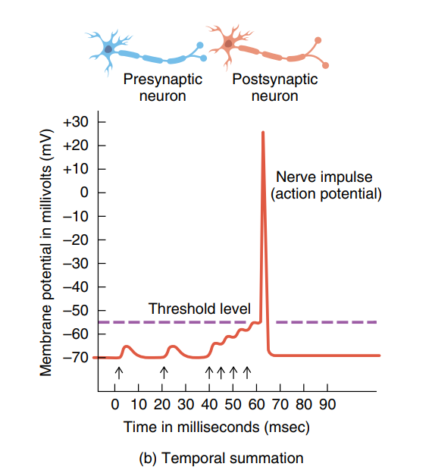

Slide 38
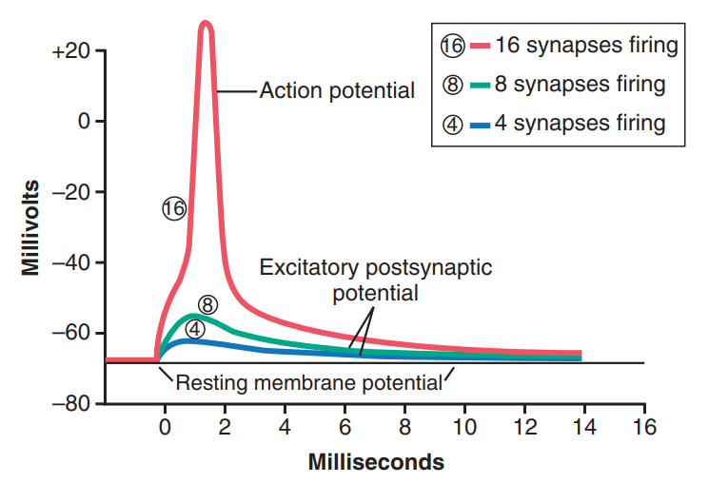

Slide 39
Time course of postsynaptic potentials
When an excitatory synapse excites the anterior motor neuron, the neuronal membrane becomes highly permeable to sodium ions for 1 to 2 milliseconds.
During this very short time, enough sodium ions diffuse rapidly to the interior of the postsynaptic motor neuron to increase its intraneuronal potential by a few millivolts, thus creating the EPSP.
This potential then slowly declines over the next 15 milliseconds because this is the time required for the excess positive charges to leak out of the excited neuron and to re-establish the normal resting membrane potential.

Slide 40
Time course of postsynaptic potentials
The opposite effect occurs for an IPSP;
The inhibitory synapse increases the permeability of the membrane to potassium or chloride ions, or both, for 1 to 2 milliseconds, and this action decreases the intraneuronal potential to a more negative value than normal, thereby creating the IPSP.
This potential also dies away in about 15 milliseconds.

Slide 41
Time course of postsynaptic potentials
Other types of transmitter substances can excite or inhibit the postsynaptic neuron for much longer periods— for hundreds of milliseconds or even for seconds, minutes, or hours. This is especially true for some of the neuropeptide transmitters.

Slide 42
Summation of IPSP and EPSP
If an IPSP is tending to decrease the membrane potential to a more negative value while an EPSP is tending to increase the potential at the same time, these two effects can either completely or partially nullify each other.

Slide 43
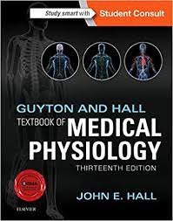
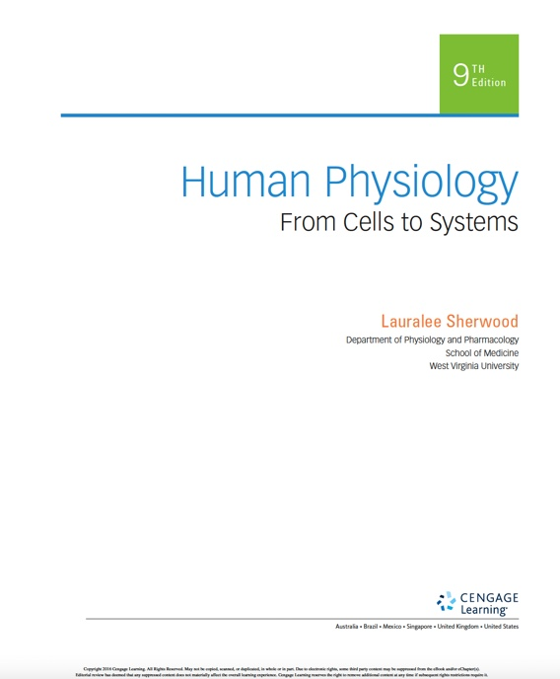
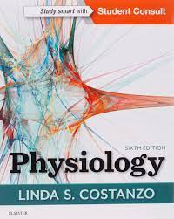
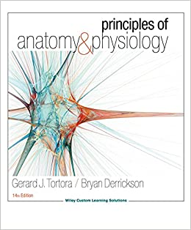
References

Slide 44


Questions? Feedback?
Thank you

