Slide 1

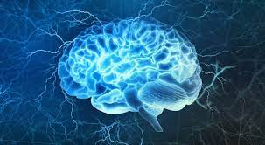
Introduction to Neurophysiology 2
Synapses
Fatima Ryalat, MD, PhD
Assistant Professor, Physiology and Biochemistry Department,
School of Medicine, The University of Jordan

Slide 2
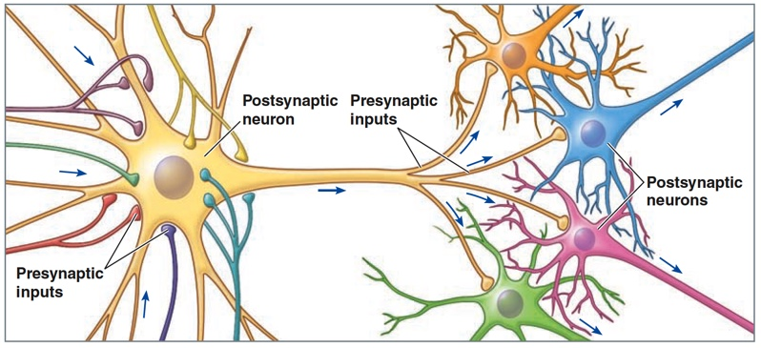

Slide 3
Synapses
The synapse is a region where communication occurs between two neurons or between a neuron and an effector cell (muscle cell or glandular cell).

Slide 4
Synaptic functions of neurons
Information is transmitted in the central nervous system mainly in the form of nerve action potentials, called nerve impulses, through a succession of neurons, one after another.
However, this impulse may be blocked, changed into repetitive impulses, or integrated with other impulses.
These functions are called synaptic functions of neurons.

Slide 5
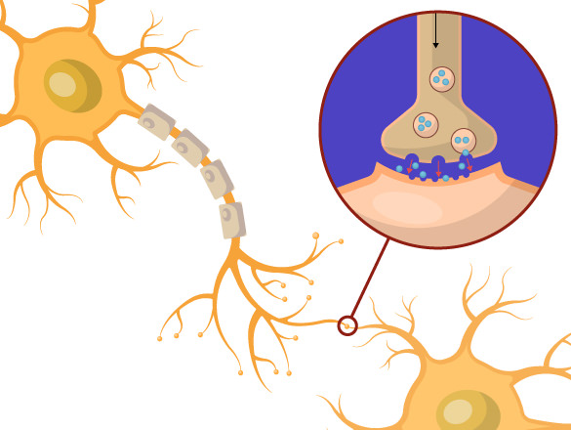

Ck12.org

Slide 6
Ck12.org

Slide 7

Synaptic functions of neuron
Ck12.org

Slide 8
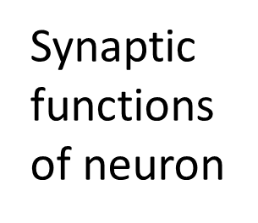

Ck12.org

Slide 9

Ck12.org

Slide 10
Types of Synapses
Chemical synapses.
Electrical synapses.

Slide 11
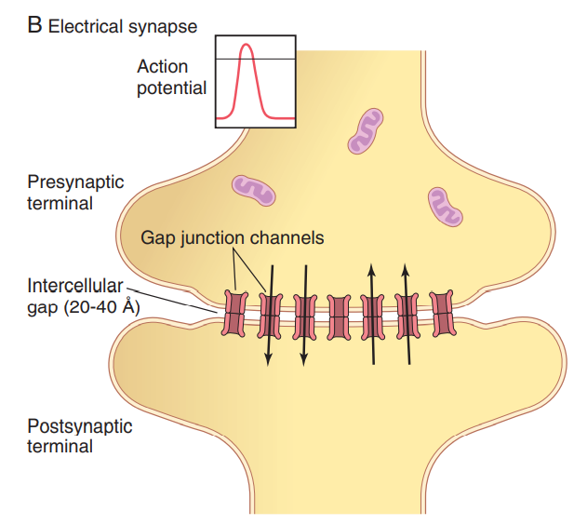

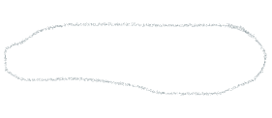

Cytoplasms are directly connected by gap junctions

Slide 12


Slide 13

FAST
Synchronization

Slide 14
Electrical Synapses
The cytoplasms of adjacent cells are directly connected by gap junctions that allow free movement of ions between cells.
Similar to the ones in smooth muscles and cardiac muscles.

Slide 15
Bidirectional transmission of electrical synapses
Two main advantages:
1. Faster communication. Because action potentials conduct directly through gap junctions, electrical synapses are faster than chemical synapses.
2. Synchronization. Electrical synapses can synchronize (coordinate) the activity of a group of neurons or muscle fibers. As well as increasing neuronal sensitivity of connected neurons.

Slide 16
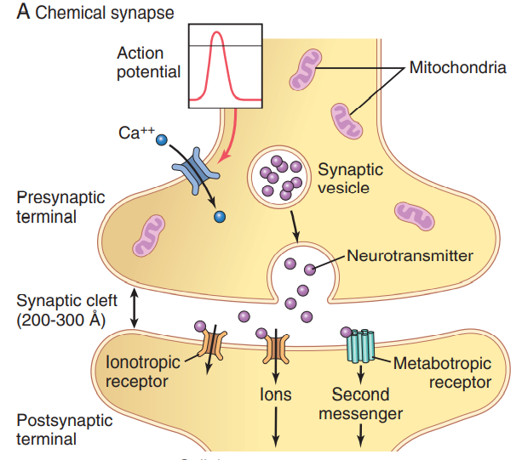

More common

Slide 17
Chemical synapses
Most of the synapses in the CNS are chemical synapses.
The first neuron secretes at its nerve ending synapse a chemical substance called a neurotransmitter.
Neurotransmitter acts on receptor proteins in the membrane of the next neuron to excite the neuron, inhibit it, or modify its sensitivity in some other way.

Slide 18
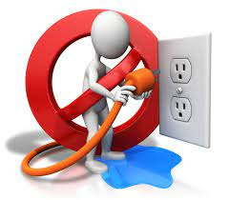


Slide 19


Slide 20



Slide 21
More Ca++
More NT

Slide 22
Presynaptic terminals
The terminal has two important internal structures:
The transmitter vesicles contain the neurotransmitter that, when released into the synaptic cleft, either excites or inhibits the postsynaptic neuron.
The mitochondria provide adenosine triphosphate (ATP), which in turn supplies the energy for synthesizing new transmitter substance.

Slide 23
Presynaptic terminals
The presynaptic membrane contains large numbers of voltage-gated calcium channels.
When an action potential depolarizes the presynaptic membrane, these calcium channels open.
The quantity of neurotransmitter that is released is directly related to the number of calcium ions that enter.

Slide 24



Cation and anion channels
Excitation (Na+) or inhibition (Cl-)

Slide 25


Prolonged action
e.g. memory

Slide 26
Principle of one-way conduction at chemical synapse

Slide 27
Principle of one-way conduction at chemical synapses
Always transmit the signals in one direction: from the presynaptic neuron to the postsynaptic neuron.
Allows signals to be directed toward specific goals and perform specific nervous functions.

Slide 28


Slide 29
Synaptic delay
During transmission of a neuronal signal from a presynaptic neuron to a postsynaptic neuron, a certain amount of time (0.5 msec) is consumed in the process of
(1) discharge of the transmitter substance by the presynaptic terminal,
(2) diffusion of the transmitter to the postsynaptic neuronal membrane,

Slide 30
Synaptic delay
(3) action of the transmitter on the membrane receptor,
(4) action of the receptor to increase the membrane permeability,
(5) inward diffusion of sodium to raise the EPSP to a high enough level to elicit an action potential.

Slide 32
Postsynaptic neurons
Receptor activation controls the opening of ion channels in the postsynaptic cell in one of two ways:
(1) by gating ion channels directly (Ionotropic receptors).
(2) by activating a second messenger (metabotropic receptors).

Slide 33
Excitation of postsynaptic neuron
Opening of sodium channels.
Changes in the internal metabolism of the postsynaptic neuron to excite cell activity or to increase the number of excitatory membrane receptors or decrease the number of inhibitory membrane receptors.

Slide 34
Inhibition of postsynaptic neuron
Opening of chloride ion channels through the postsynaptic neuronal membrane.
Increase in conductance of potassium ions out of the neuron.
Activation of receptor enzymes that inhibit cellular metabolic functions or that increase the number of inhibitory synaptic receptors or decrease the number of excitatory receptors.

Slide 35
Second-messenger system
Many functions of the nervous system—for instance, the process of memory—require prolonged changes in neurons for seconds to months after the initial transmitter substance is gone.
The ion channels are not suitable for causing prolonged postsynaptic neuronal changes because these channels close within milliseconds after the transmitter substance is no longer present.

Slide 36
Second-messenger system
However, in many instances, prolonged postsynaptic neuronal excitation or inhibition is achieved by activating a “second messenger” chemical system inside the postsynaptic neuronal cell itself, and then it is the second messenger that causes the prolonged effect.

Slide 37
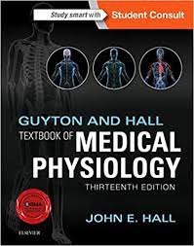
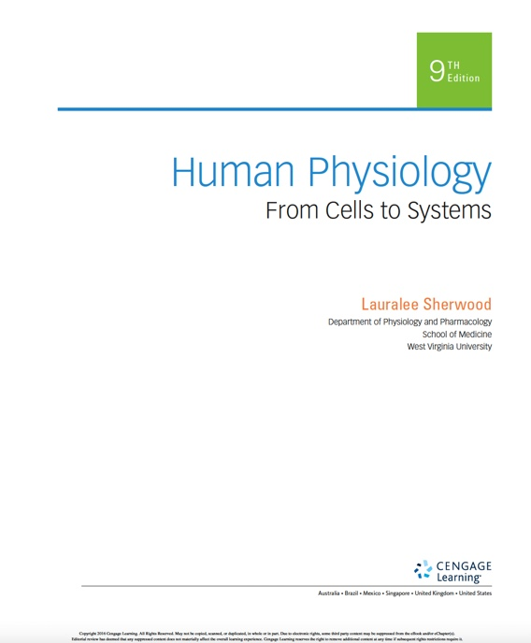
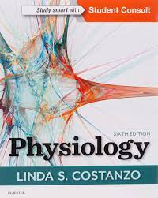
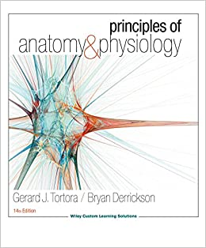
References

Slide 38


Questions? Feedback?
Thank you

