Slide 1

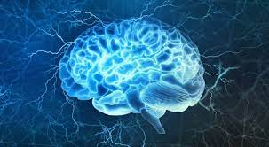

Introduction to Neurophysiology 1
Organization and functions of the nervous system
Fatima Ryalat, MD, PhD
Assistant Professor, Physiology and Biochemistry Department, School of Medicine, The University of Jordan

Slide 2
Overview of the nervous system
The nervous system is composed of two divisions:
The central nervous system (CNS), which includes the brain and the spinal cord.
The peripheral nervous system (PNS), which includes sensory receptors, nerves, and ganglia.

Slide 3
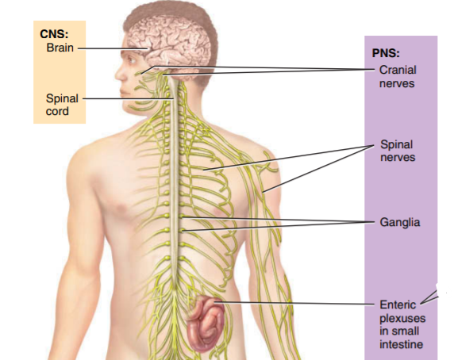
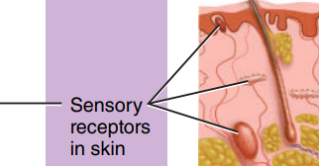
Organization of the nervous system

Slide 4
Functions of the nervous system
Sensory function: sensory receptors detect internal or external stimuli. The sensory information is carried to the CNS through cranial and spinal nerves.
Integrative function: process sensory information by analyzing it and making decision for appropriate responses.
Motor function: activation of effectors (muscles and glands) through cranial and spinal nerves.

Slide 5
Sensory function
Most activities of the nervous system are initiated by sensory experiences that excite sensory receptors.
These sensory experiences can either cause immediate reactions from the brain, or memories of the experiences can be stored in the brain for minutes, weeks, or years and determine bodily reactions at some future date.

Slide 6
Functions of the nervous system
Sensory function: sensory receptors detect internal or external stimuli. The sensory information is carried to the CNS through cranial and spinal nerves.
Integrative function: processes sensory information by analyzing it and making decision for appropriate responses.
Motor function: activation of effectors (muscles and glands) through cranial and spinal nerves.
Notes:
CNS
Collect sensory information
Process sensory info/ Compare and contrast / integrate the present information to the previous ones.
Decide about the motor response
PNS
Take info from periphery to CNS (sensory NS) and vice versa (motor NS).

Slide 7
Integrative function
More than 99 percent of the sensory information is discarded by the brain as irrelevant and unimportant.
However, when important sensory information excites the mind, it is immediately channeled into proper integrative and motor regions of the brain to cause desired responses.
This channeling and processing of information is called the integrative function of the nervous system.

Slide 8
Storage of information: memory
Only a small fraction of even the most important sensory information usually causes immediate motor response.
Much of the information is stored for future control of motor activities and for use in the thinking processes.
Most storage occurs in the cerebral cortex, but even the basal regions of the brain and the spinal cord can store small amounts of information.

Slide 9
Storage of information: memory
Once memories have been stored in the nervous system, they become part of the brain processing mechanism for future “thinking.”
The thinking processes of the brain compare new sensory experiences with stored memories; the memories then help to select the important new sensory information and to channel this into appropriate memory storage areas for future use or into motor areas to cause immediate bodily responses.

Slide 10
Spinal cord
The spinal cord has two main functions:
1- nerve impulse propagation (sensory and motor tracts): transmits signals from the periphery of the body to the brain, or in the opposite direction from the brain back to the body.
2- integration of information (such as in spinal reflexes).

Slide 11
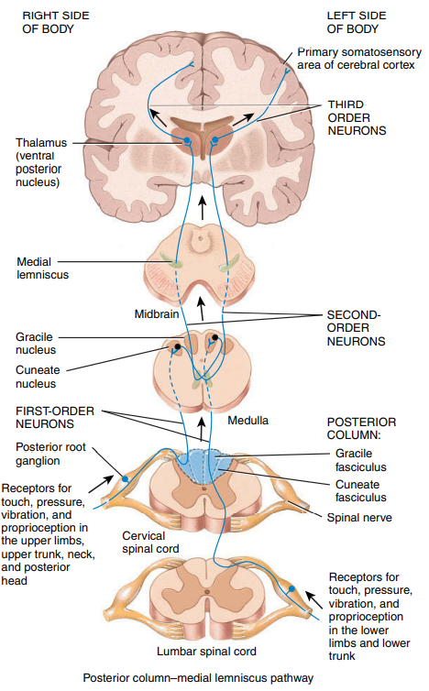
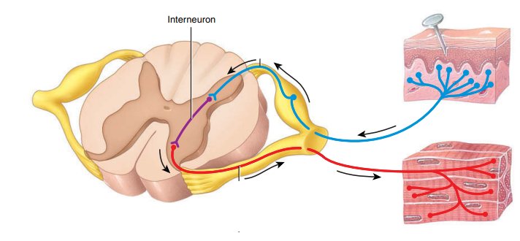

Slide 12
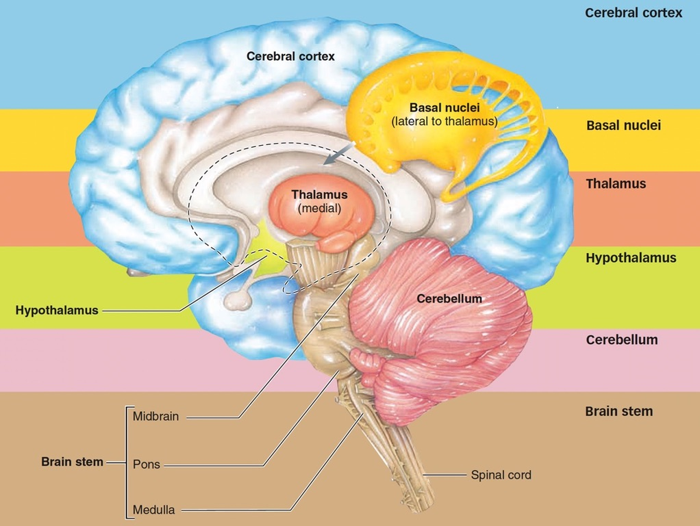

Slide 13
Lower brain (subcortical regions)
Many, if not most, of the subconscious activities of the body are controlled in the lower areas of the brain.
Examples of subcortical structures are brain stem, cerebellum, diencephalon, basal nuclei, hippocampus, and amygdala.

Slide 14
Higher brain (cerebral cortex)
Cerebral cortex is an extremely large memory storehouse.
Without the cerebral cortex, the functions of the lower brain centers are often imprecise. Cortical information usually converts these functions to determinative and precise operations.
The cerebral cortex is essential for most of our thought processes.

Slide 15
Functions of the nervous system
Sensory function: sensory receptors detect internal or external stimuli. The sensory information is carried to the CNS through cranial and spinal nerves.
Integrative function: process sensory information by analyzing it and making decision for appropriate responses.
Motor function: activation of effectors (muscles and glands) through cranial and spinal nerves.
Notes:
CNS
Collect sensory information
Process sensory info/ Compare and contrast / integrate the present information to the previous ones.
Decide about the motor response
PNS
Take info from periphery to CNS (sensory NS) and vice versa (motor NS).

Slide 16
Motor function
The most important eventual role of the nervous system is to control the various bodily activities.
This task is achieved by controlling:
(1) contraction of appropriate skeletal muscles throughout the body.
(2) contraction of smooth muscle in the internal organs.
(3) secretion of active chemical substances by both exocrine and endocrine glands in many parts of the body.

Slide 17
Motor function
These activities are collectively called motor functions of the nervous system.
The muscles and glands are called effectors because they are the actual anatomical structures that perform the functions dictated by the nerve signals.

Slide 18
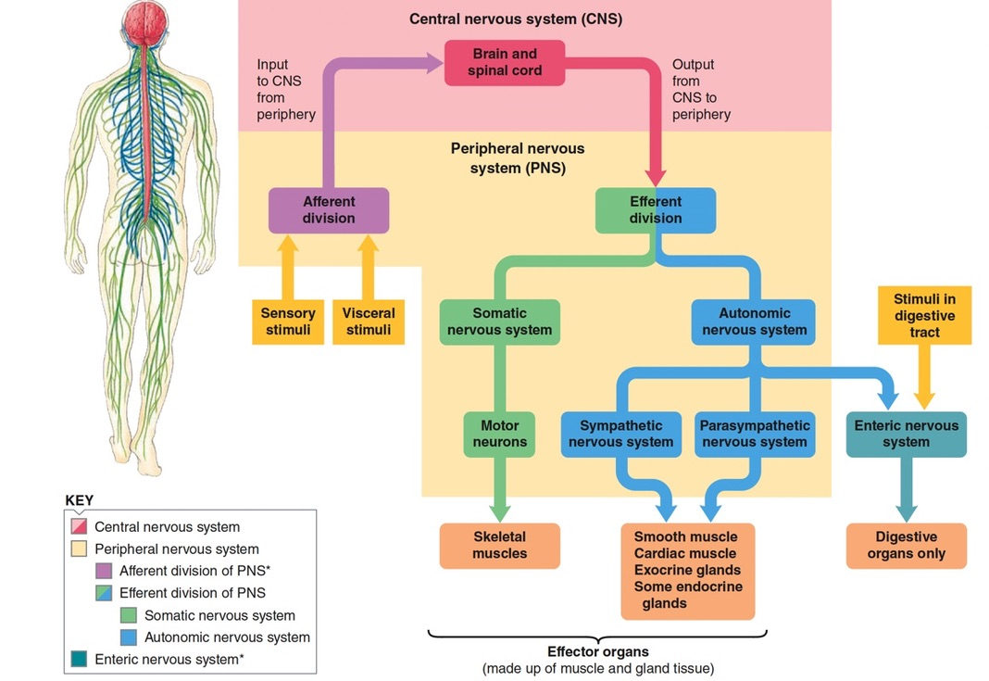

Slide 19
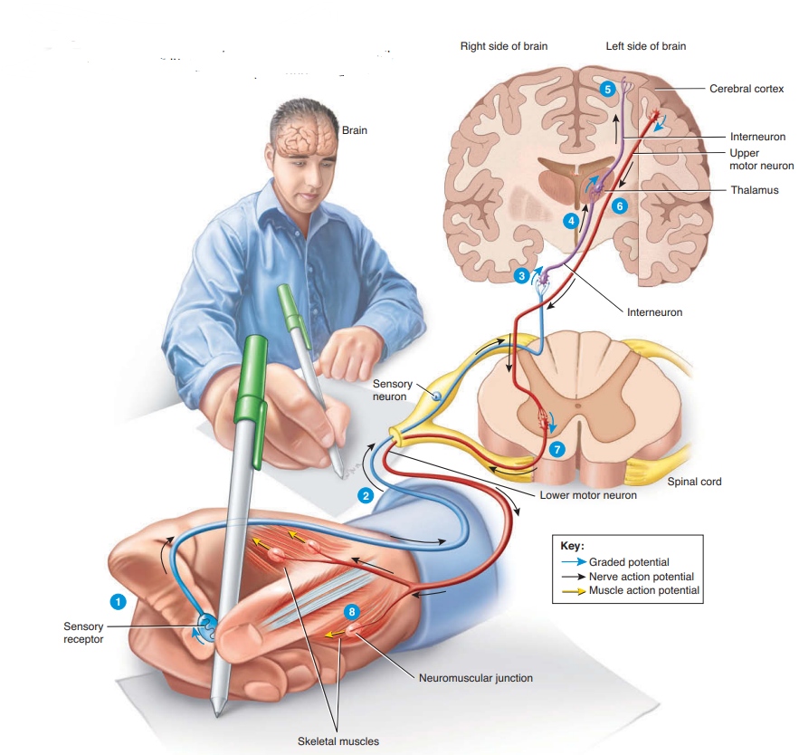

Slide 20
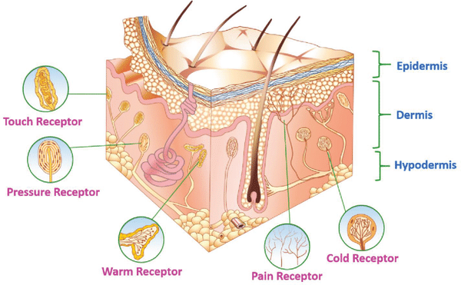

Slide 21
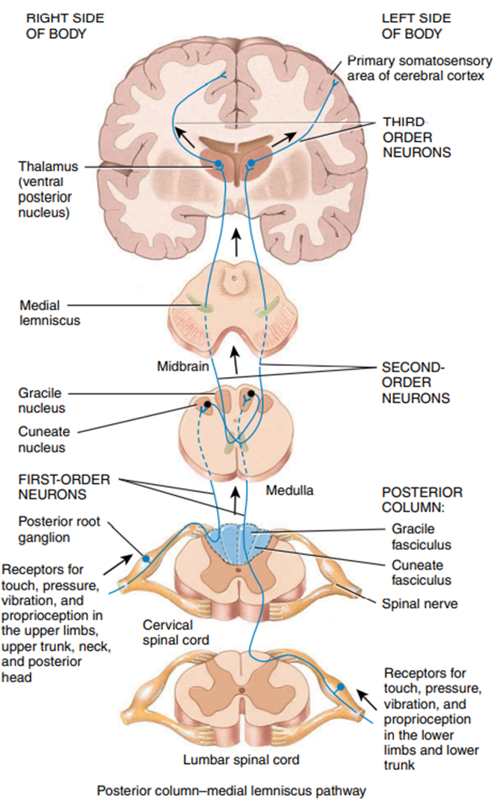

Slide 22
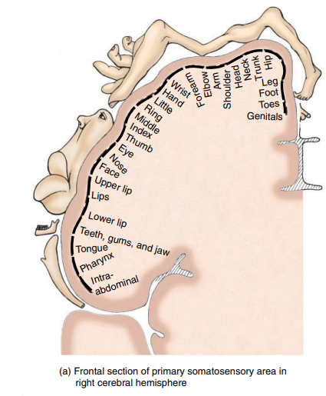

Slide 23
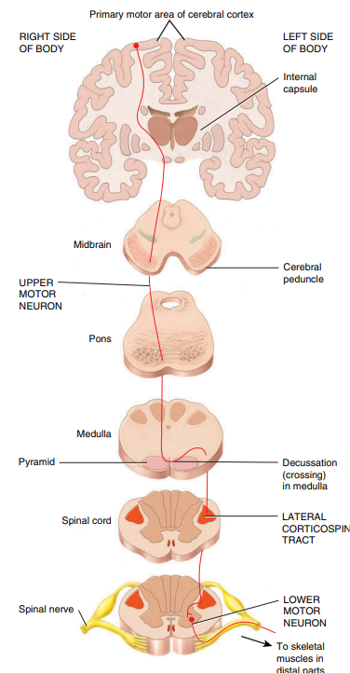

Slide 24
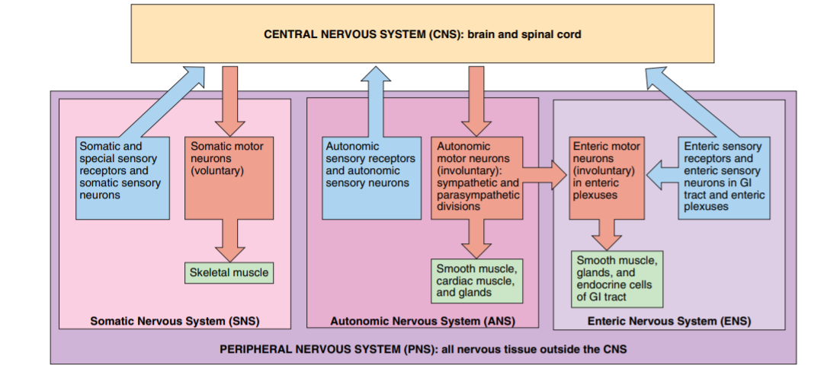

Slide 25
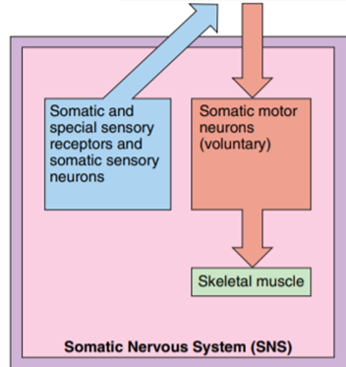
Somatic nervous system
sensory neurons: convey information from somatic receptors (in the in the head, body wall and limbs)and from receptors of special senses: vision, hearing and taste to the CNS.
motor neurons: conduct impulses from CNS to skeletal muscles only.
It is the voluntary part of PNS because the motor response can be consciously controlled.

Slide 26
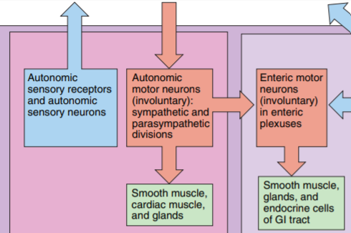
Autonomic nervous system
sensory neurons: convey information from autonomic sensory receptors (located mainly in the visceral organs) to the CNS.
motor neurons: conduct impulses from CNS to smooth muscles, cardiac muscles and glands. because the motor responses are not normally under conscious control, its action is involuntary.
The motor part is divided into sympathetic and parasympathetic divisions.
Notes:
Most not all effectors receive nerves from both divisions, Usually they have opposing actions: sympathetic: fight or flight action, parasympathetic: rest and digest.

Slide 27
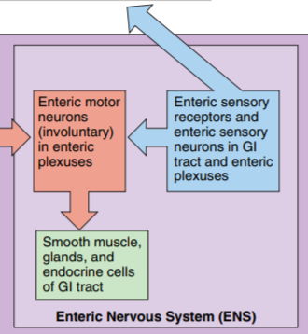
Enteric nervous system
Sensory neurons: monitor changes within the digestive system (gastrointestinal: GI).
Motor neurons: control the contraction of GI smooth muscles , the secretions of GI organs, and the activities of GI endocrine cells. It is called the brain of the gut.
It is involuntary. Many of ENS neurons function independent of ANS or CNS, although they also communicate with the CNS via sympathetic and parasympathetic neurons.

Slide 29
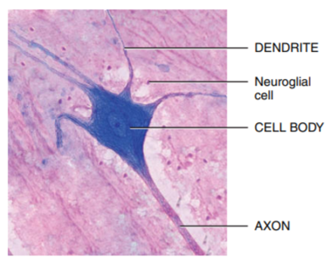
The functional unit of the nervous system is the neuron

Slide 30
Collections of nervous tissue
Components of nervous tissue are grouped together in a variety of ways.

Slide 31
Collections of axons
The widespread collection of axons in the CNS is called white matter.
A bundle of axons in the CNS is called tract.
A bundle of axons in the PNS is called nerve.

Slide 32
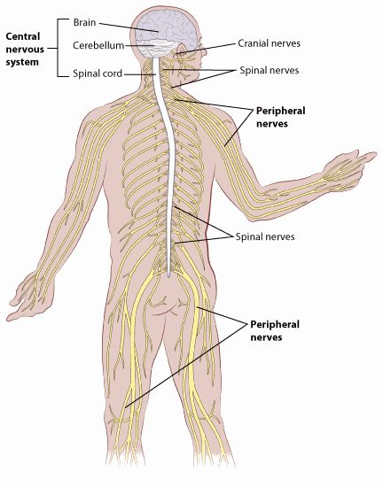
Nerve
Cancer.org
Notes:
Nerves: a bundle of axons plus associated connective tissues and blood vessels outside the CNS. 12 cranial and 31 spinal. Each nerve follows a defined path and serve specific region of the body. What is the difference between nerves and tracts (nerves are outside CNS, and surrounded by schwan cells, but in tracts no schwan cells but oligodendrocytes.)

Slide 33
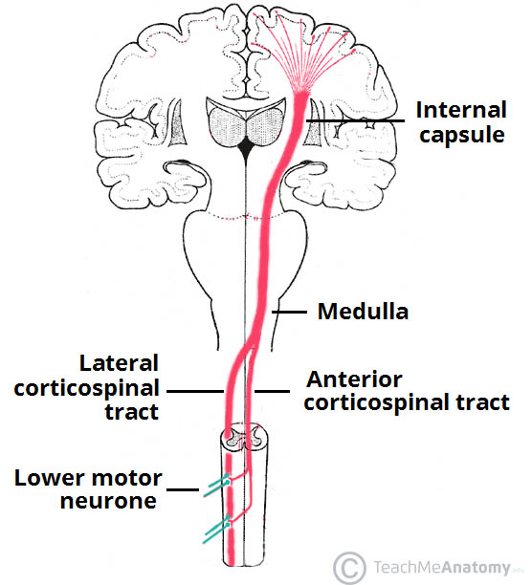
Tract
Descending pathway
Notes:
Can be classified according to the direction of information transmission by the neurons:
tracts (bundles of white matter transmitting signals up and down): ascending tracts(upward: cephalically), descending(downward: caudally)
Commisural fibers : Connect R to L or vice versa e.g. corpus callosum(the largest one).
Association fibers: connect antero-posterior (front to back) and vice versa.
Reticular formation: a deeper part of brain stem where grey matter and white matter mix. Like a network. Brain stem has many nuclei and reticular formation.

Slide 34
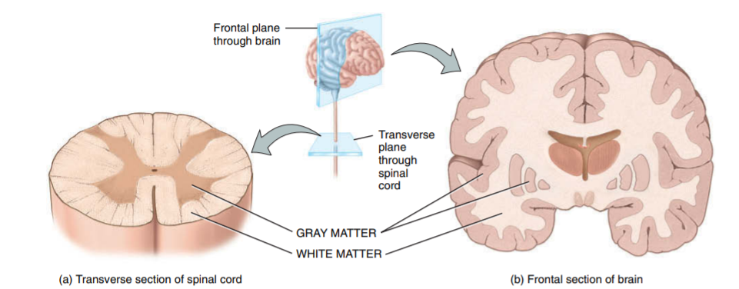
White matter

Slide 35
Collections of neuronal cell bodies
A widespread collection of neuronal cell bodies is called gray matter.
A cluster of neuronal cell bodies in the CNS is called nucleus.
A cluster of neuronal cell bodies in the PNS is called ganglion.

Slide 36
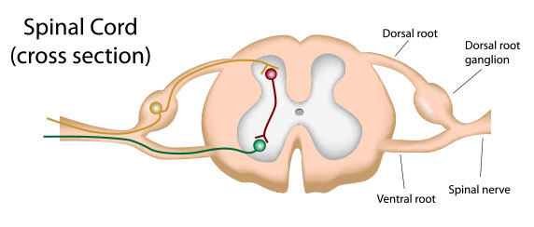
Ganglion
https://socratic.org

Slide 37
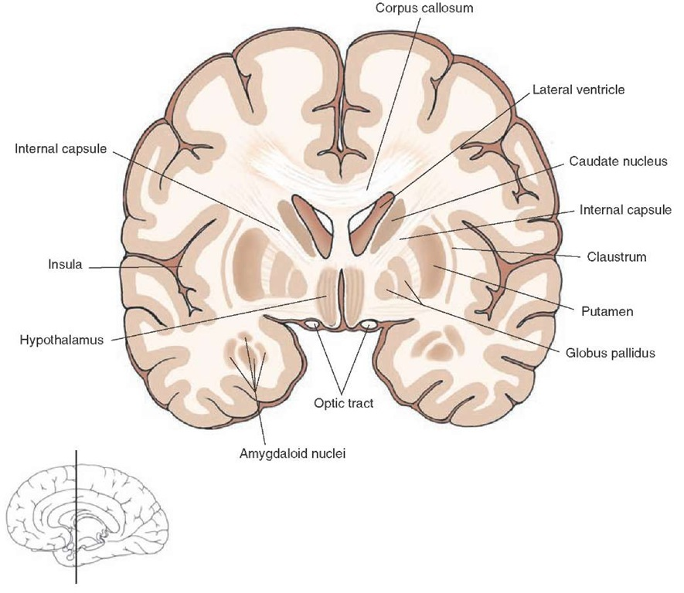
Nucleus
https://what-when-how.com/

Slide 38
Gray matter
Notes:
Gray matter is composed of neuronal cell bodies in the CNS: cortex (grey matter on the surface of brain: cerebral and cerebellar) vs nuclei (collection of cell bodies (pieces of grey matter surrounded by white matter: deep):

Slide 39
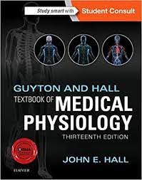
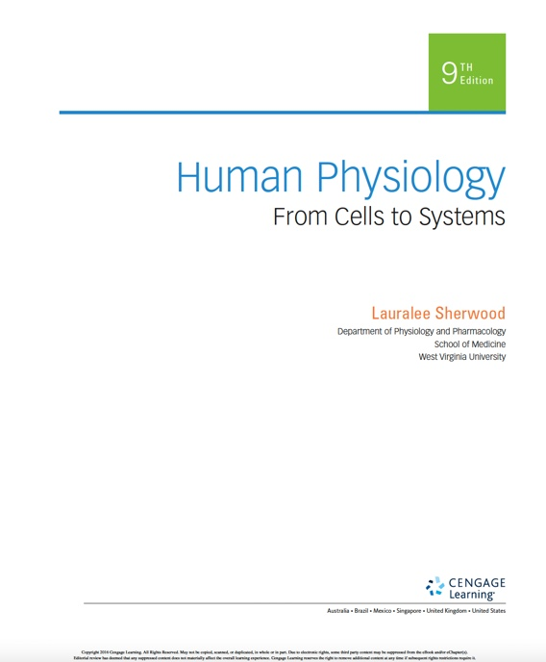
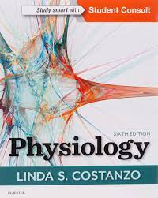
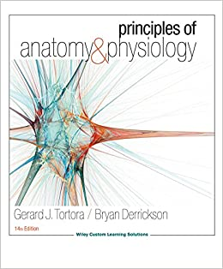
References

Slide 40


Questions? Feedback?
Thank you

